Slide 1
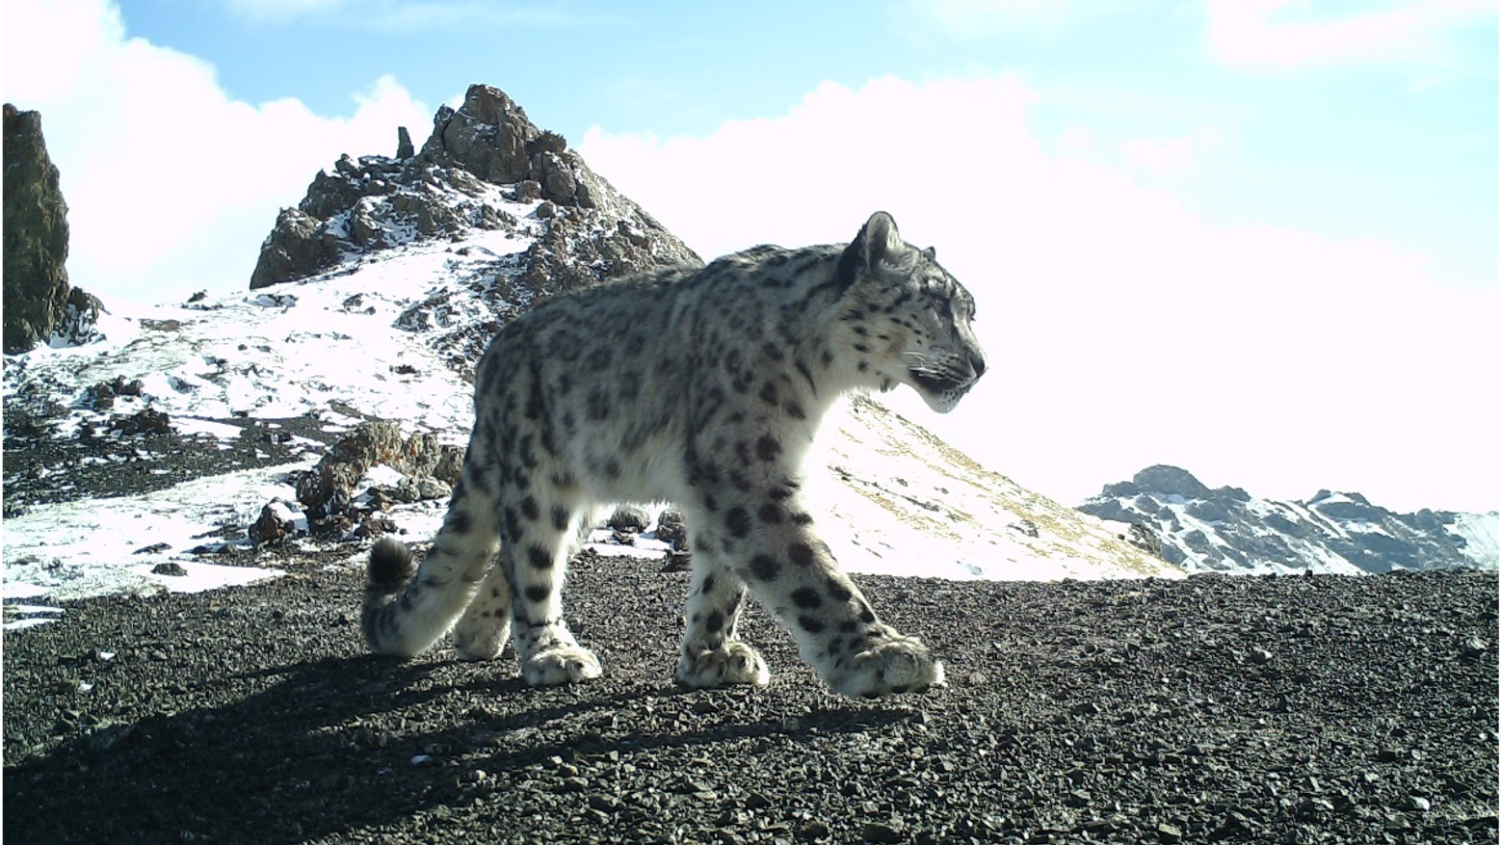
GSLEP program update
China
Steering Committee Meeting, February 2024
Samarkand

Slide 2
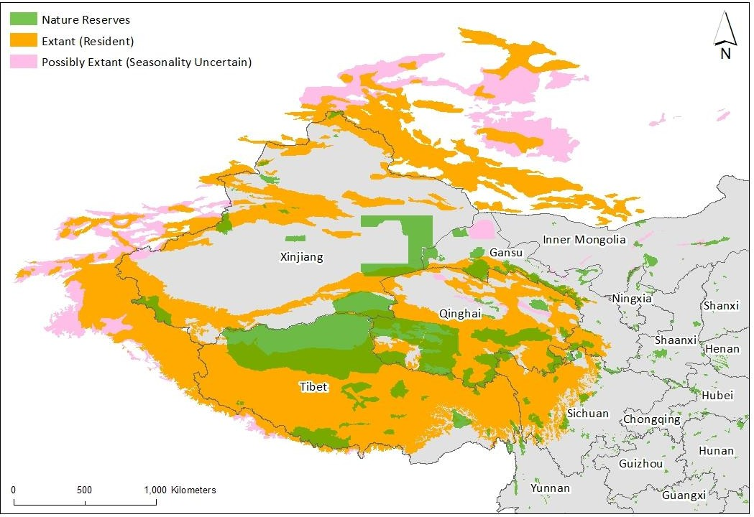
Overview on snow leopard status in China
As the most important snow leopard range country, China contains as much as 60% of the potential habitat (McCarthy and Chapron, 2003),and approximately 60% of the global population of snow leopard (Riordan and Shi, 2016).
An estimated 4500 individuals inhabit over 1.7million km² of suitable habitat, which includes numerous mountain ranges across 8 provinces in West and Central China. (Riordan and Shi, 2016; Shi et al. 2024).
Notes:
Overview on snow leopard status in China. https://doi.org/10.1016/B978-0-323-85775-8.00021-2
Currently, snow leopards in China are known to be present in Tibet, Qinghai, Xinjiang, Gansu, Sichuan, Yunnan, Inner Mongolia, and Ningxia

Slide 3
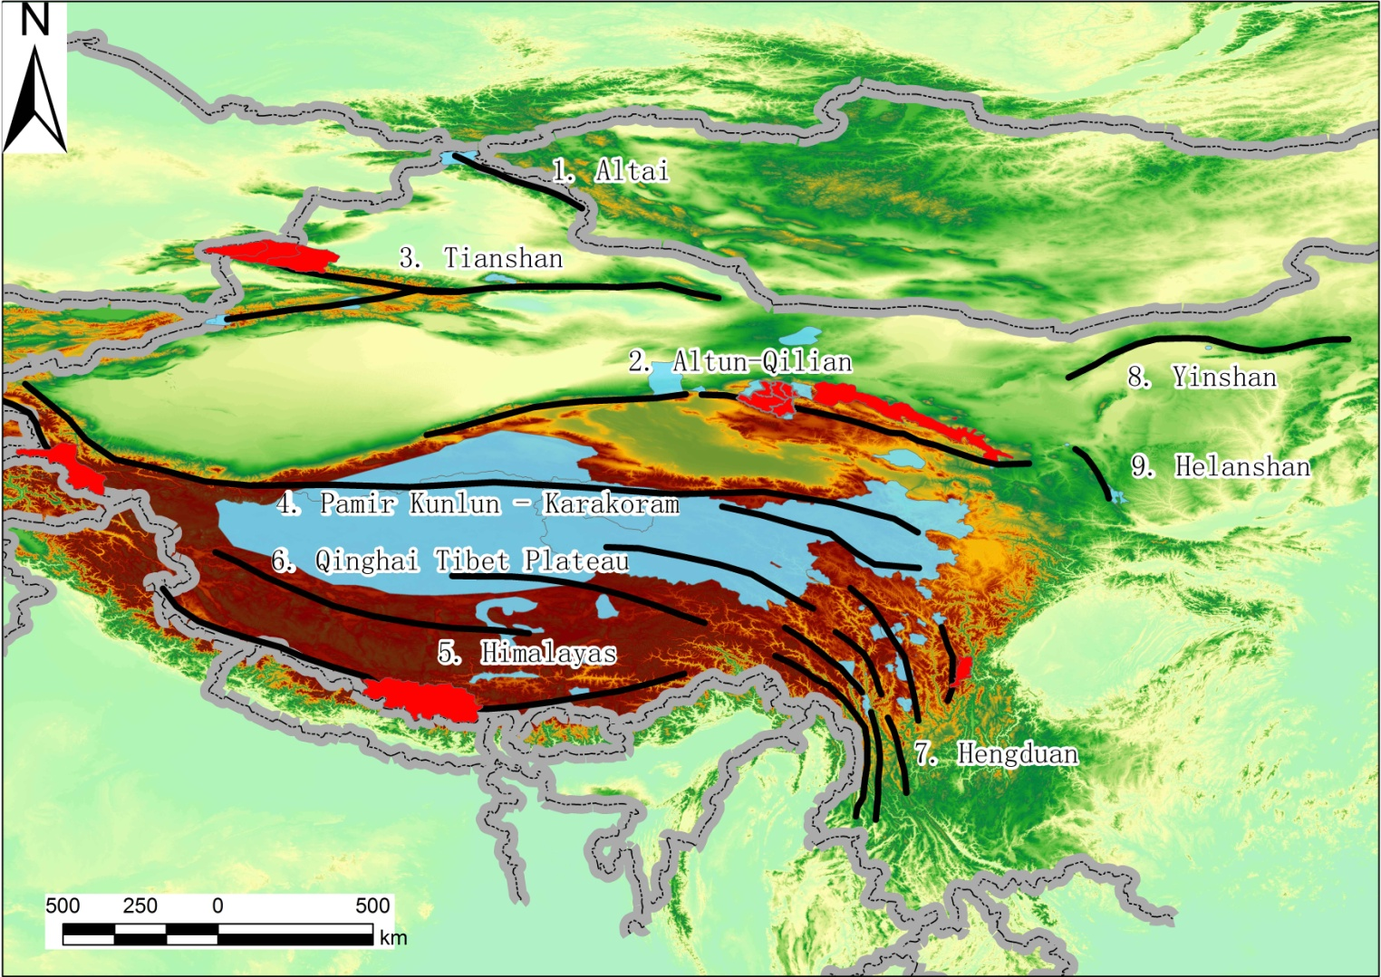
Nine regions:
(1) Altai Mountain
(2) Altun-Qilian
(3) Tianshan
(4) Pamir’s Kunlun-
Karakoram
(5) Himalayas
(6) Qinghai Tibet Plateau
(7) Hengduan Mountain
(8) Yinshan
(9) Helanshan Mountain
Nine core distribution regions of snow leopard in China (CSLCAP, 2013)
Notes:
According to China Snow leopard conservation action plan drafted by State Forestry Administration, totally 9 key landscapes have been identified in entre range of snow leopard in China.

Slide 4
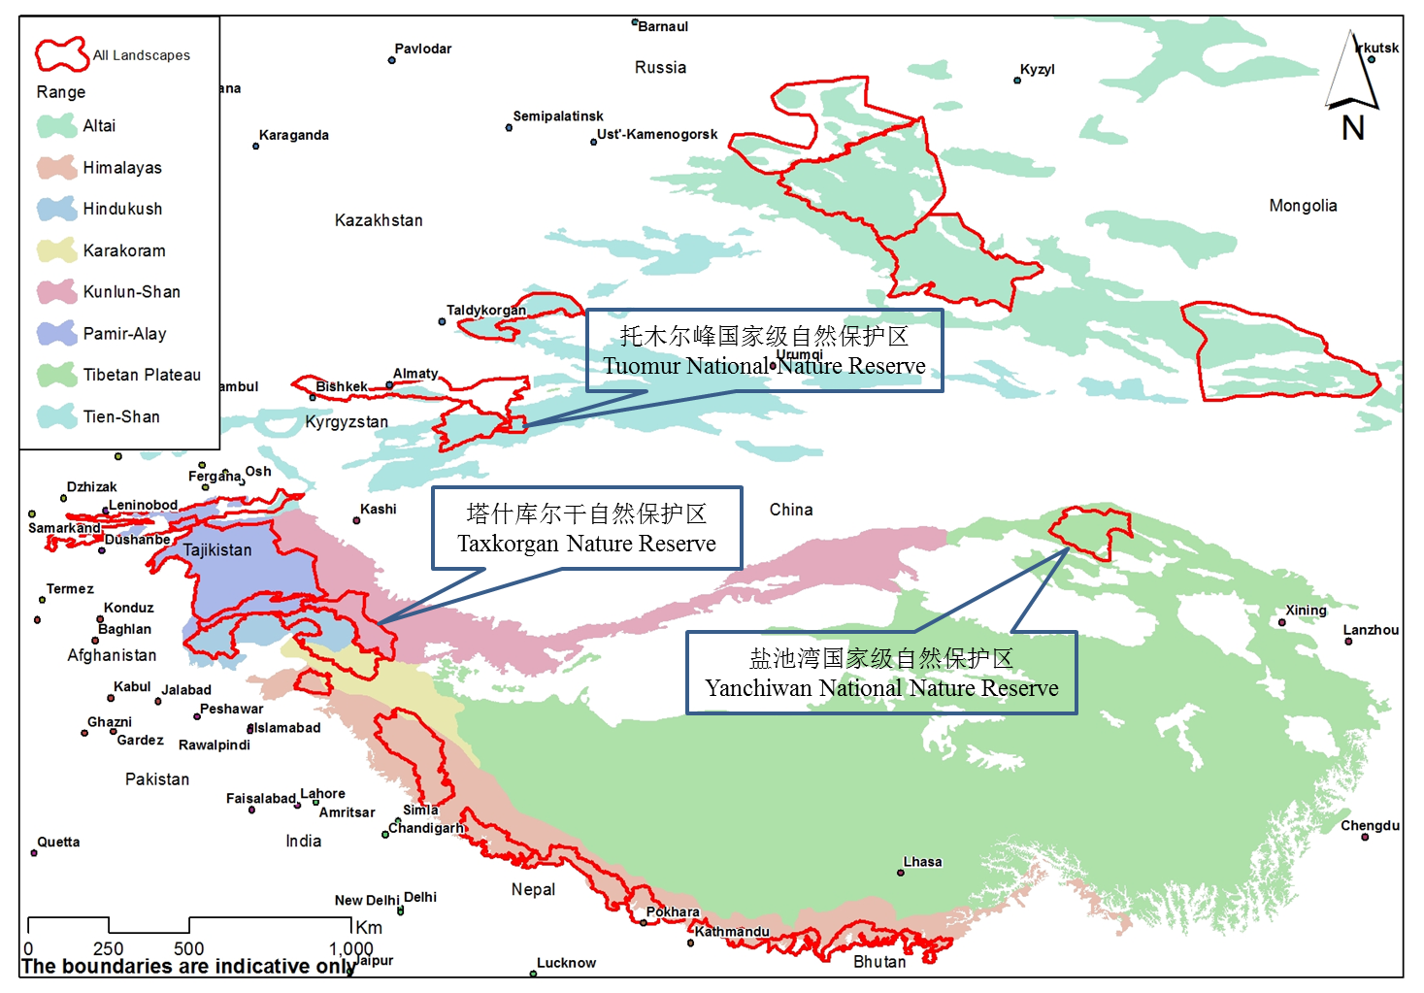
Notes:
This is the map of 3 GSLEP landscape(s) locations in China. Tuomur, 3804.80km2; YCW, 13600km2; Taxkurgan, 15000km2
One landscape is Tashikuergan, which is a provincial NR in Xinjiang, located in border area between China and Tajikistan, Pakistan and Afghanistam; Another one is Tuomuer, peek of the Tianshan, near the boder with Kyrgyz
The landscape present today is Yanchiwan, which is a national nature reserve in northeastern part of Qilian Mountain, north edge of Qinghai-Tibet Plateau.

Slide 5
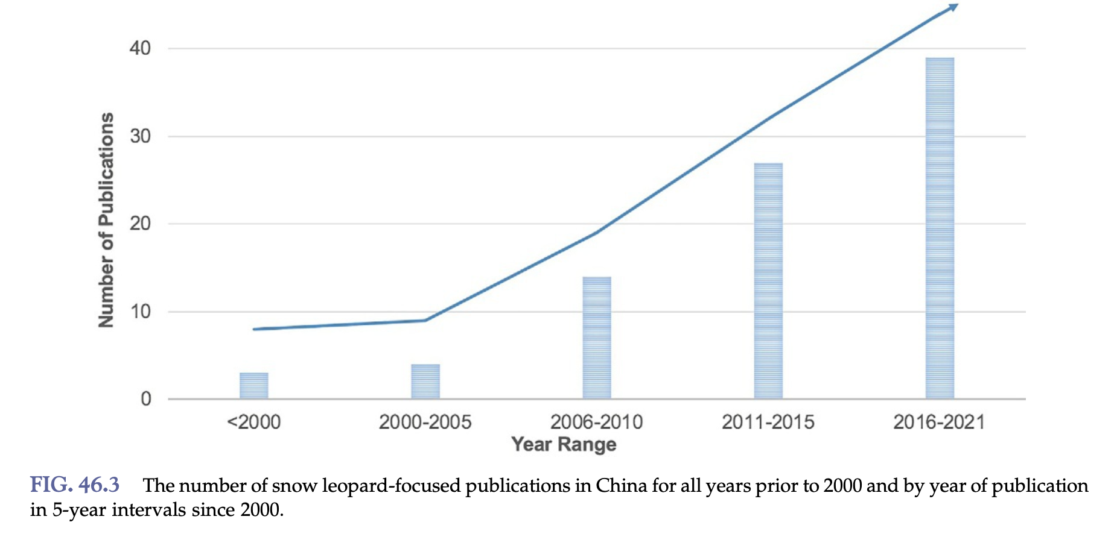
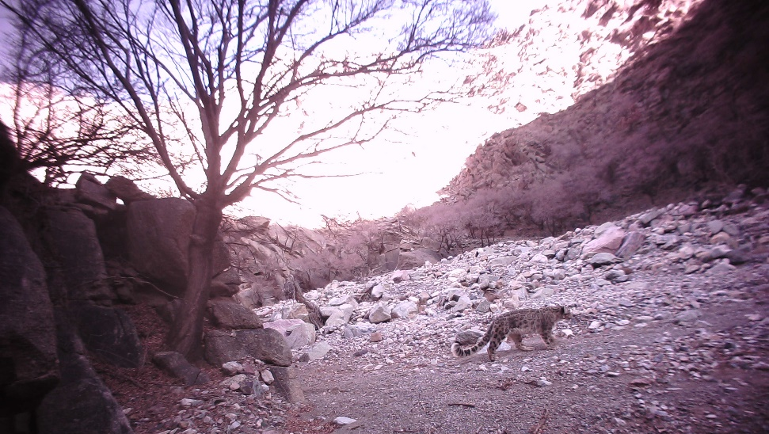
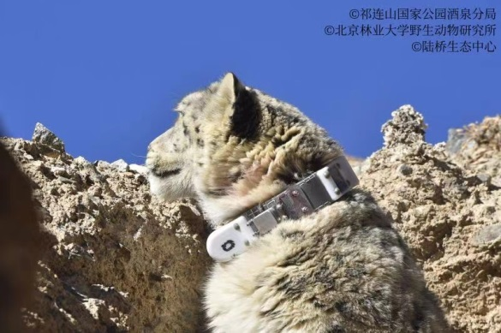
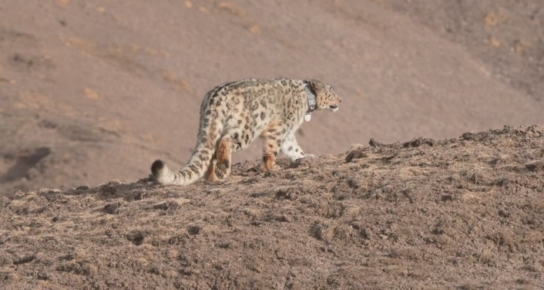
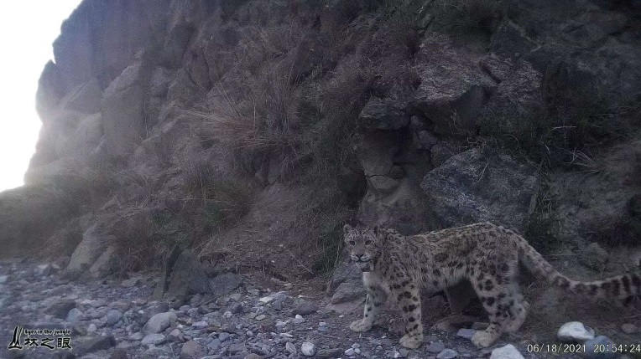
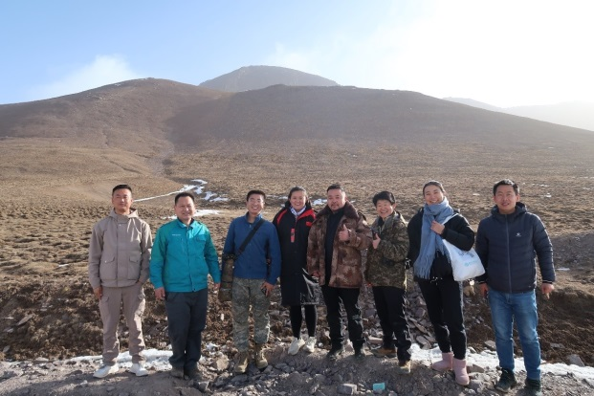
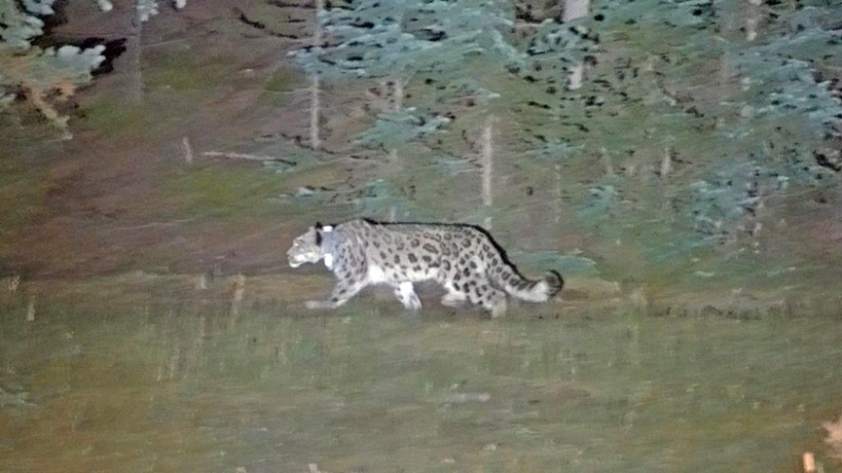
Implementation status of the NSLEP
#1 Goal : Investigating and monitoring snow leopard populations and habitat dynamics, strengthening basic research and conservation planning
Progress & Status
-- Snow leopard survey has covered areas in all 7 range-provinces , rapidly increasing “snow leopard population and habitat survey and assessment ” projects taking place in snow leopard habitat
--Government funded snow leopard satellite tracking projects : 10 collared snow leopards from 4 provinces, ongoing snow leopard rehabilitation and reintroduction programs in Helan Mountain and related ranges etc.
--Sub-regionally make scientific planning for snow leopard: increased snow leopard monitoring projects supported by provincial administrations in major mountains across all 7 range provinces since 2018, which 5 provinces yielded snow leopard density estimates as main results
Increased publications on snow leopard-related topics in China
Notes:
-Please refer to the respective NSLEP docs and provide status of each target/goal set therein;
-Describe how you plan to achieve the goals/targets not or partially achieved with a proposed timeline;
-Add slides to report all the targets/goals
10 collared snow leopards from 4 provinces (Qinghai/Gansu/Ningxia/Xinjiang)

Slide 6
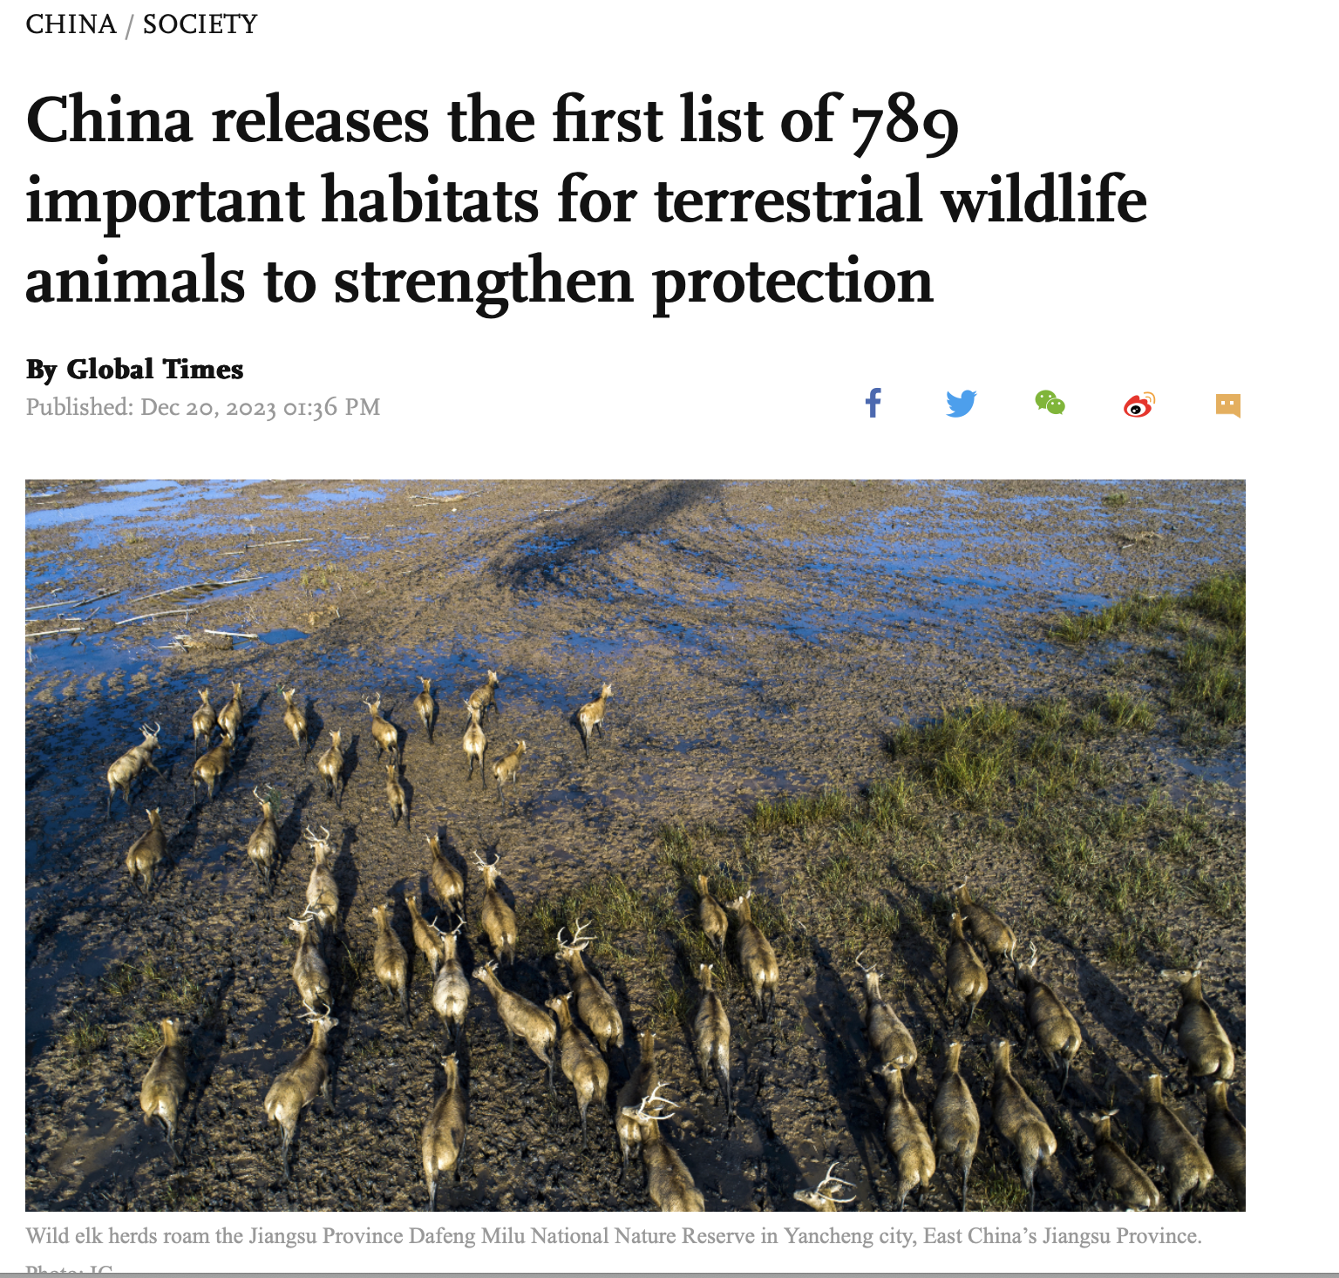
#2 Goal : Perfect the management system of protection, enhance the protection of habitats
Progress & Status
--Perfect the system of conservation management of snow leopard population and their habitats, which is with the nature reserves as mainstay: 3 Newly established National Parks, and 78 newly listed Important Wildlife Habitat across at least 831,700 km² of land.
--Strengthening the capacity building of snow leopard conservation and management system: benefited by National Nature Reserve Construction Projects/every survey is coupled with capacity training
--Conserving, restoring and extending snow leopard habitat : National Park policy, Highway Wildlife Pass construction, Important Habitats for Terrestrial Wildlife, etc.
Notes:
-Please refer to the respective NSLEP docs and provide status of each target/goal set therein;
-Describe how you plan to achieve the goals/targets not or partially achieved with a proposed timeline;
-Add slides to report all the targets/goals

Slide 7
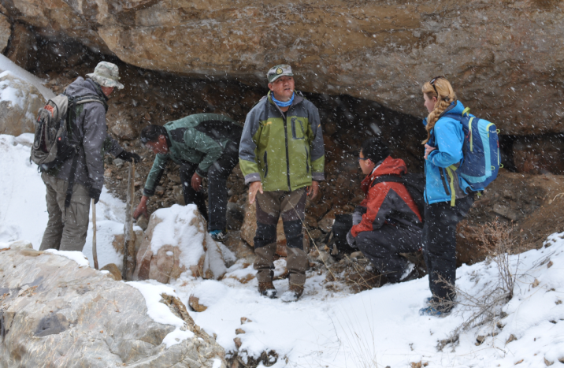
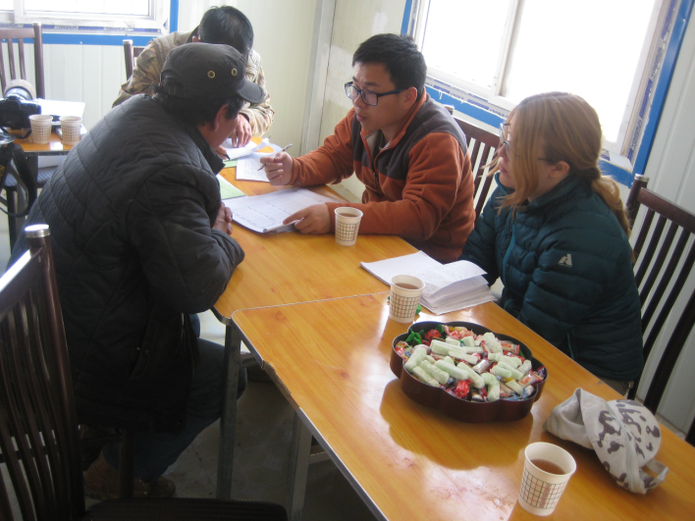
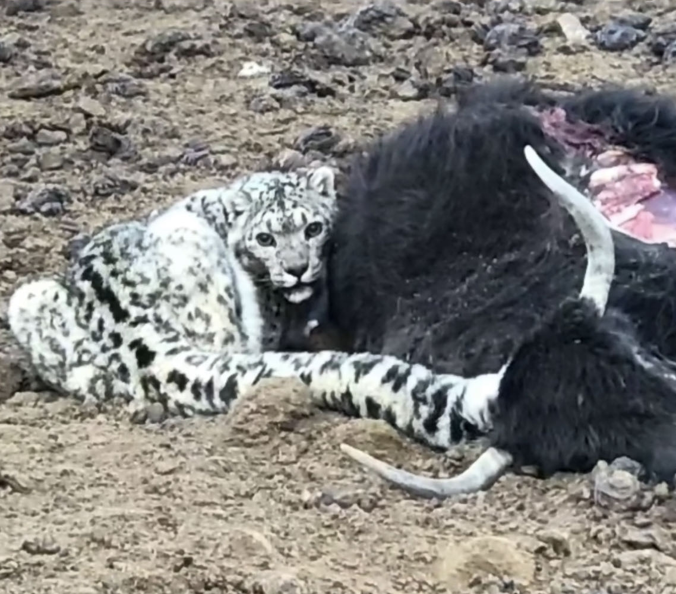

#3 Goal: Coordination of snow leopard conservation and the local community's social and economic development
Progress & Status
--Compensating damage or loss of snow leopard depredation & Preventing damage or loss caused by the snow leopard attacks on people and livestock: Sanjiangyuan NP funded the first community co-managed HWC foundation in Zaduo County/ GEF funded the “Promoting community-based conservation for snow leopards in Yanchiwan reserve, Qilian Mountain National Park” which promoted local livestock insurance coverage and supported 10 households for pilot electrical corral anti-depredation measure.
-- Pilot demonstration of eco-friendly mode of economic development : The Nature Watch Project in National Parks
Notes:
-Please refer to the respective NSLEP docs and provide status of each target/goal set therein;
-Describe how you plan to achieve the goals/targets not or partially achieved with a proposed timeline;
-Add slides to report all the targets/goals

Slide 8



#4 Goal: Strengthening law enforcement propaganda, cracking down on illegal activities
Progress & Status
Strengthened law enforcement capacity building of institutions, and more effectively carrying out the inspection of law enforcement and special combat operations: up to 10 years imprisonment with serious charges of sl poaching and illegal trading.
Develop extensive publicity and education on snow leopard conservation: International sl day, mainstream social media promotion and awareness-raising, muti-level sl and sl habitat conferences
Notes:
-Please refer to the respective NSLEP docs and provide status of each target/goal set therein;
-Describe how you plan to achieve the goals/targets not or partially achieved with a proposed timeline;
-Add slides to report all the targets/goals

Slide 9



#5 Goal: Expanding International Cooperation and Exchanges on Global Snow Leopard Conservation
Progress & Status
Improve international cooperation mechanisms on snow leopard conservation :academic collaboration , UNDP funded community-based conservation projects, collaborations with international Foundations and NGOs SLT/SLN, IUCN CEC
Notes:
-Please refer to the respective NSLEP docs and provide status of each target/goal set therein;
-Describe how you plan to achieve the goals/targets not or partially achieved with a proposed timeline;
-Add slides to report all the targets/goals

Slide 10
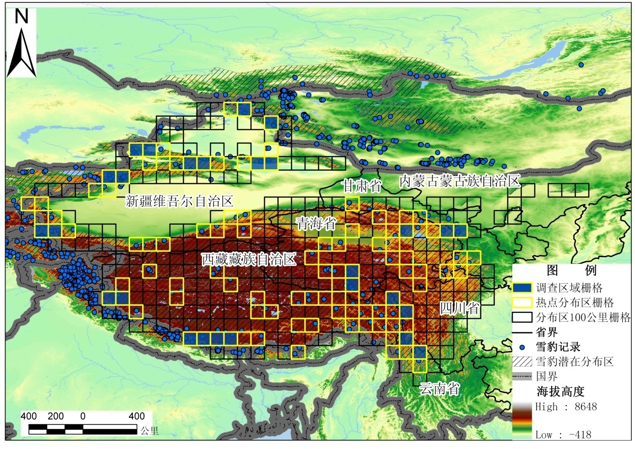
#6 Goal : Improve policy for snow leopard conservation
Progress & Status
--China's "five-year planniong" ecological construction, “Belt and Road: initiative, the project of returning grazing land to grassland, wildlife protection and nature reserve construction
--Chinese rare and endangered species rescue breeding, investigation and supervision and the 2nd national terrestrial wildlife resources survey projects, 2nd Scientific Survey on Qinghai-Tibet Plateau etc.
Notes:
-Please refer to the respective NSLEP docs and provide status of each target/goal set therein;
-Describe how you plan to achieve the goals/targets not or partially achieved with a proposed timeline;
-Add slides to report all the targets/goals

Slide 11
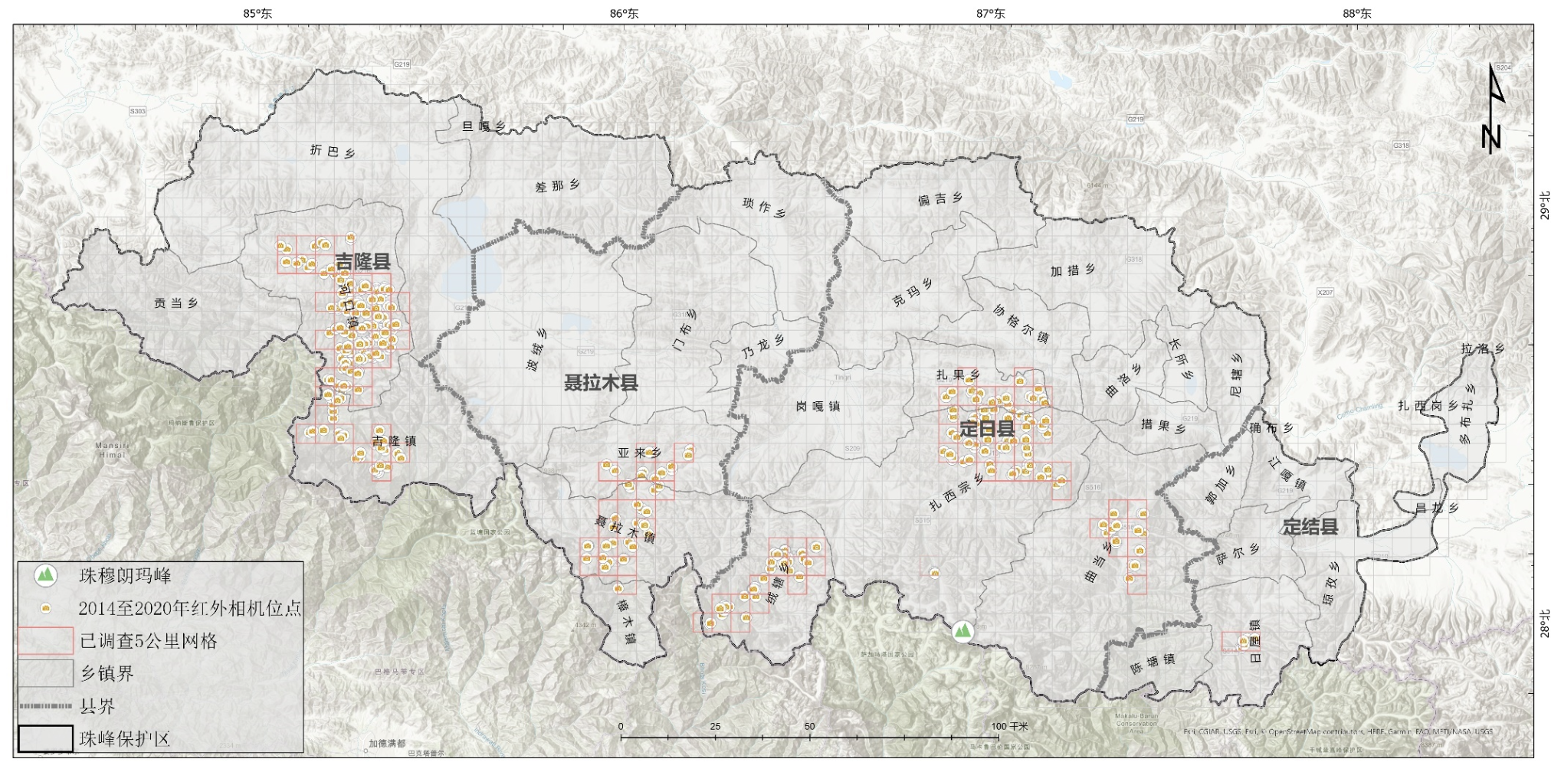
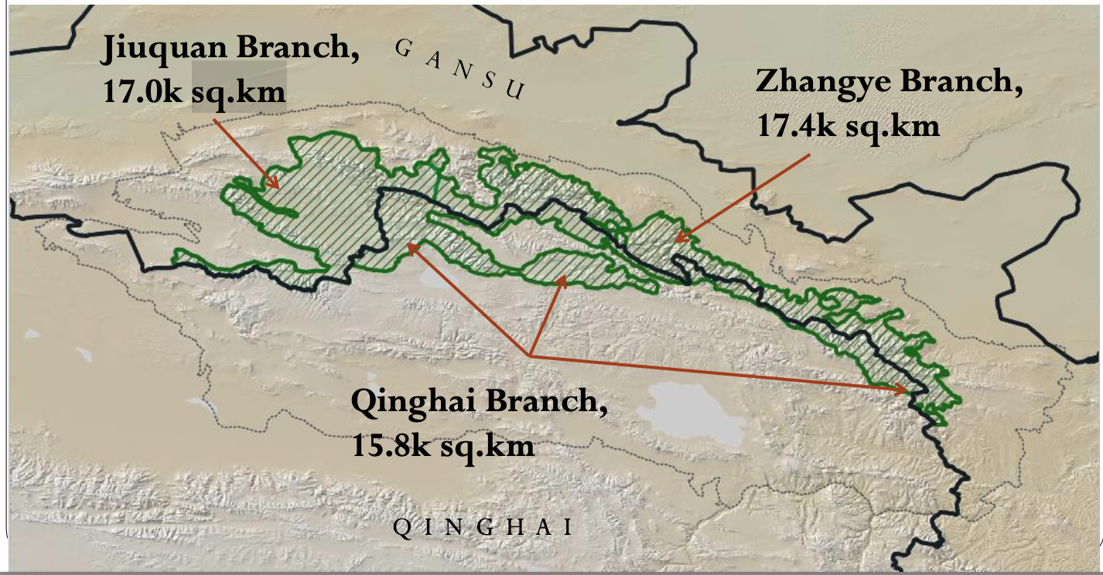
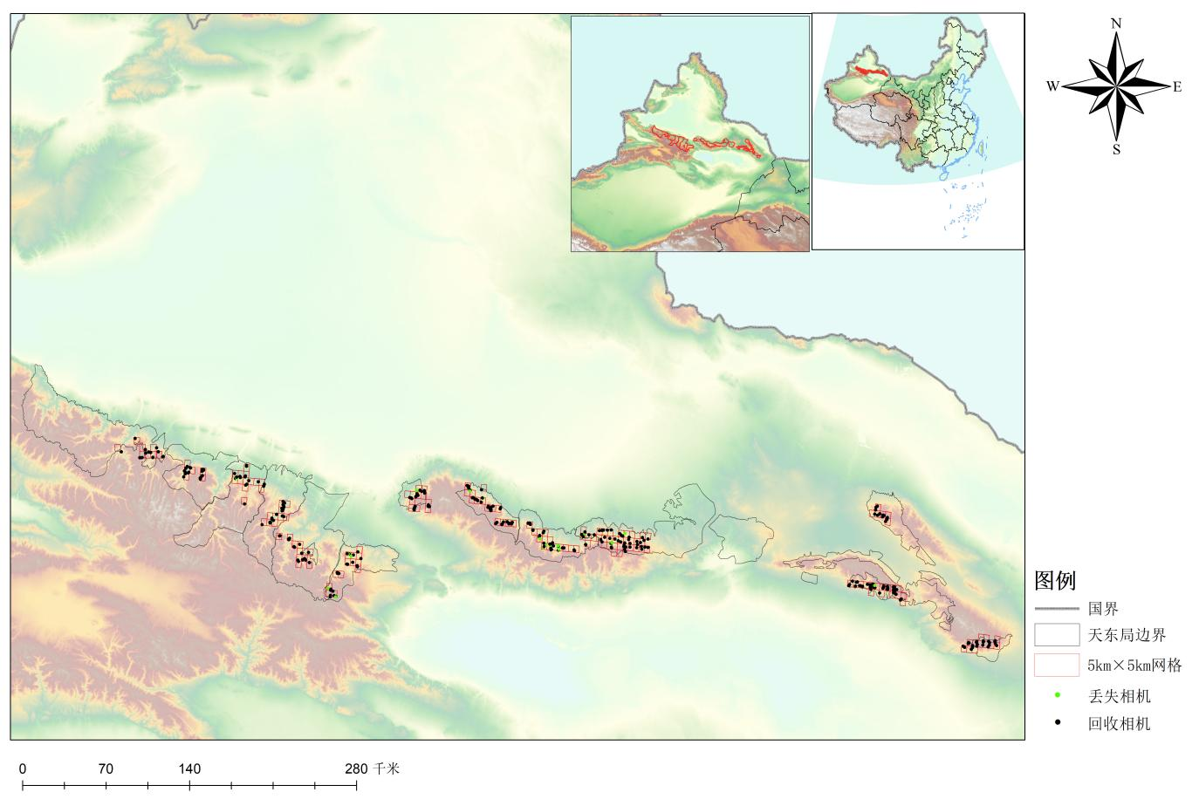
Resource mobilization for NSLEP
Funds secured from
  i) internal [government]
  Increased capital investment to the snow leopard conservation: i.e endangered species breeding projects/national surveys/species-focused regional or provincial surveys
Monitoring on snow leopards in Qomolangma NNR
Survey on snow leopards in the pilot area of Qilian Mountain National Park
Survey on snow leopards in Mid-Eastern Tianshan
Notes:
-Please provide synthesis of the funds secured from the government and international donors to accomplish the NSLEP goals and targets;
-Refer to the NSLEP doc, please describe the amount of funds proposed at the onset and proportion of funds secured until now and financial gap thereof;
-How do you plan to mobilize resources to pluck the financial gap during the upcoming years;
-Add slides, if required.

Slide 12
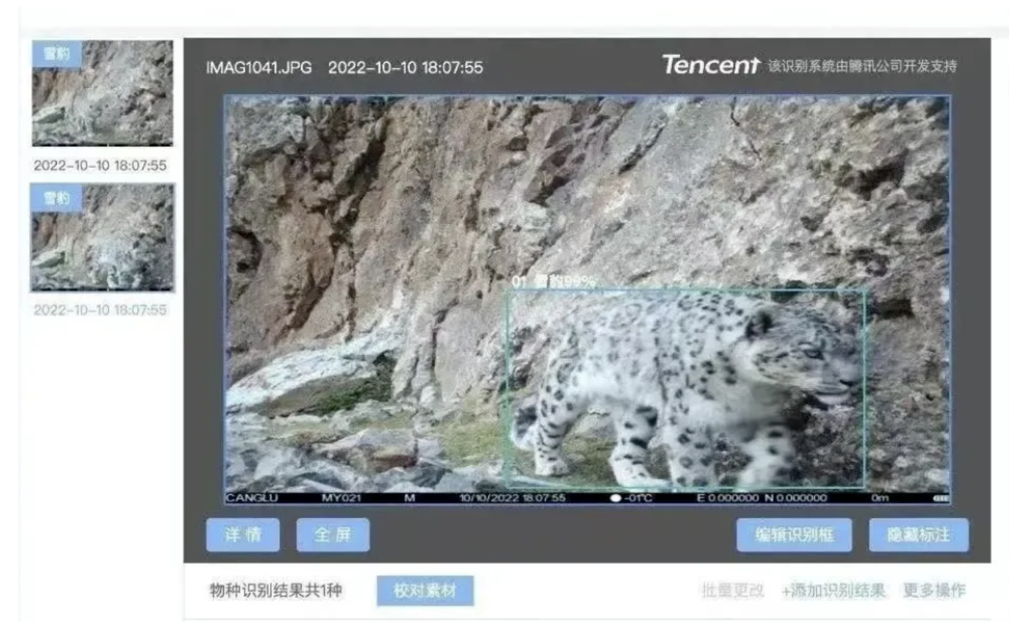



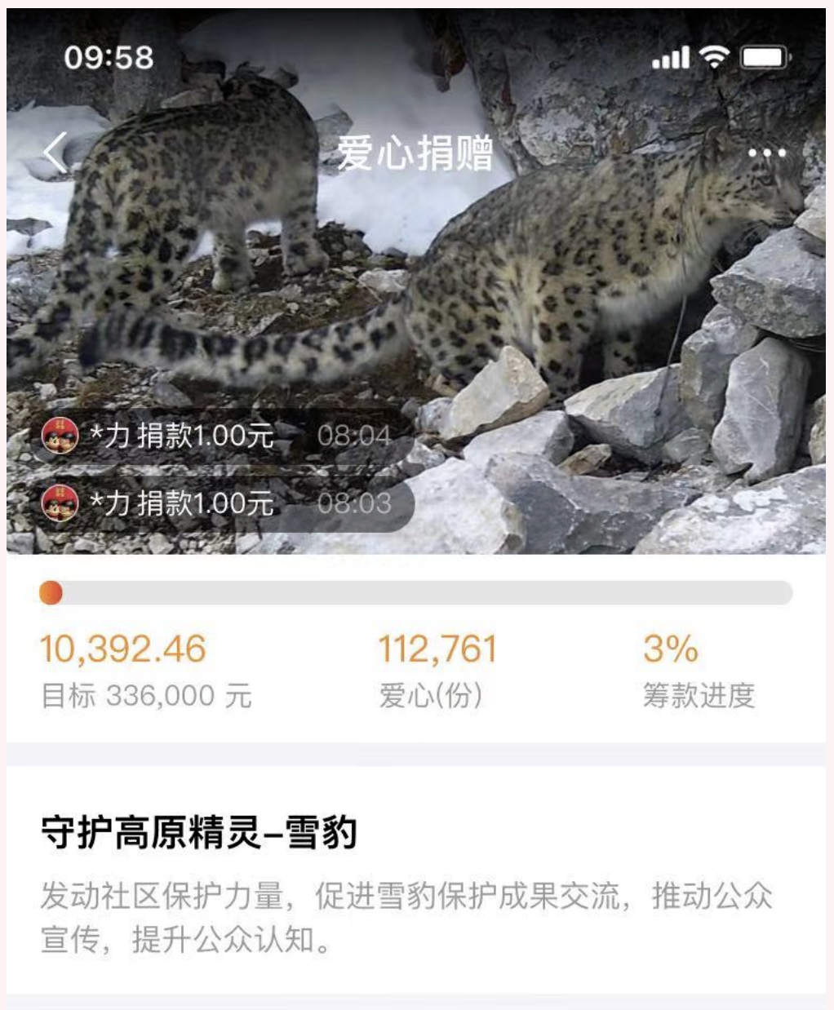



Resource mobilization for NSLEP
  ii) external [donors]
  Civil body or other non-governmental organizations i.e Vanke, Tencent Funds, UNDP GEF
  Internet-based crowdfunding programs (Tencent public welfare , Sina Weibo, titled #Safeguard Snow Leopard Habitat Action#，tencent “Snow Leopard Intelligent Identification and Monitoring Data Management Cloud Platform”, “ Journey with Leopards - Snow Leopard Conservation Small Grant Program” )
Notes:
-Please provide synthesis of the funds secured from the government and international donors to accomplish the NSLEP goals and targets;
-Refer to the NSLEP doc, please describe the amount of funds proposed at the onset and proportion of funds secured until now and financial gap thereof;
-How do you plan to mobilize resources to pluck the financial gap during the upcoming years;
-Add slides, if required.

Slide 13



Resource mobilization for NSLEP
Financial gaps and needs：
Snow leopard conservation and monitoring in its entire range will require a significant investment of funds in next five years, necessary budget needs to be resourced
Future plans :
Gradually increase capital investment to the snow leopard conservation: China fiscal decentralization, increased capital funds for endangered species conservation programs.
Activate more private fundraising channels or foundations to provide necessary funding for snow leopard conservation projects; Tencent foundation，vanke foundation, international foundations
Strive for International support for cross-border cooperation projects
Notes:
-Please provide synthesis of the funds secured from the government and international donors to accomplish the NSLEP goals and targets;
-Refer to the NSLEP doc, please describe the amount of funds proposed at the onset and proportion of funds secured until now and financial gap thereof;
-How do you plan to mobilize resources to pluck the financial gap during the upcoming years;
-Add slides, if required.

Slide 14
Re-analysing Threats to Snow Leopards, their Ecosystems, and Local Livelihoods
Referring to China's Snow Leopard Conservation Action Plan (Internal Deliberation Draft) released in 2013 & 2018, Snow Leopard Survival Strategy, Snow Leopard Network 2013
Overall Threat Assessment:
  High ratings for “ Perception-related Threats”（low-awareness） and "Habitat and Prey-related Threats."
  Low rating for "Killing and Capture of Snow Leopards," reflecting significant progress in habitat patrols, law enforcement, and public awareness in China.
National Threat Ranking:
  Top threats, based on weighted provincial scores:
    Insufficient capacity in conservation frontline.
    Climate change.
    Lack of community awareness.
  Concerns about potential impacts of climate change, population growth, and large-scale development activities.
Weakness in Snow Leopard Conservation:
  “Lack of scientific research and related awareness” identified as a weak point in China's snow leopard conservation efforts.

Slide 15
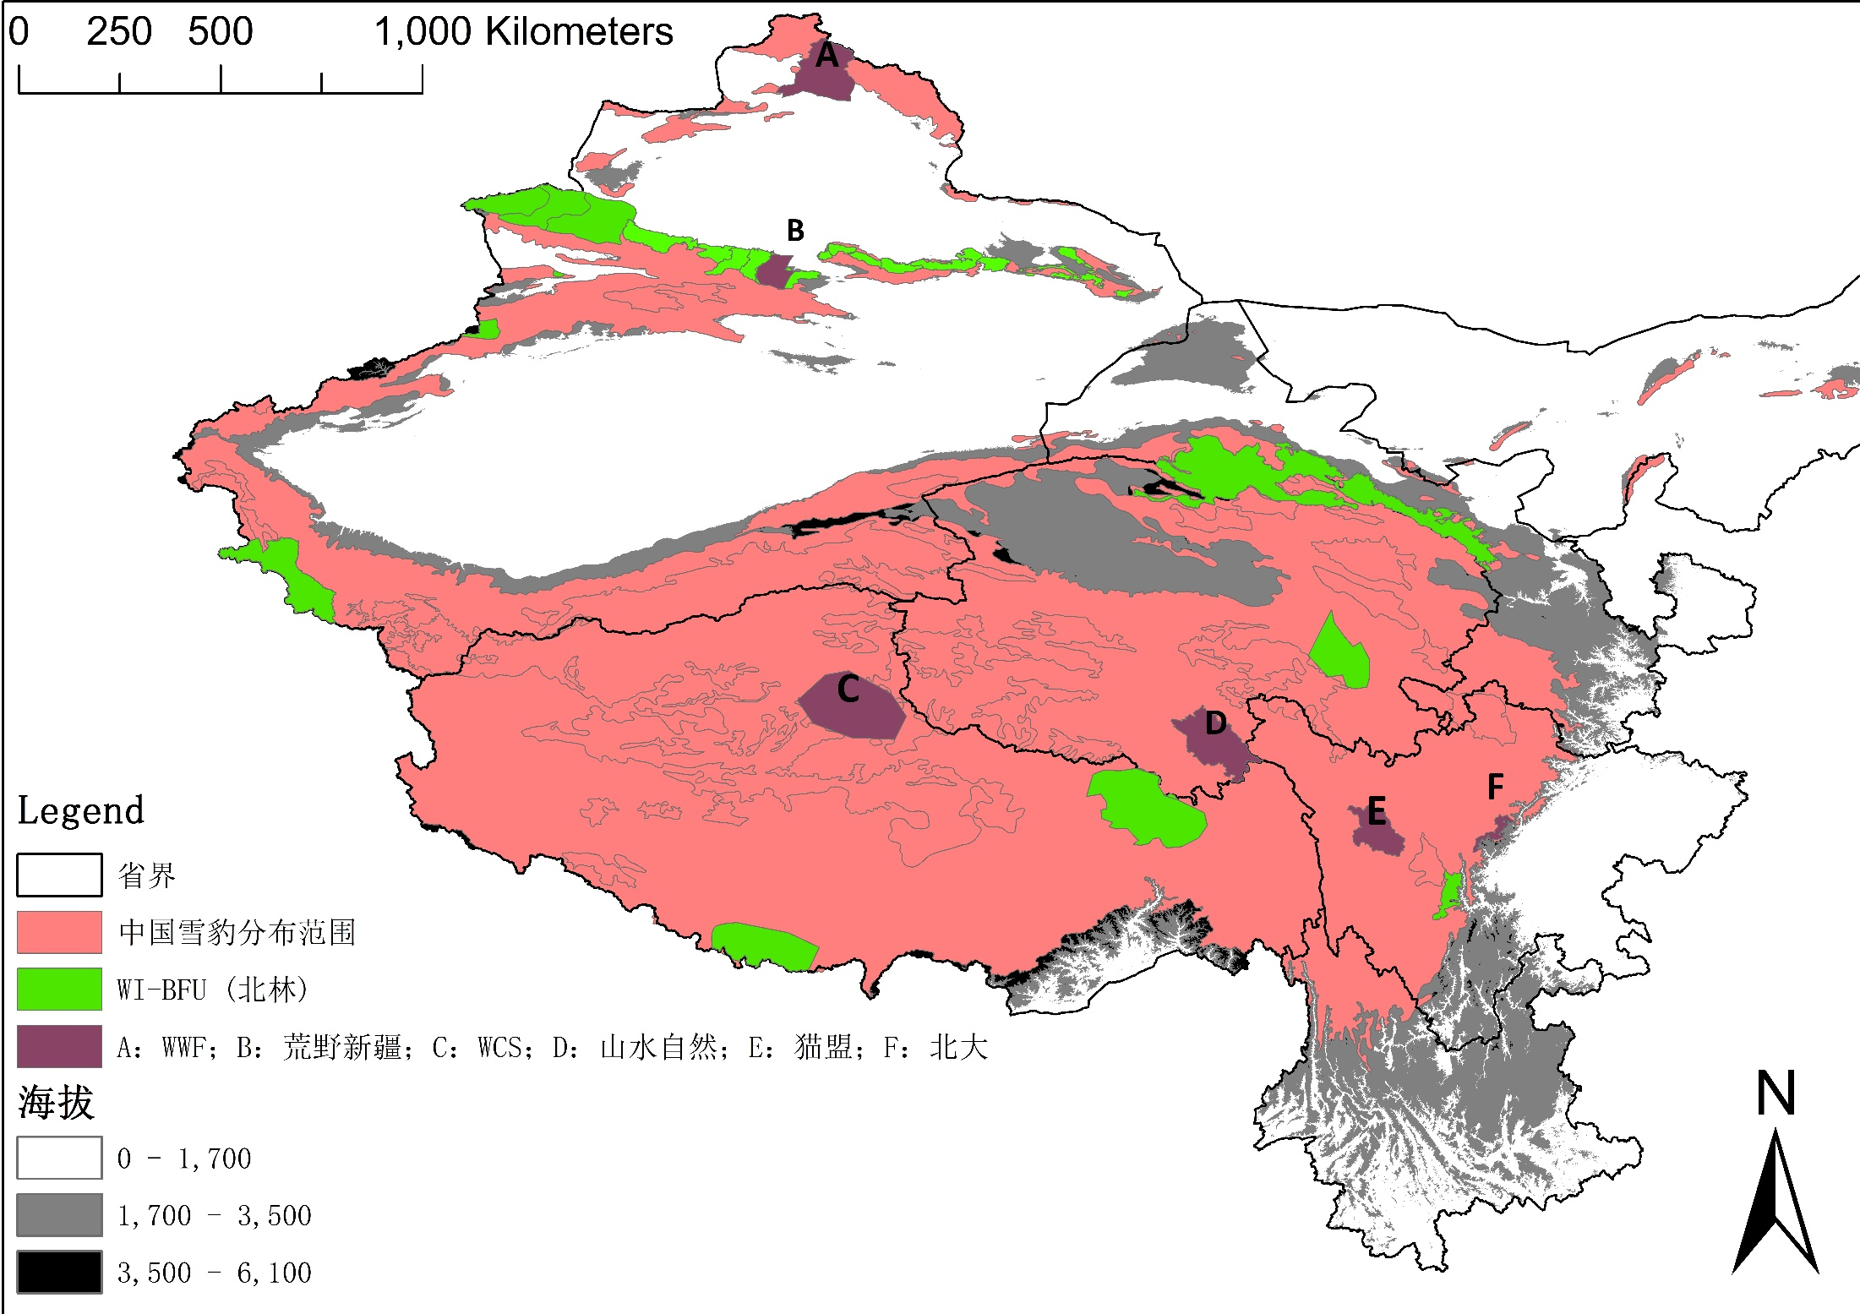
Drawing on PAWS protocols
Surveys drawing on PAWS protocols
Assessment on SL population and habitat has been conducted by governments and NGOs over last 10 years. In 2023, National Forestry and Grassland Administration issued a technical guide for monitoring terrestrial wildlife, providing guidance on the basic principles, content, monitoring units, sampling, testing, and monitoring techniques for monitoring different groups of terrestrial wildlife such as mammals, birds, amphibians, reptiles, and insects.
Gaps and needs/next steps:
(1) Summarize and integrate existing and planned survey efforts by region to achieve regional snow leopard population assessment drawing on PAWS analyzing method.
(2) Enhance and promote data management system to improve data storage, coordinating and analysis.

Slide 16
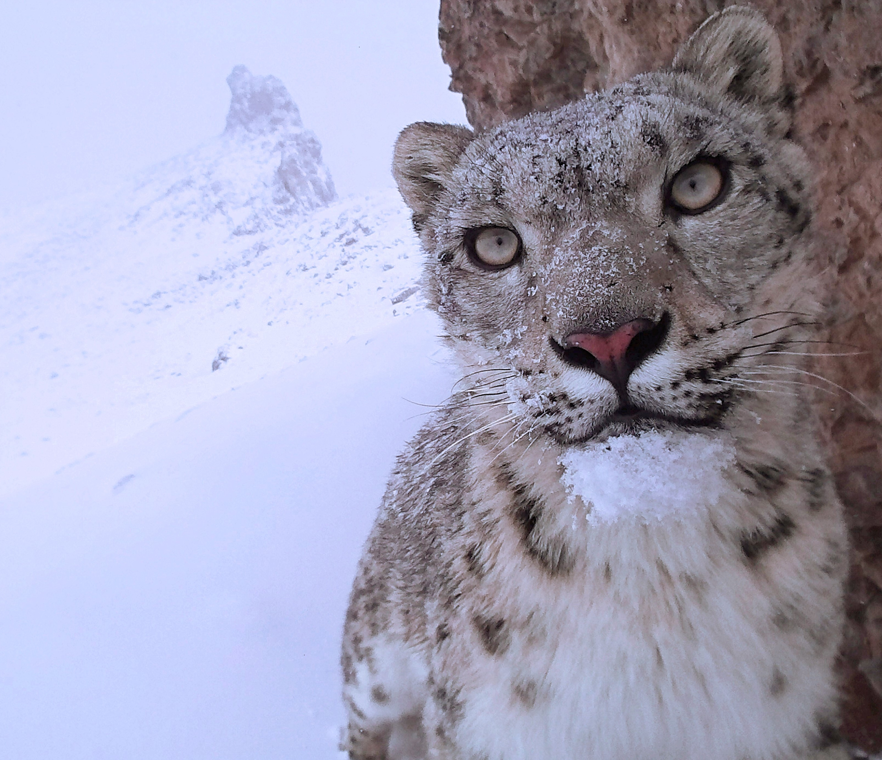
Climate Adaptations/Nature-based Solutions
A high- elevation resettlement project that has taken place to move some of the population to the southern cities and suburbs of Tibet, as showcased by Rongma Town of Nyima County, Nagqu , This measure has significantly relieved pressure on local ecology and the existing human-wildlife competition for natural resources.
Mountain ranges have been identified snow leopard habitats, and further reserach will be conducted in next stage to provide scientific evidence supporting policy making for SL conservation in context with climate changes.
Alipay, one of China’s most popular online payment and lifestyle platforms in China, launched “The Alipay Ant Forest” project to promote climate-friendly actions among the public in August 2016.

Slide 17
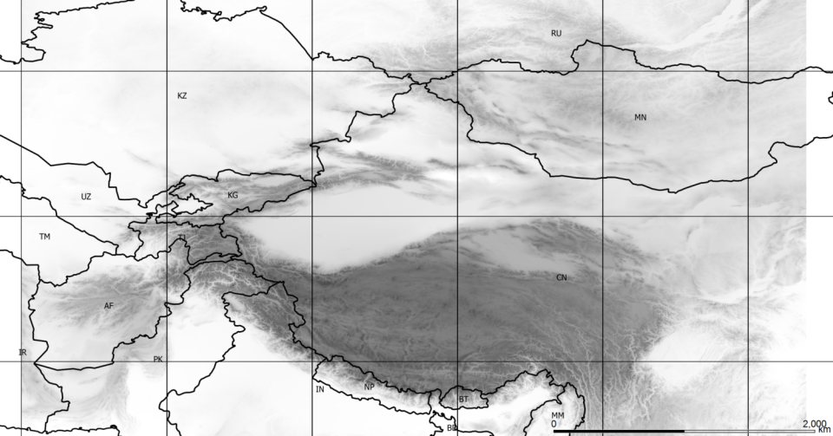
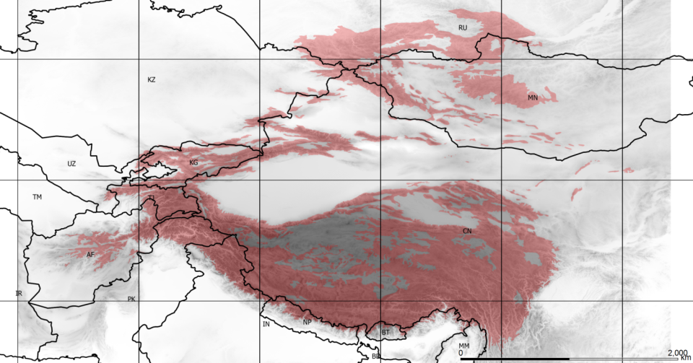
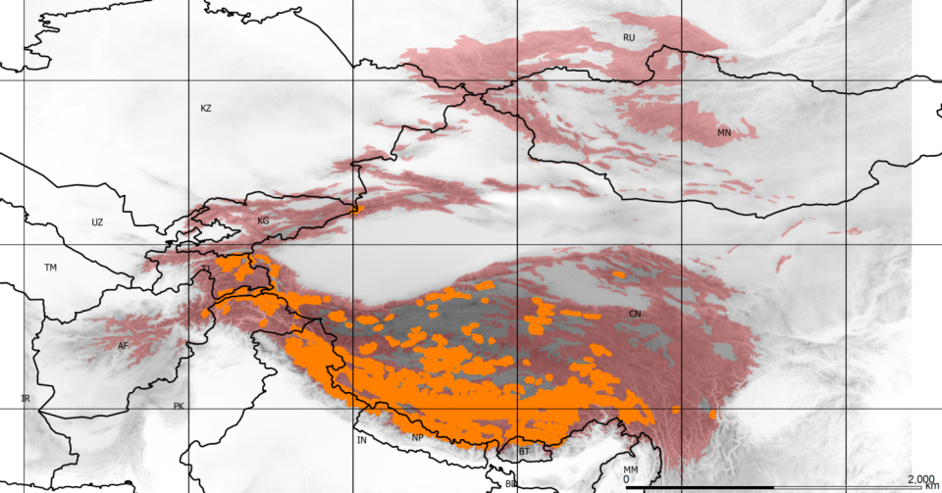
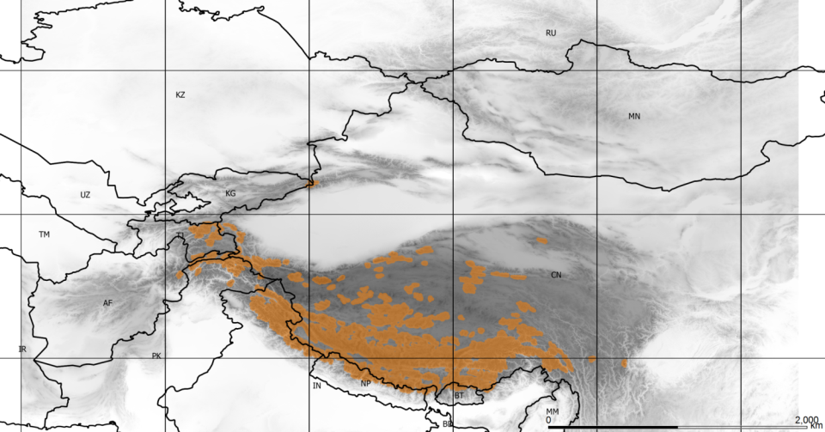
Snow Leopard Range Under Climate Change
Zero Adaptation
Notes:
Here we Modeled impact of climate change on the distribution of snow leopard, we see clear risk of range contraction, fragmentation and population decline

Slide 18
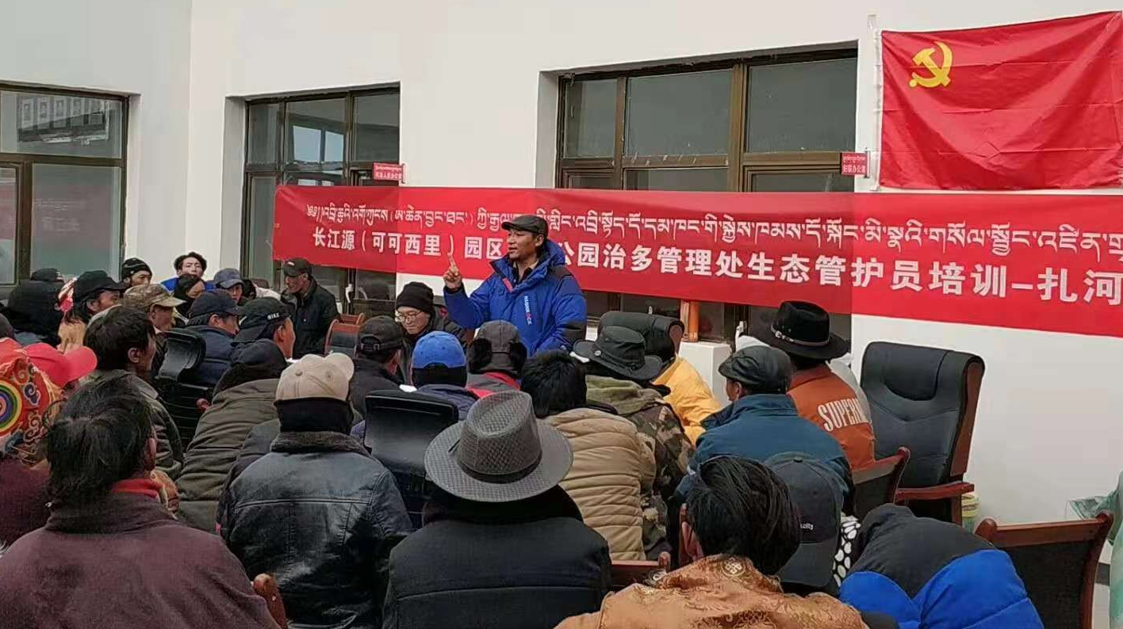
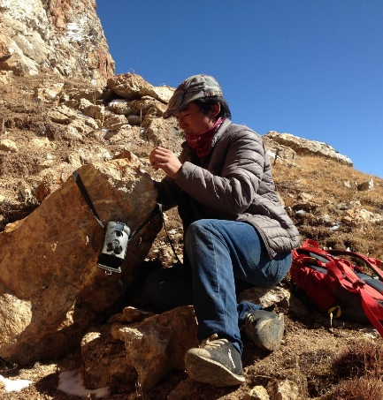
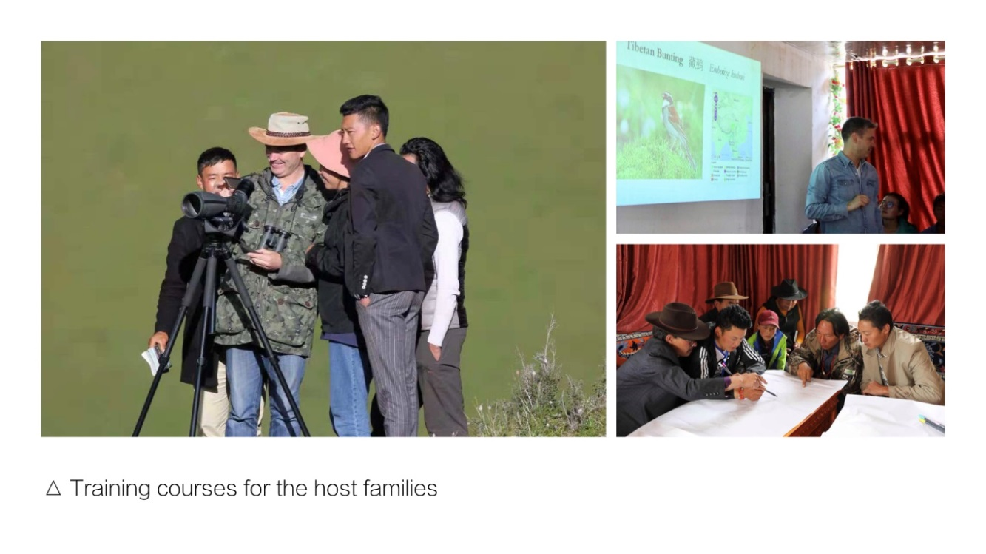

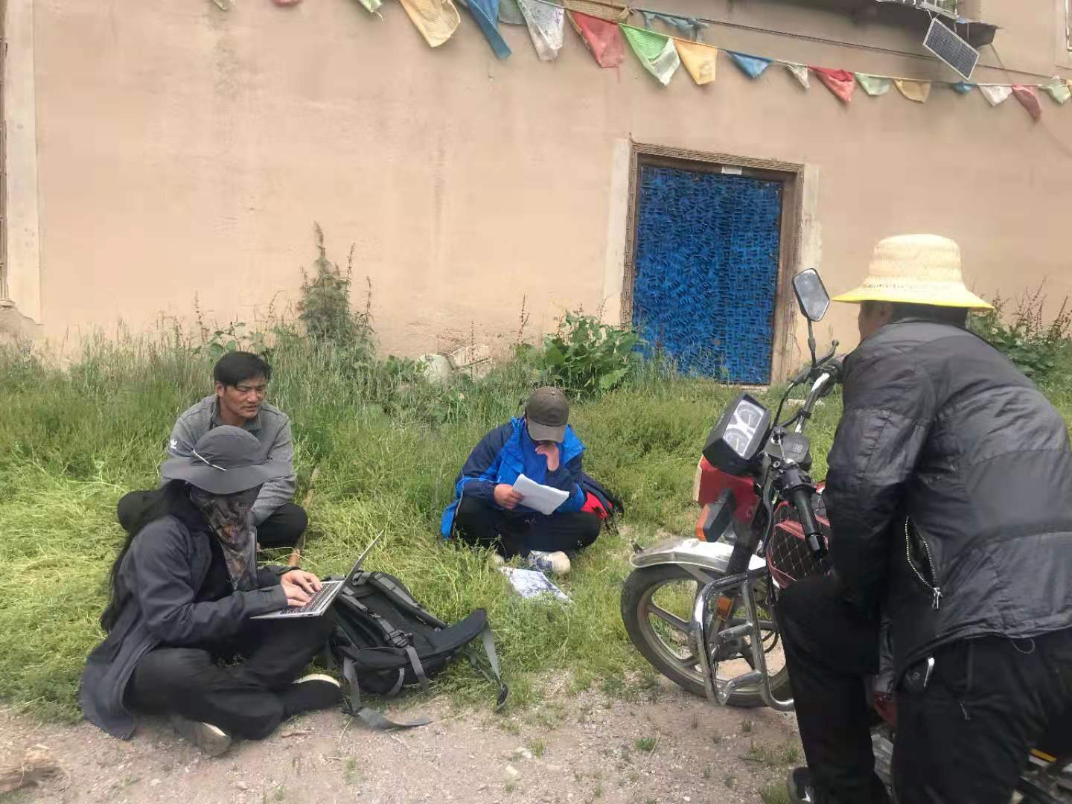
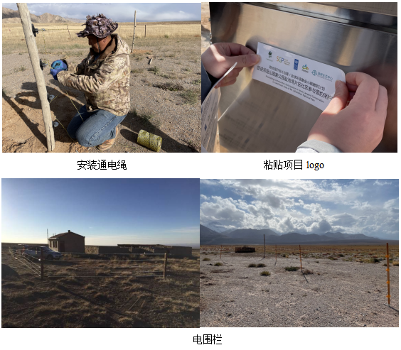
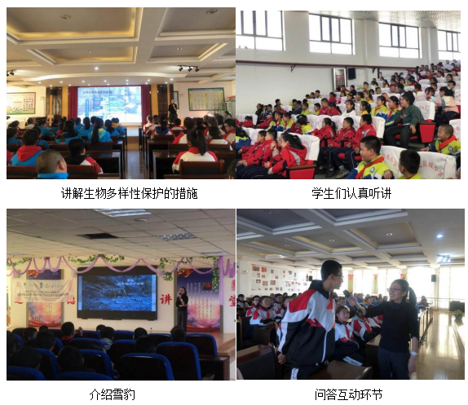
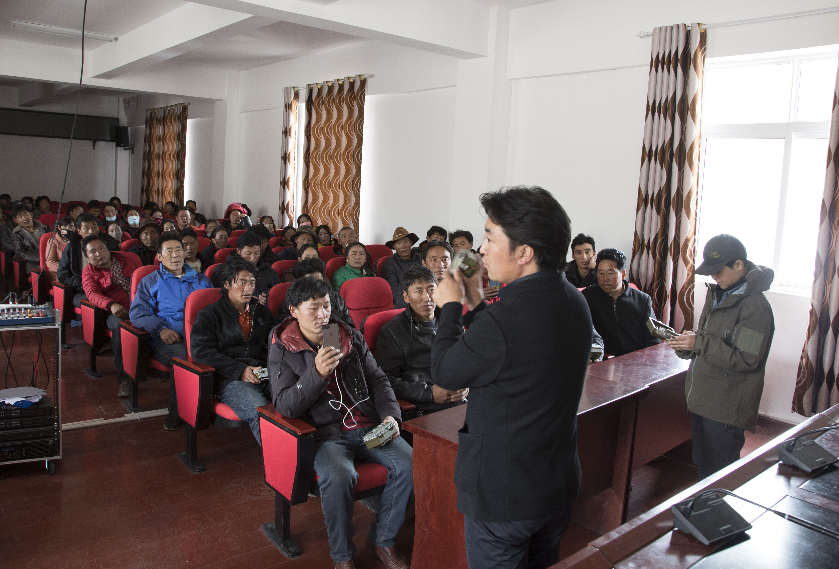
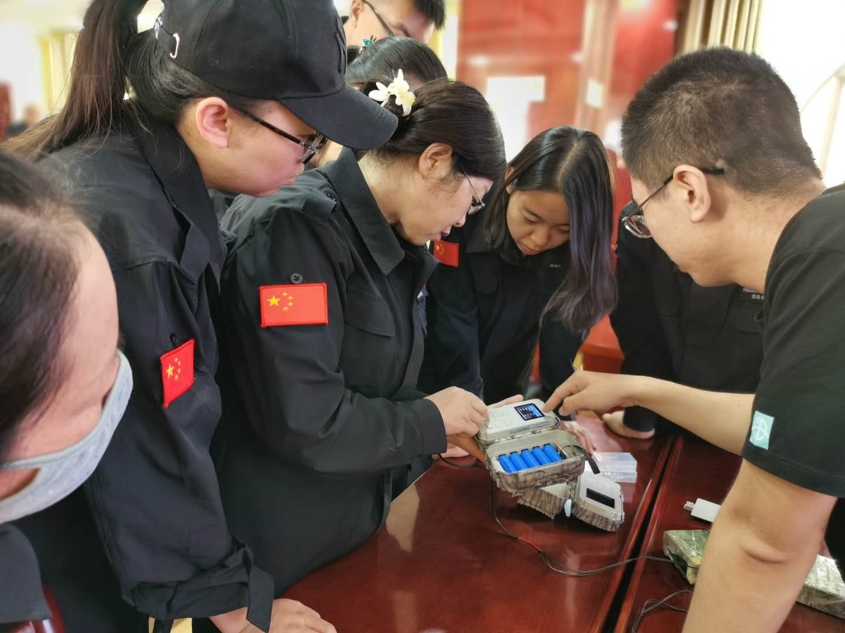
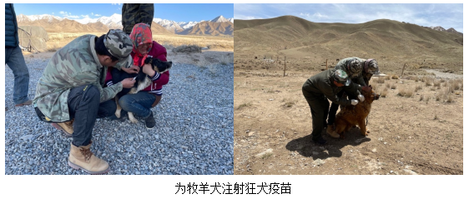
Community-based conservation initiatives
The Community-based Monitoring in Sanjiangyuan Region
The Nature Watch Project in Sanjiangyuan National Park
Monitoring System
Training and Field Work of Community Monitor
GEF funded “Promoting community-based conser vation for snow leopards in Yanchiwan reserve, Qilian Mountain National Park”
Community-based snow leopard conservation projects in Mount. Bujia, Tibet
Notes:
On-going or proposed community-based conservation programs in the snow leopard habitat
Gaps and needs

Slide 19
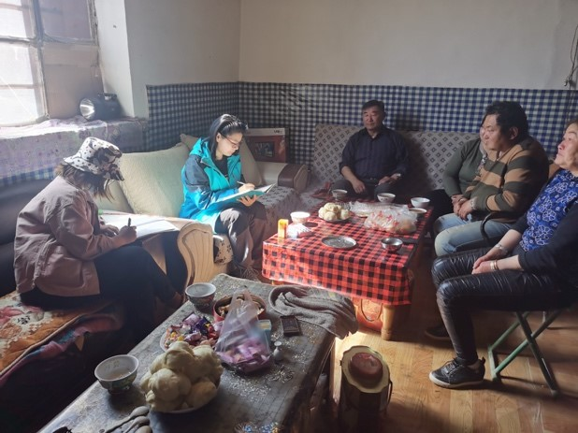
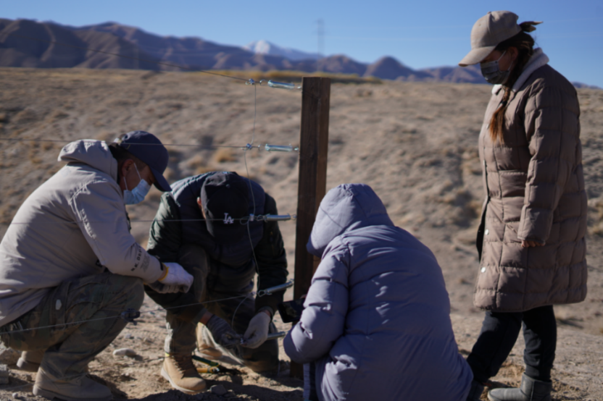
Development and implementation of livestock insurance and compensation scheme
The “Wildlife Conservation Law” clearly states that the local government should compensate for any damages caused by protected wildlife species under this law.
In Qinghai, Gansu, Xizang, Sichuan, Inner Mongolia, and Yunnan, where local governments work with insurance companies to verify reported snow leopard damages and decide on the amount of compensation in a case-by-case manner
Starting from 2016, the Zaduo county government, Qinghai, together with NGO and the local community in Sanjiangyuan National Park, funded the first community co-managed HWC foundation. The first phase of funding reached a total amount of USD 31,000 (Luo, 2016 )
In 2021, the GEF small grants programme funded the “Promoting community-based conservation for snow leopards in Yanchiwan reserve, Qilian Mountain National Park” The activities include establishing conservation monitoring sites, conducting technical training sessions on snow leopard patrol and monitoring, collecting data on corral installation in target areas, compiling and analyzing corral improvement data, developing corral improvement plans, establishing pilot corral improvement techniques, conducting livestock insurance seminars, promoting livestock insurance to local communities, and vaccinating sheepdogs
Notes:
ease the conflicts between snow leopard and the local people’s production and living and to promote understanding and support of the local public for snow leopardconservation.

Slide 20


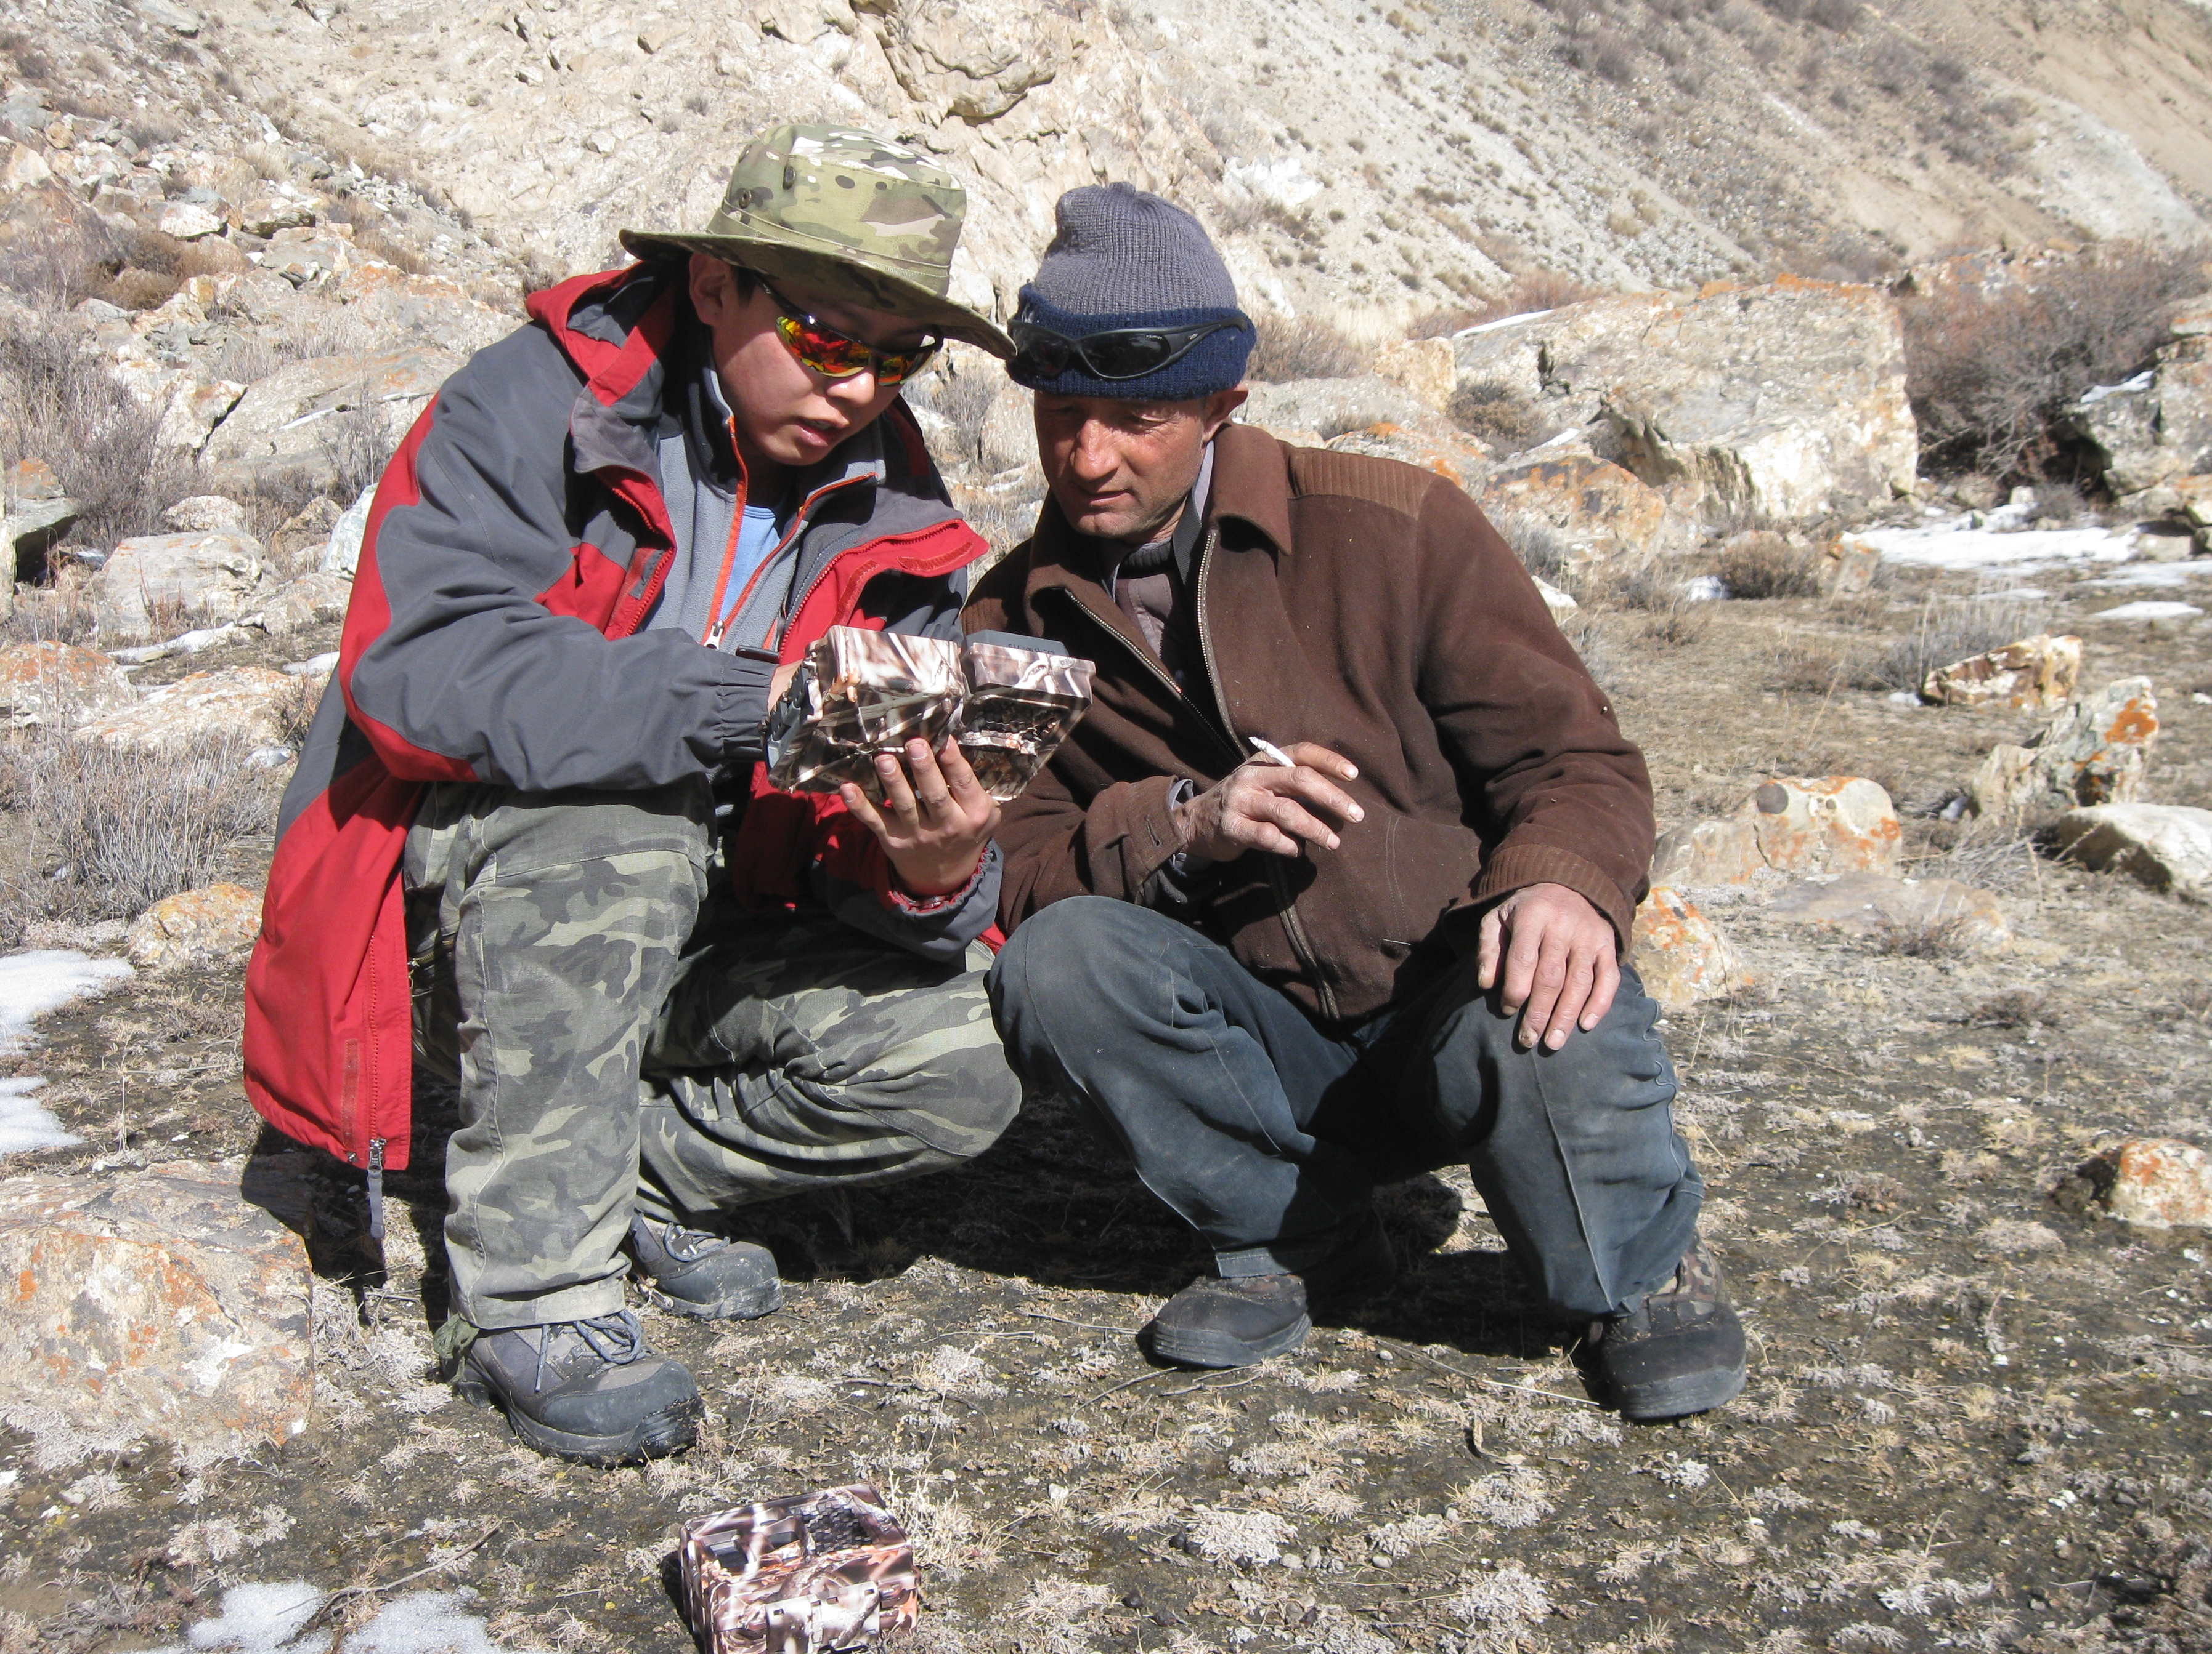
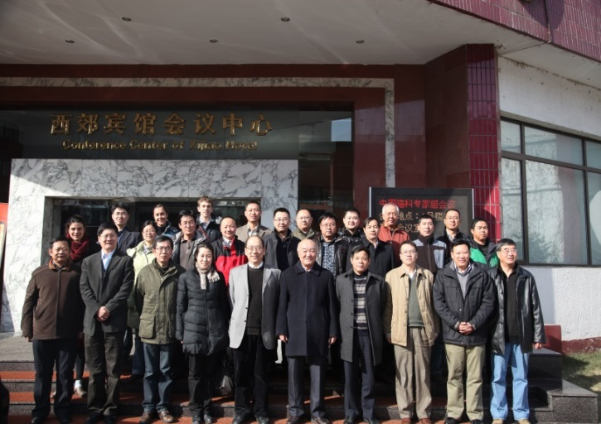


Community-based conservation initiatives
Capacity Building: Conducting snow leopard survey and conservation trainings for over 1600 front-line staffs in Qinghai, Xinjiang, Gansu, Sichuan, Ningxia, Inner Mongolia and Tibet, etc. during last five years. Institutional and local community based training, major focus by state administartion
Notes:
Through by Darwin Initiative project and collaborative projects for snow leopards, over 200 front-line staff has been trained and most of them are working in nature reserves cross over snow leopard land scapes

Slide 21
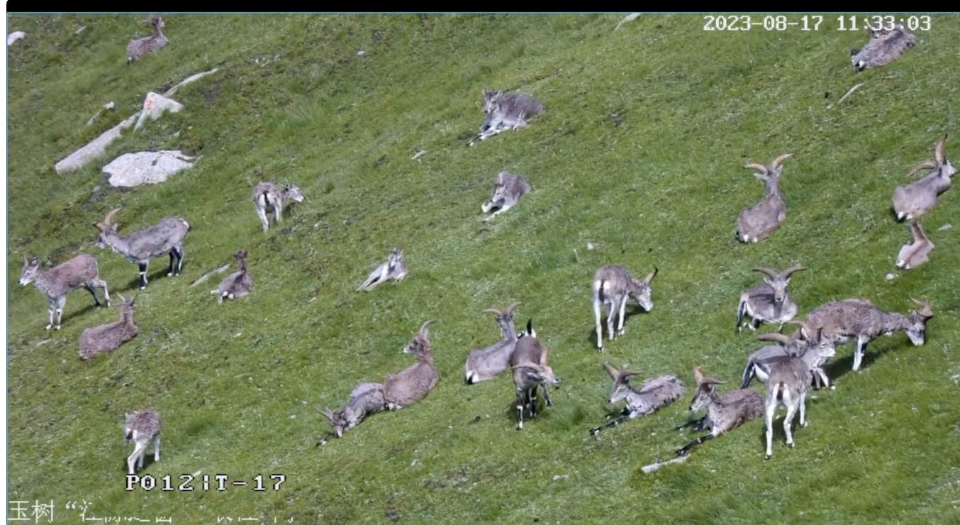
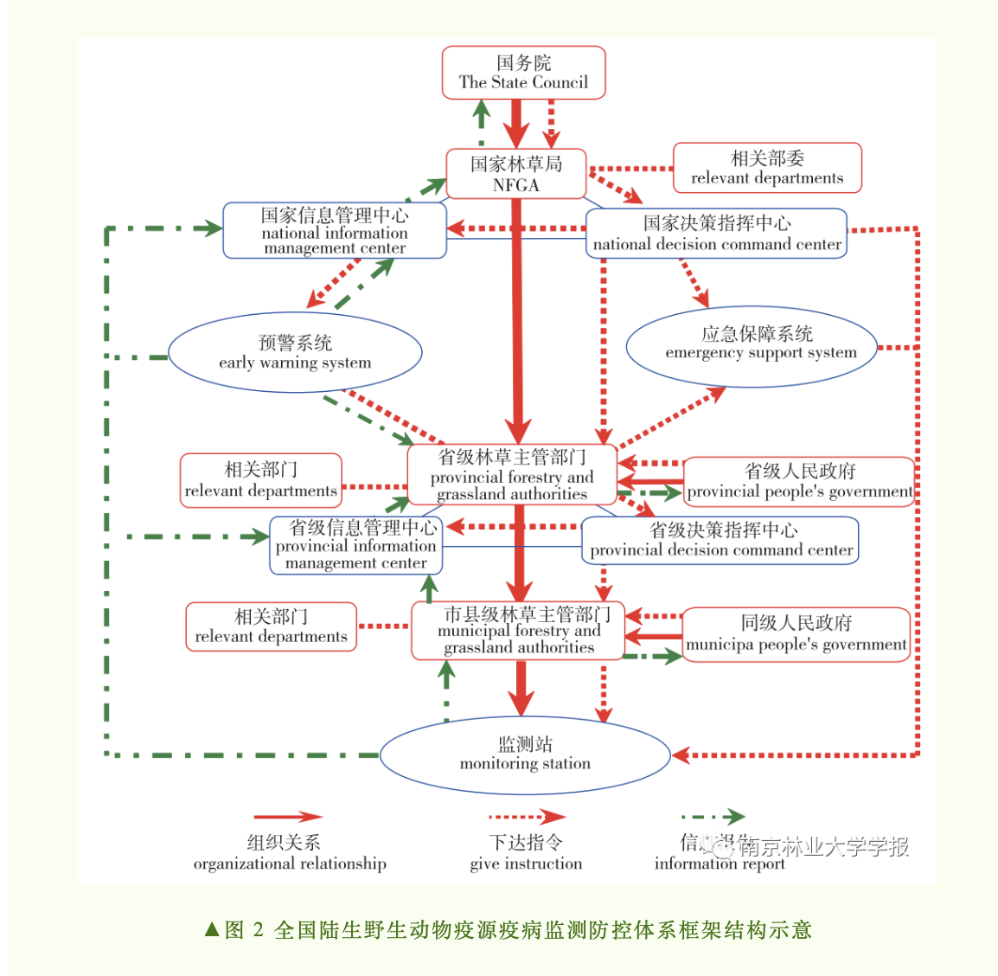

Management & monitoring of disease systems
The routine monitoring of diseases mainly 742 national level monitoring stations, with the National Forestry and Grassland Administration Monitoring Station located in Shenyang; The main disease monitoring countries arrange research topics and funds annually to collaborate with research institutes to carry out specialized research.
During the 13th Five Year Plan period, six major national projects were implemented in the field of wild animal disease monitoring, with a cumulative investment of nearly 100 million yuan. The National Innovation Alliance for Wild Animal Disease Monitoring under the National Forestry and Grassland Administration was established.
National Terrestrial Wildlife zoonotic disease monitoring and prevention system flowchart
Measure for quarantine of wildlife

Slide 22

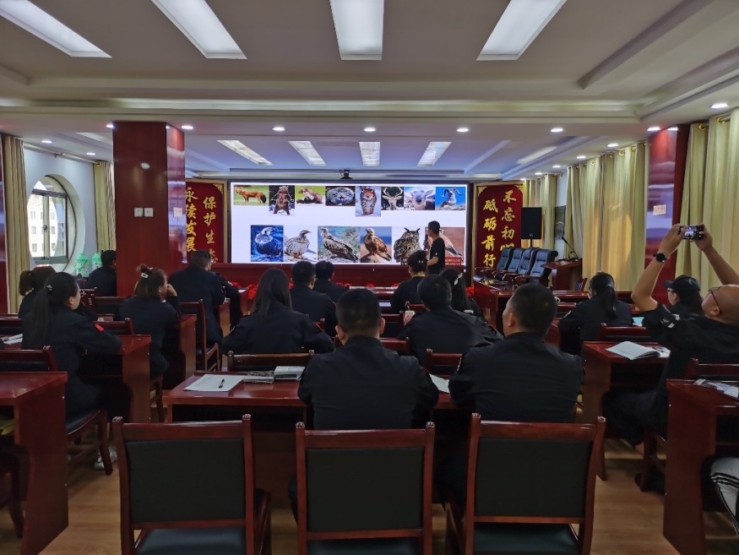

Status of national wildlife laws and enforcement
The National Wildlife Protection Law has been revised in 2016. The Law prohibits hunt, capture or kill wild animals under national major conservation, including snow leopard (ClassⅠ) and their preys such as blue sheep, siberian ibex (ClassⅡ）.
According to existing laws and regulations, the behaviors of unauthorized hunting snow leopard and selling, purchasing, transporting, smuggling snow leopard product, etc. are classified as serious criminal acts. Severe punishment including fines and imprisonment will be given; in serious cases will even resulted in life imprisonment.
China has established the multi-leveled, multi-linked wild animal conservation law enforcement system and mechanism of law enforcement coordination among departments of forestry, public security, industry and commerce, customs department.
Due to the new law, key habitats of endangered species need to be identified and protected by state, provincial, regional and local authorities.
Continue enhancing market patrol system, responsibility system, the public report reward system
Notes:
Efforts made to disrupt poaching and illegal wildlife trade in snow leopard habitat
Number of snow leopard poaching/confiscation cases in the past 2-3 years, especially during the lockdowns due to COVID (if any)
Number of convictions (if any)
Any additional information or observations
Gaps and needs
The renewed Law also expands the hunting methods prohibited by the old Law to include poisons, explosives, electronic shock, electronic trap devices, snares, leg-hold traps, makeshift guns, etc. Nighttime hunting with lights, guerrilla-style hunting, and hunting by destroying nests or using fire, smoke, or nets are also generally prohibited. (2016 Law, art. 24.)

Slide 23
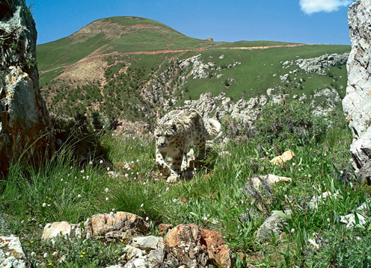
Managing Linear Infrastructure in snow leopard landscape
According to China's Wildlife Coservation Law, linear infrastructure sites should eliminate or reduce adverse impacts on wildlife. Where the construction project may have an impact on snow leopards and other wildlife under key state protection, the environmental impact assessment document shall consult the competent authorities in charge of wildlife conservation under the State Council.
According to the Nature Reserve Regulations, no infrastructure for production shall be built in the core areas of nature reserves; No infrastructure for production that pollute the environment or destroy resources or landscapes shall be built in the experimental areas. Projects to be built in the peripheral protection zones of nature reserves shall not harm the environmental quality of the nature reserves.

Slide 24
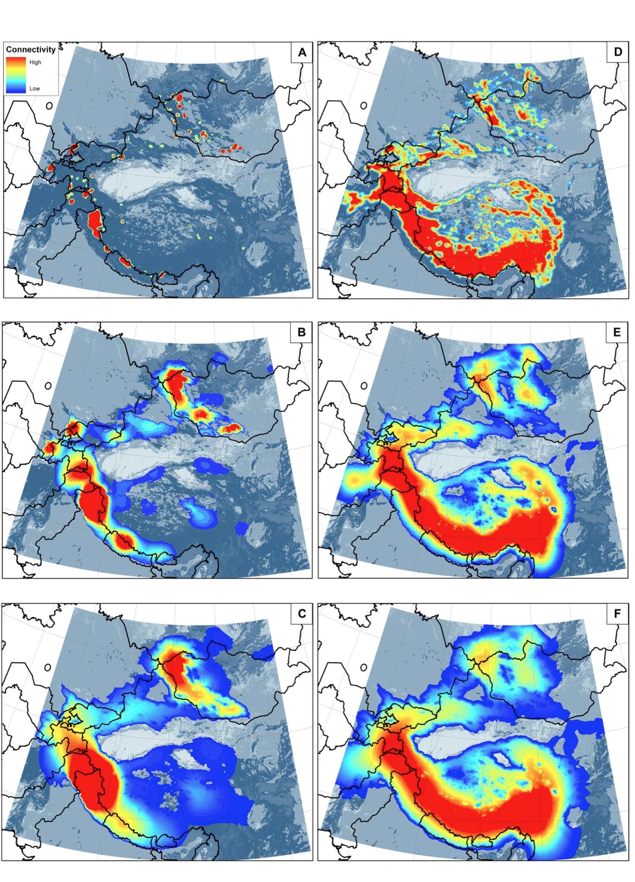
Notes:
All of the cumulative resistant kernel maps highlight a core connectivity zone for the global snow leopard population, located southwest of the QTP, through the west Himalaya, Karakorum, Pamir, and Tian Shan Mountain ranges
, through the west Himalaya, Karakorum, Pamir, and Tian Shan Mountain ranges (fig. 2). The cumulative resistant kernel maps show a second, lesser core area predicted in Altai-Sayan ranges in Mongolia and Russia.

Slide 25
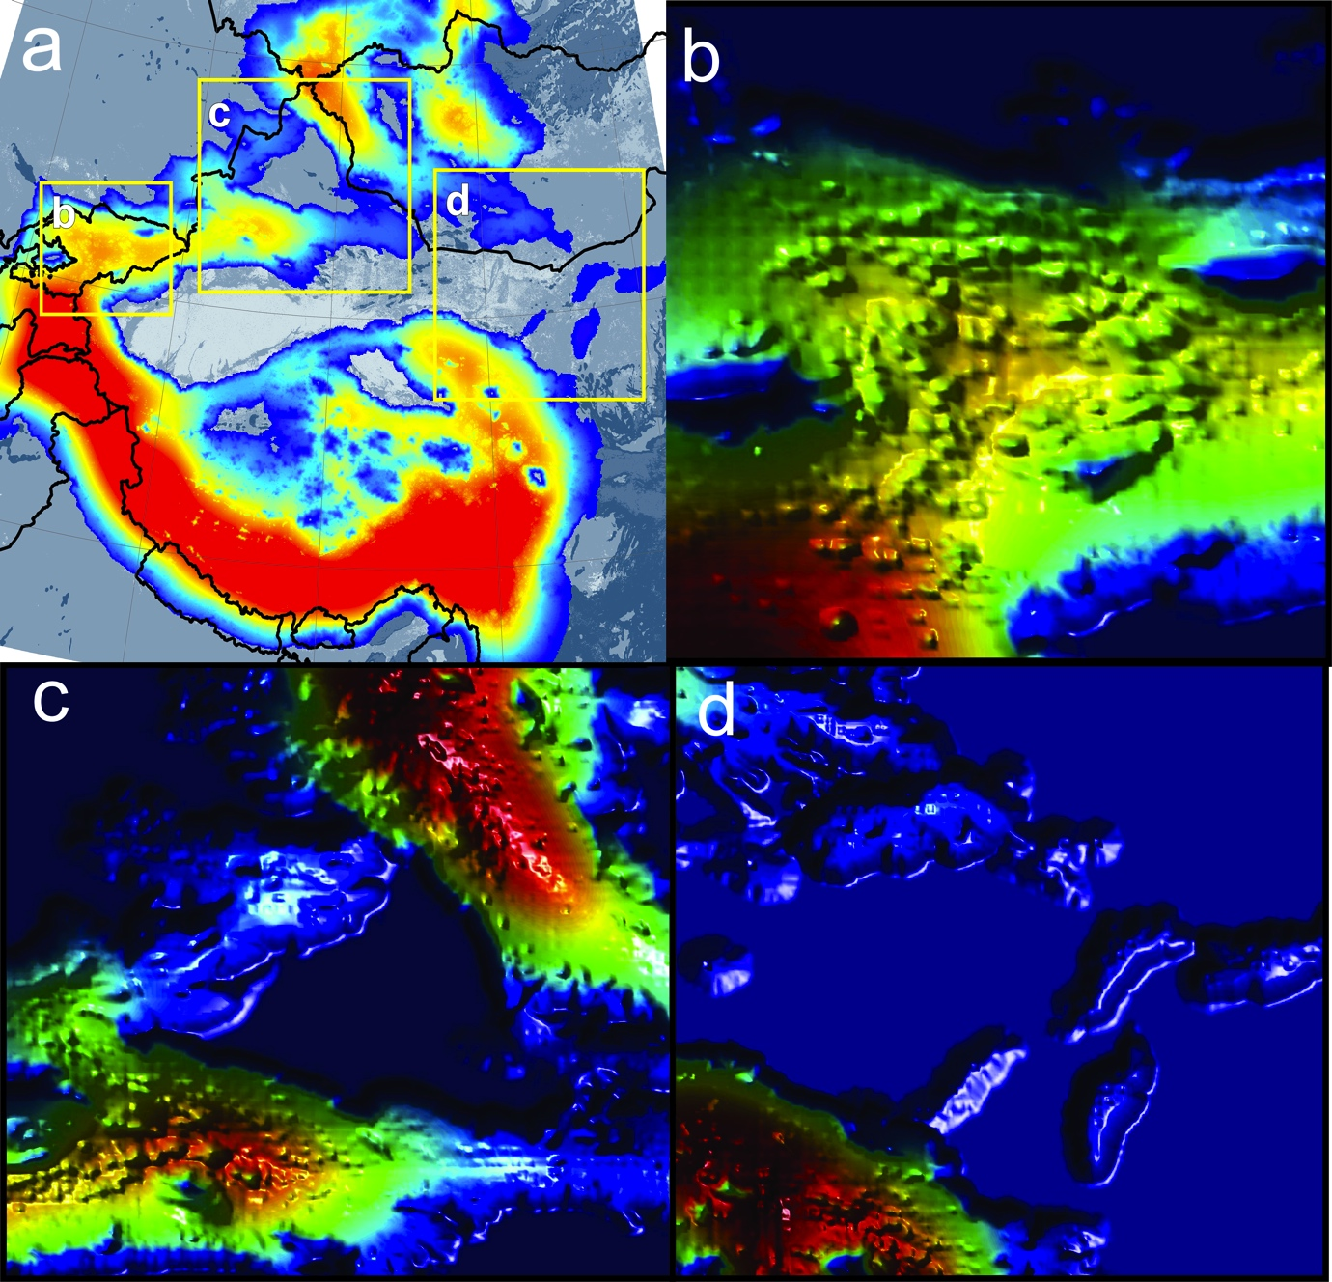
Notes:
linking the Altay Mountains to the Tien Shan Mountains along the Alatau and Tarbagatay Mountains to the west, and to the south along the Borohoro Range (fig. 3c). Under the 1000km dispersal scenario, potential range connectivity becomes apparent in the in the eastern edge of the range across the Gobi Desert (fig. 3d). The position of stepping stones across this point, including the Helan and Yin Mountains in China, may offer a link connecting the extant populations in the Tost Mountains in Mongolia with the Qilian Mountains in China.

Slide 26

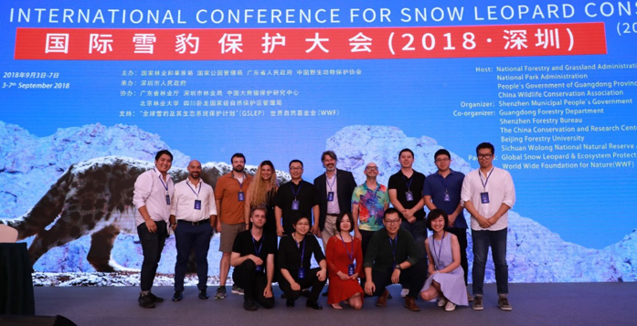
Trans-boundary initiatives
China also shares over 10,000km of national borders with 10 snow leopard range countries (Riordan and Shi, 2016)
Protected in China located on, or within approximately 10–30 km of, an international boundary
To continuous expand international cooperation and optimize international cooperation mechanisms
Discuss future cross-border cooperation actions in the South Gobi of Mongolia and Inner Mongolia of China, Pamirs, Altai, Himalayas and other border areas within SL range
Promote exchange between states and research/conservation institutions
Promote the exchange of information and the development of law enforcement mechanisms in the border trade zones of the states concerned
Facilitate information flows between the customs of the states concerned
Regularly assess the effectiveness of cross-border conservation
Notes:
and shares trans-boundary habitat with ten other range- countries for roughly 10,000 km

Slide 27
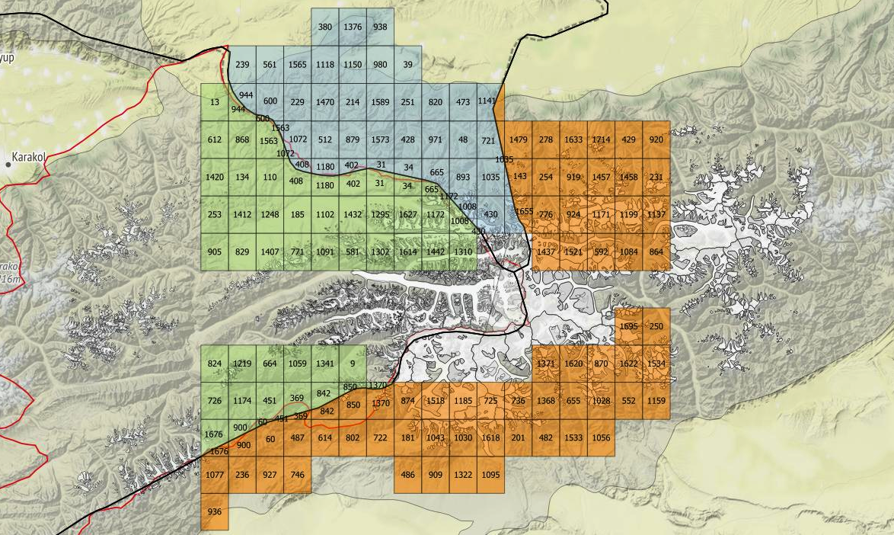
Proposed transboundary monitoring for snow leopard in Tomur (the peak of Tianshan Mountains) among China, Kazakhstan and Kyrgyzstana. Looking forward to resuming discussions on this valuable collaboration.

Slide 28
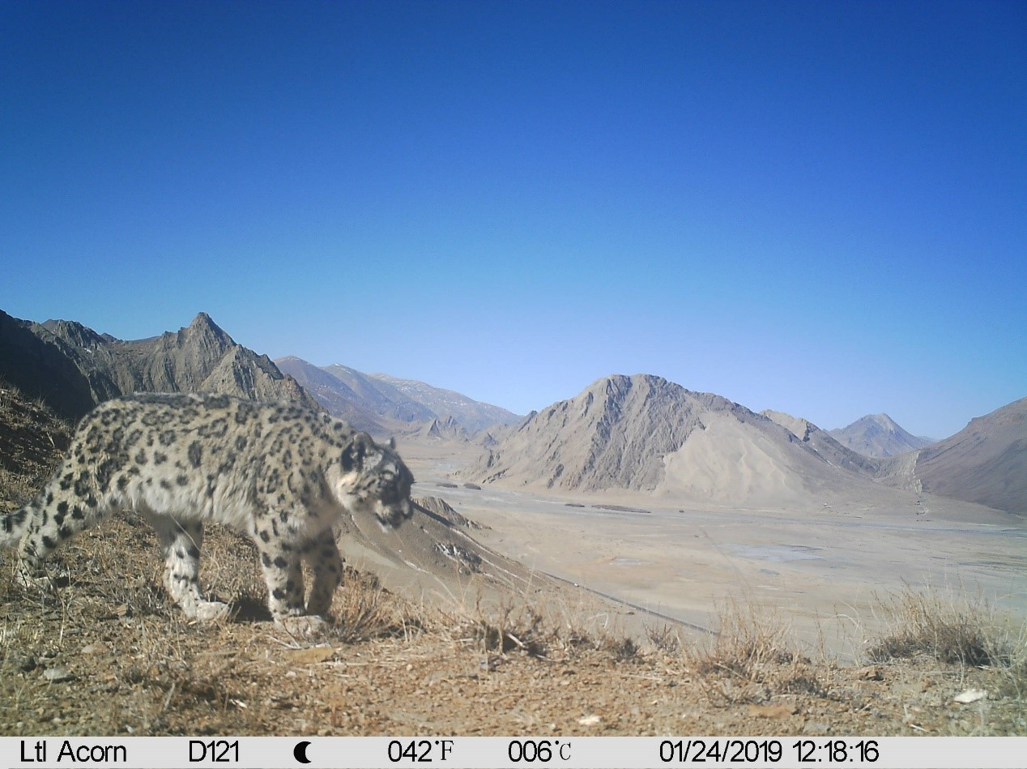
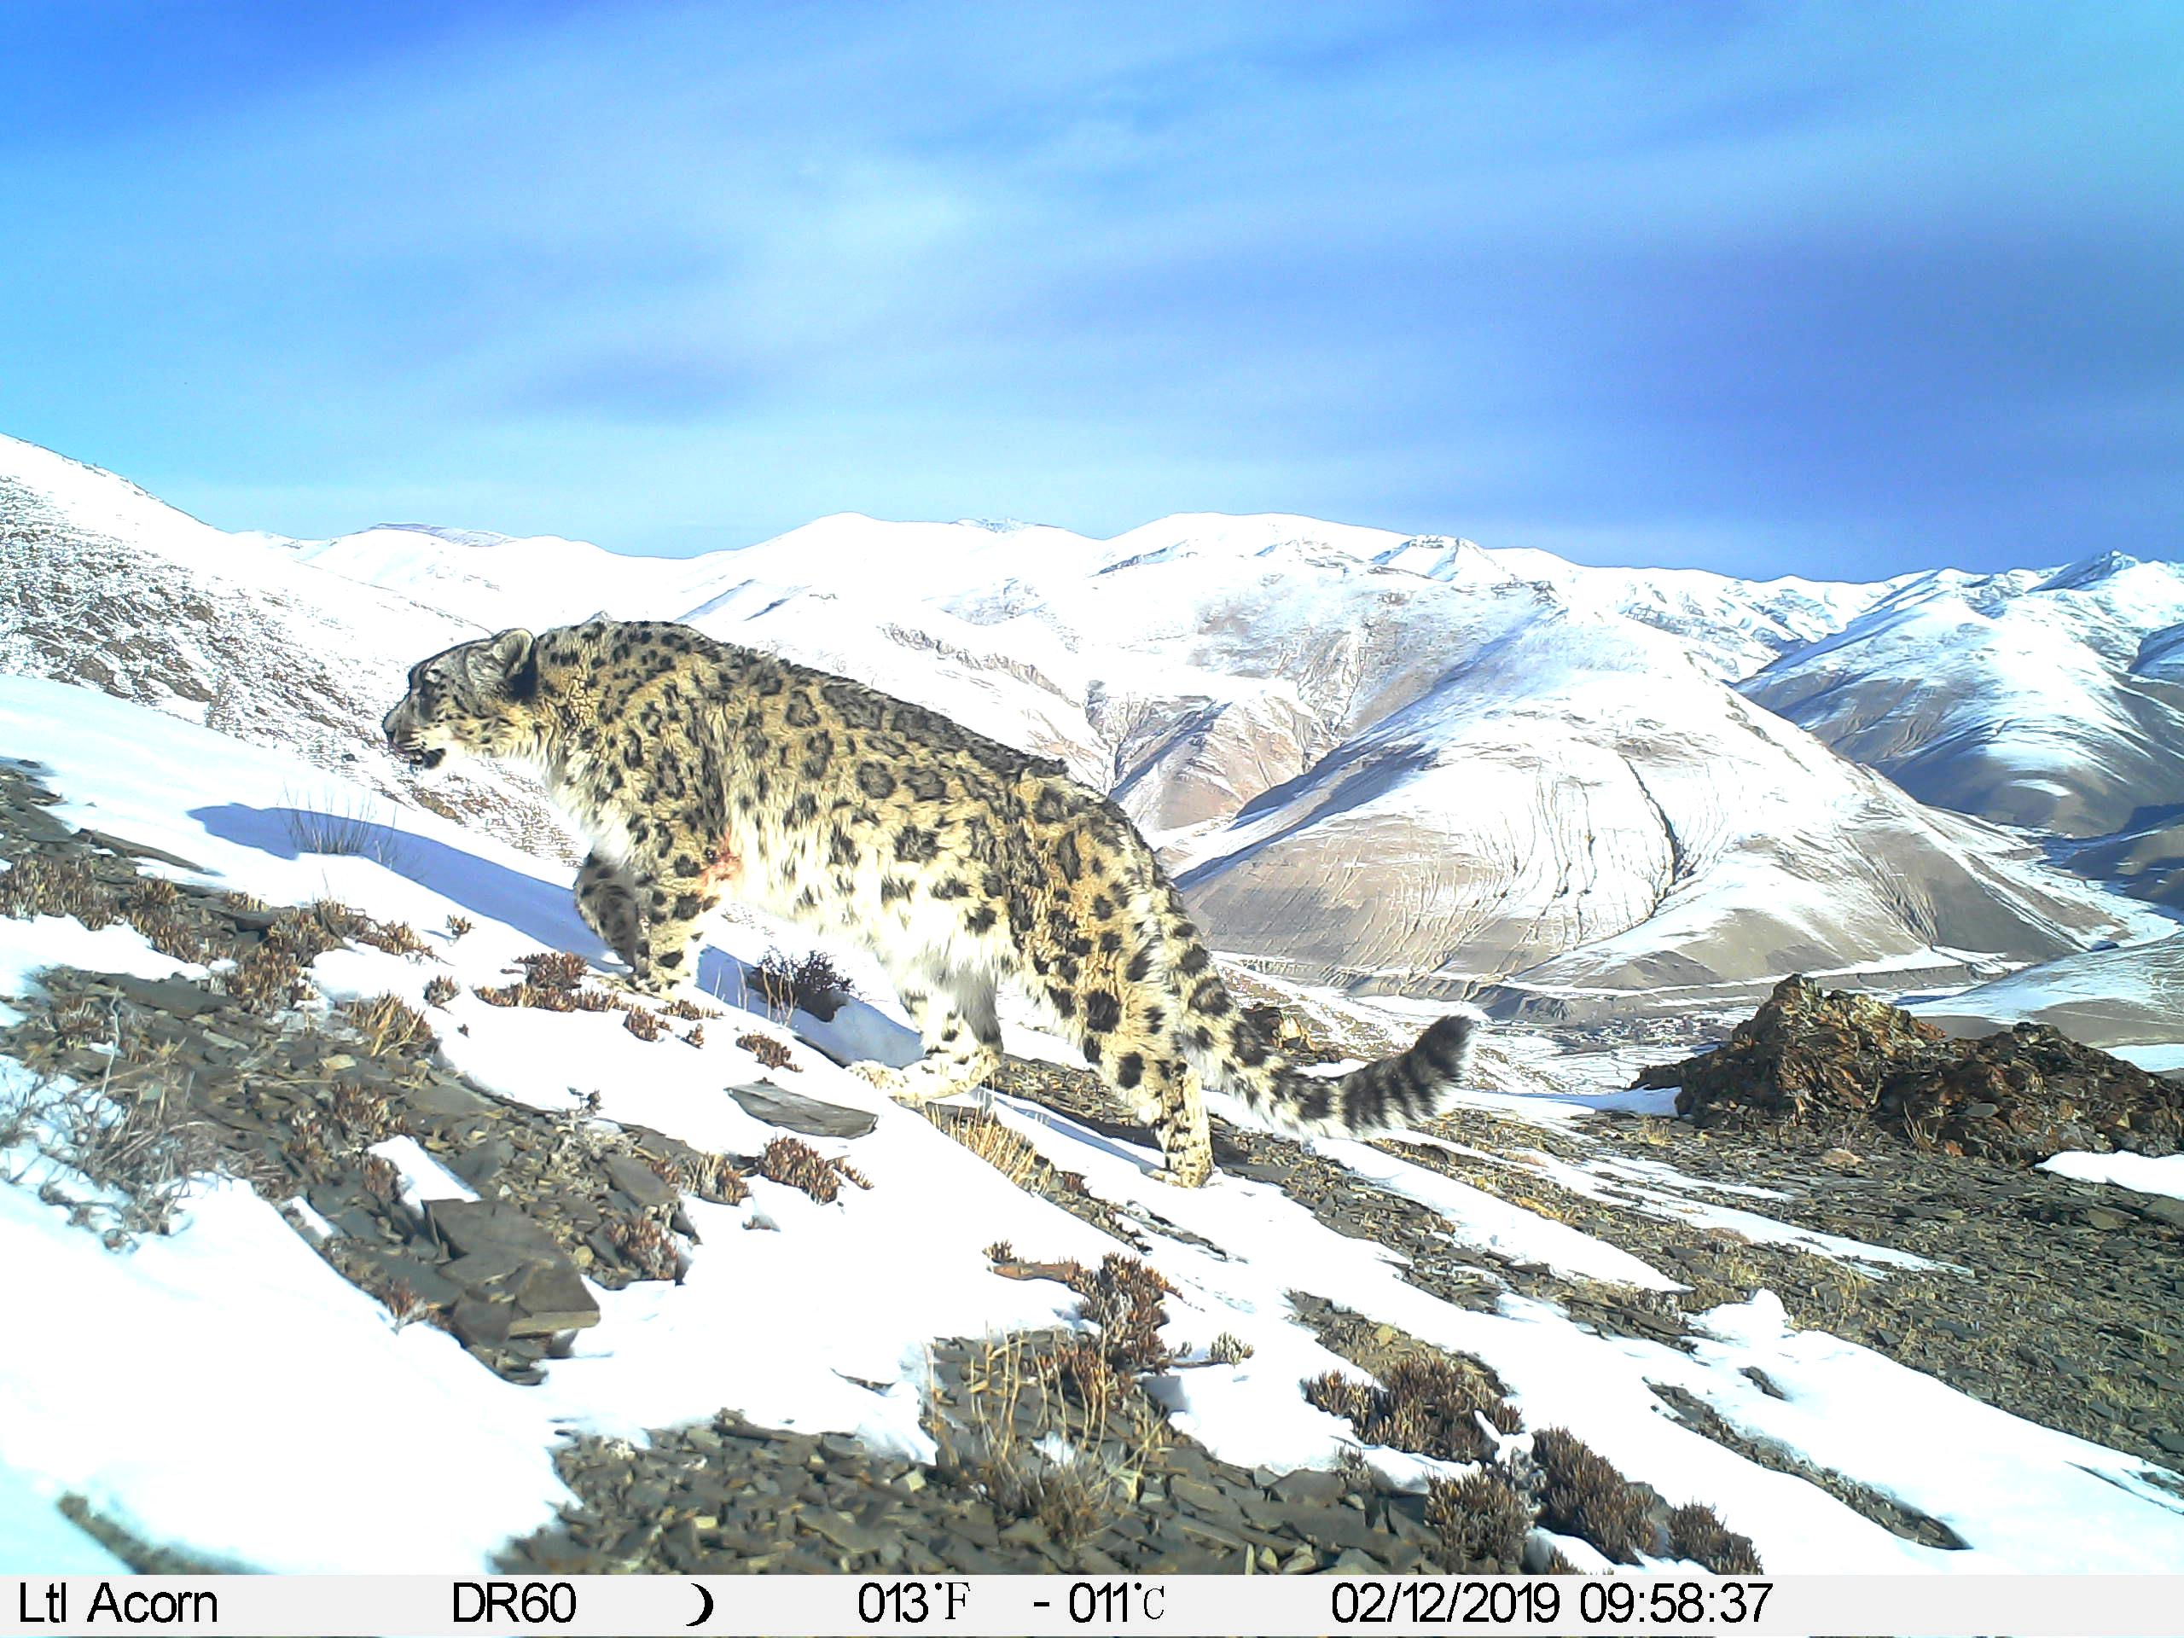




Next-step to continue fulfilling NSLEP
National Snow Leopard Population Survey :
  Conduct a nationwide survey of snow leopard populations.
  Complete surveys for 20% of suitable snow leopard habitats nationwide.
Enhancement of Protected Area Patrol and Monitoring Capabilities:
  Improve monitoring and management capabilities for patrols in protected areas.
  Establish monitoring systems for patrols in seven key protected areas.
Community-based Comprehensive Protection Demonstration Sites:
  Establish comprehensive protection demonstration sites in five communities.
Development of Key Snow Leopard Landscape Conservation Plans:
  Formulate comprehensive conservation plans for snow leopard landscapes in five key provinces/regions.
Establishment of Snow Leopard China Network:
  Create the Snow Leopard China Network to support harmonious development between humans and nature in China's high-altitude ecosystems.

Slide 29

Thank you all!

