Slide 1
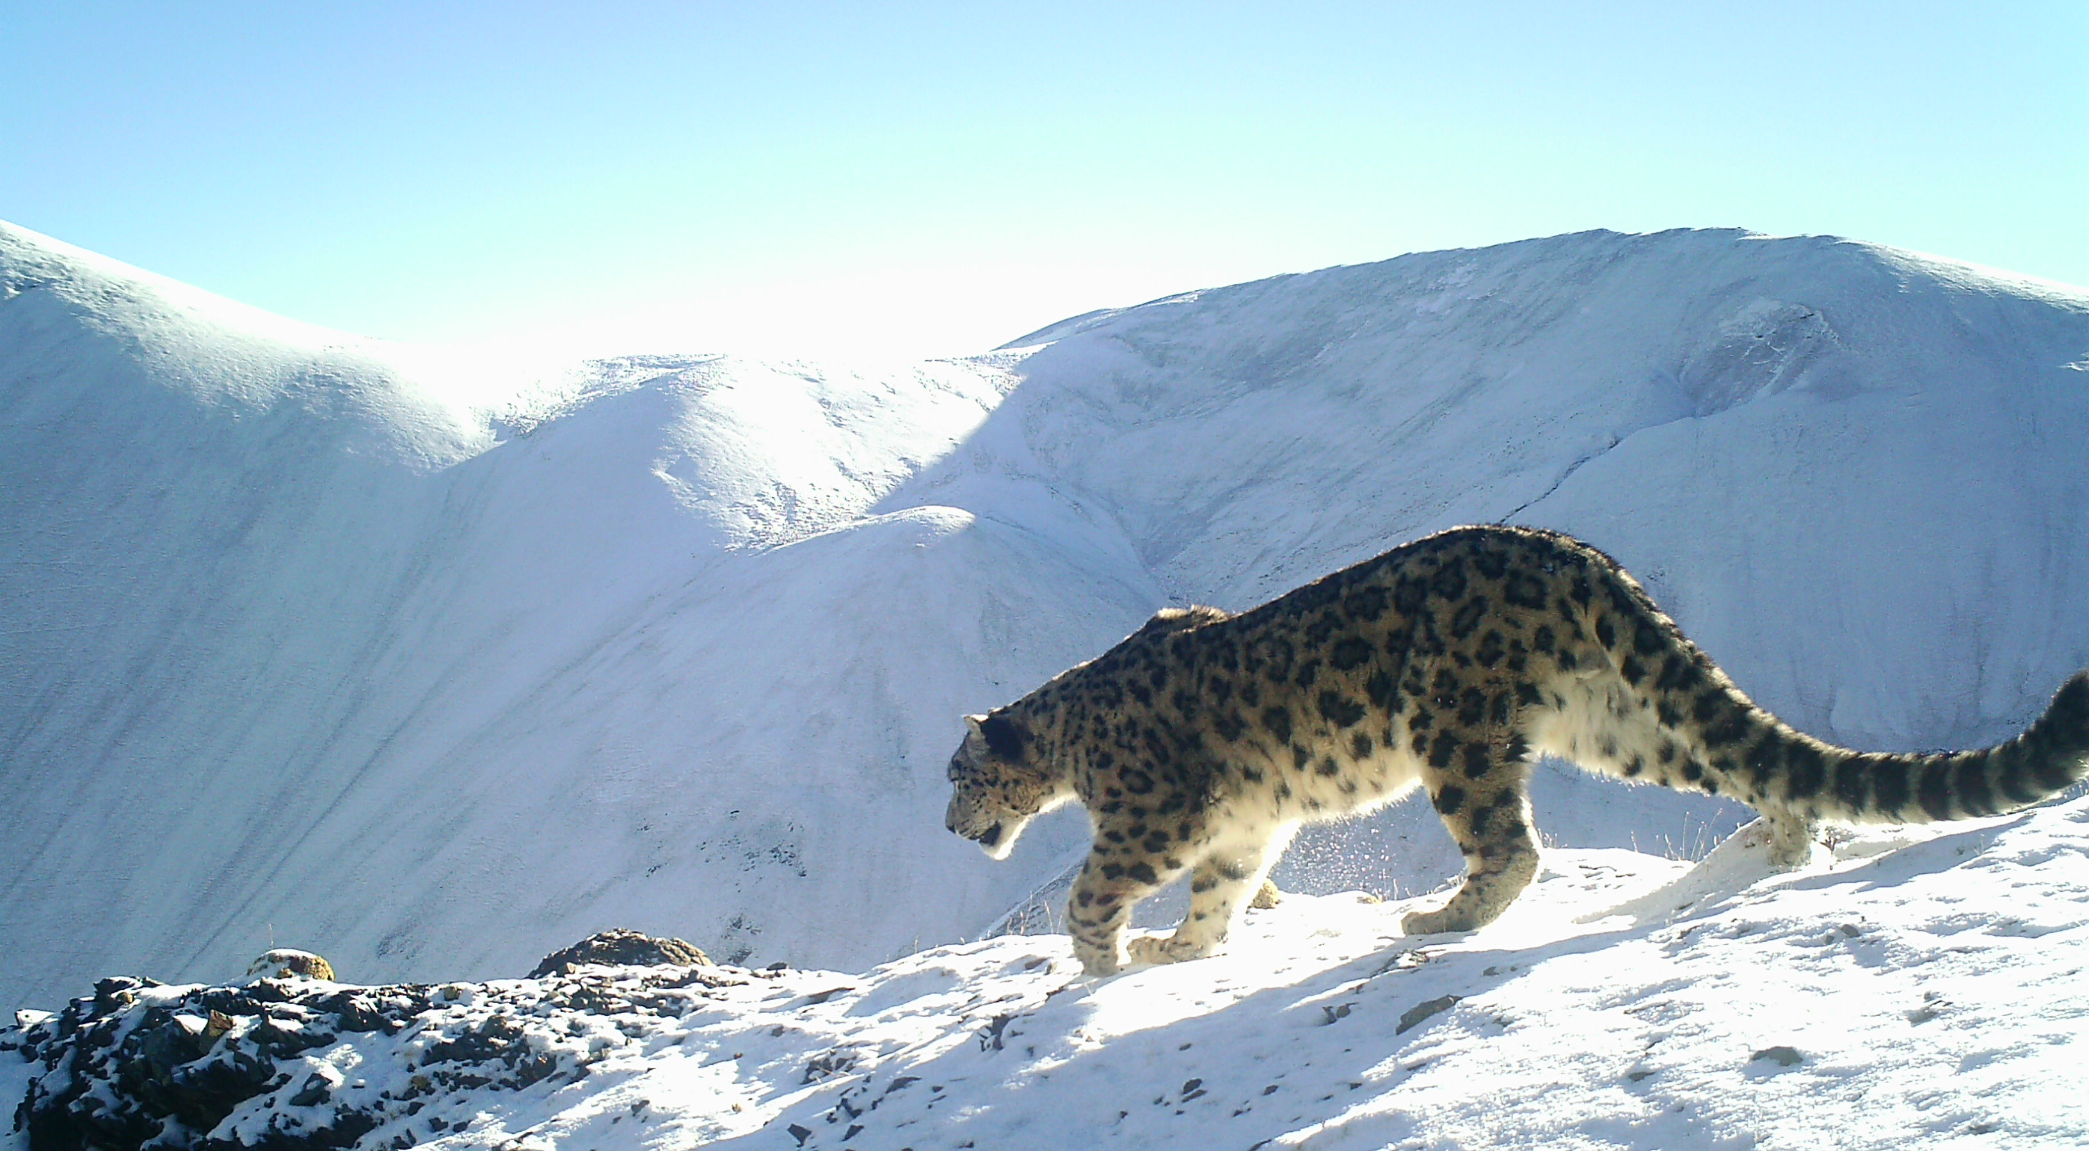
GSLEP program update Bhutan
VIII Steering Committee Meeting
February 10 – 11, 2024
Samarkand, Uzbekistan
Department of Forests & Park Services
Ministry of Energy & Natural Resources
Royal Government of Bhutan
Bhutan State of Snow Leopard 2024

Slide 2
Implementation status of the NSLEP (National Goals of GSLEP)
Nationwide Snow Leopard Survey-I (2015-2016)
Snow leopard Conservation Action Plan for Bhutan (2018-2023)
Goal: To maintain a viable population of snow leopards in Bhutan with
ecological links to snow leopards in the eastern Himalayan
mountain landscape.
Target 1: By 2023, Snow leopard populations in Bhutan are stable or
increasing.
Target 2: By 2023, important snow leopard habitat mapped and secured
for conservation to ensure ecological and demographic
connectivity of snow leopard population.
Target 3: By 2023, over 80% of the local communities are engaged as
willing conservation stewards of snow leopards, prey
species and habitat.
Notes:
-Please refer to the respective NSLEP docs and provide status of each target/goal set therein;
-Describe how you plan to achieve the goals/targets not or partially achieved with a proposed timeline;
-Add slides to report all the targets/goals

Slide 3
Progress:
Nationwide Snow Leopard Survey-I (2015-2016) – 96 individuals
Snow leopard Conservation Action Plan for Bhutan (2018-2023) prepared with 8 objectives, 19 outputs, 54 actions under 3 targets.
Status:
45 action achieved (83.33%) and 9 were not achieved (16.67%).
Estimated budget BTN 255 million (USD 3.2 million)
Implemented almost 80% of the action plan
Funding gap of over 30% of total cost

Slide 4
Resource mobilization
Bhutan for Life Transition Fund
Total Project
US$ 118M
Internal (RGoB)-63%
External (conservation project)-37%
Bhutan for Life - estimates of funding to fill financial gap for 14 years (Total Project US$118m).
$43 M donations
Gap in RGoB financing
Future plans: * Enhancing community based ecotourism.
* Secure fund to implement 2nd snow leopard conservation action plan (2024-2033) which estimate BTN 300m (US$ 3.9m)
$0.5 M/year Bhutan Trust Fund
$2.9 M/year existing
Bhutan Govt. internal funding

Slide 5
Threats to Snow Leopards, their Ecosystems, and Local Livelihoods
Climate change: global threat to ecosystems & human communities
Human-wildlife Conflict: livestock depredation
Habitat degradation: shifts in vegetation, shrubs overtaking, alpine
habitat shrinks, grazing competition, NWFP collection.
Disease & feral dogs: transmission of diseases
Proposed strategy: Snow leopard Conservation Action Plan for Bhutan 2024-2033 – this will be achieved through strategic actions grouped under 4 objectives, 10 strategies and 53 actions with fund estimate of BTN 300m (3.9 US$).

Slide 6
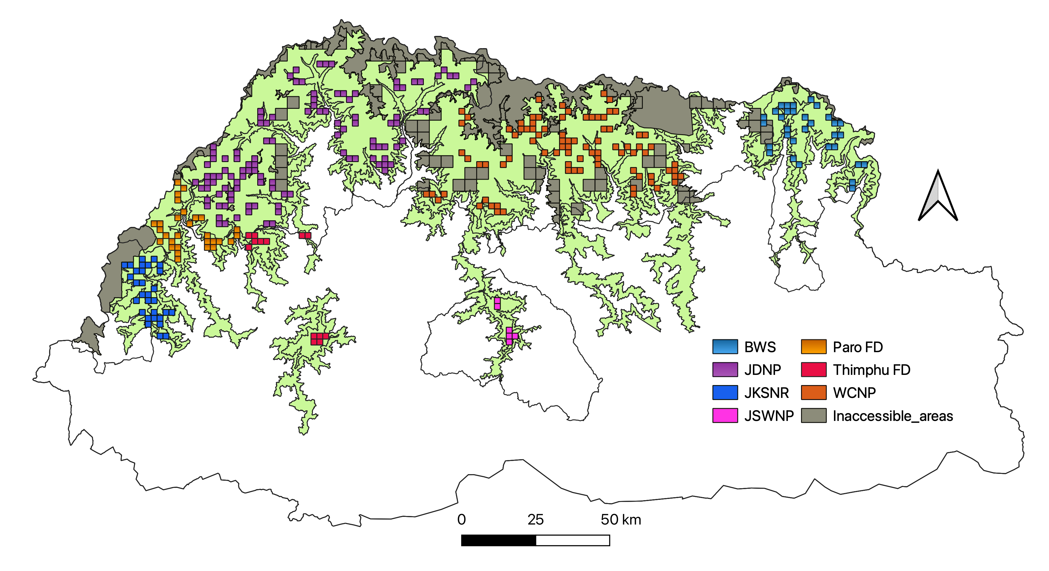
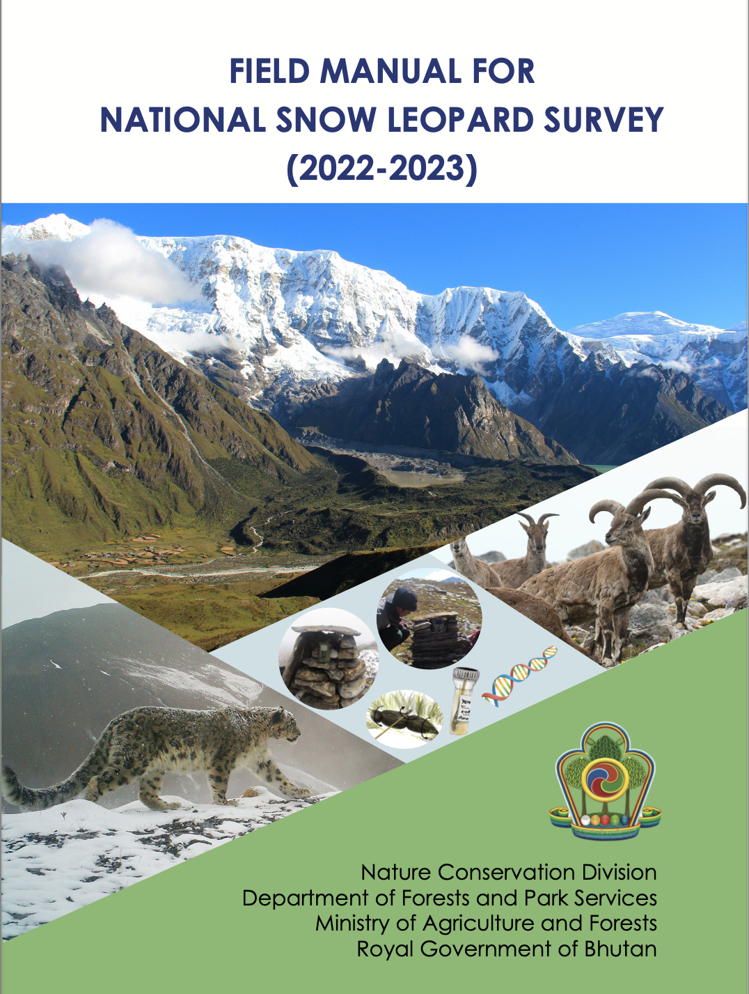
Snow Leopard Population Survey-II
NSLS-II (2022-2023)-Updated status of snow leopards through camera trapping based on PAWS protocols.
Current population
Distribution pattern
Spatial coverage: ~10,000 km² in the potential snow leopard habitats of JKSNR, JDNP, WCNP, BWS, JSWNP, Paro and Thimphu Forest Division (3600m – 5090m).
310 grids of 2x2 km grid, 620 camera traps from Aug till Dec 2022, by 90 rangers with fund of US$ 0.55m
Snow leopard scats were also collected.

Slide 7
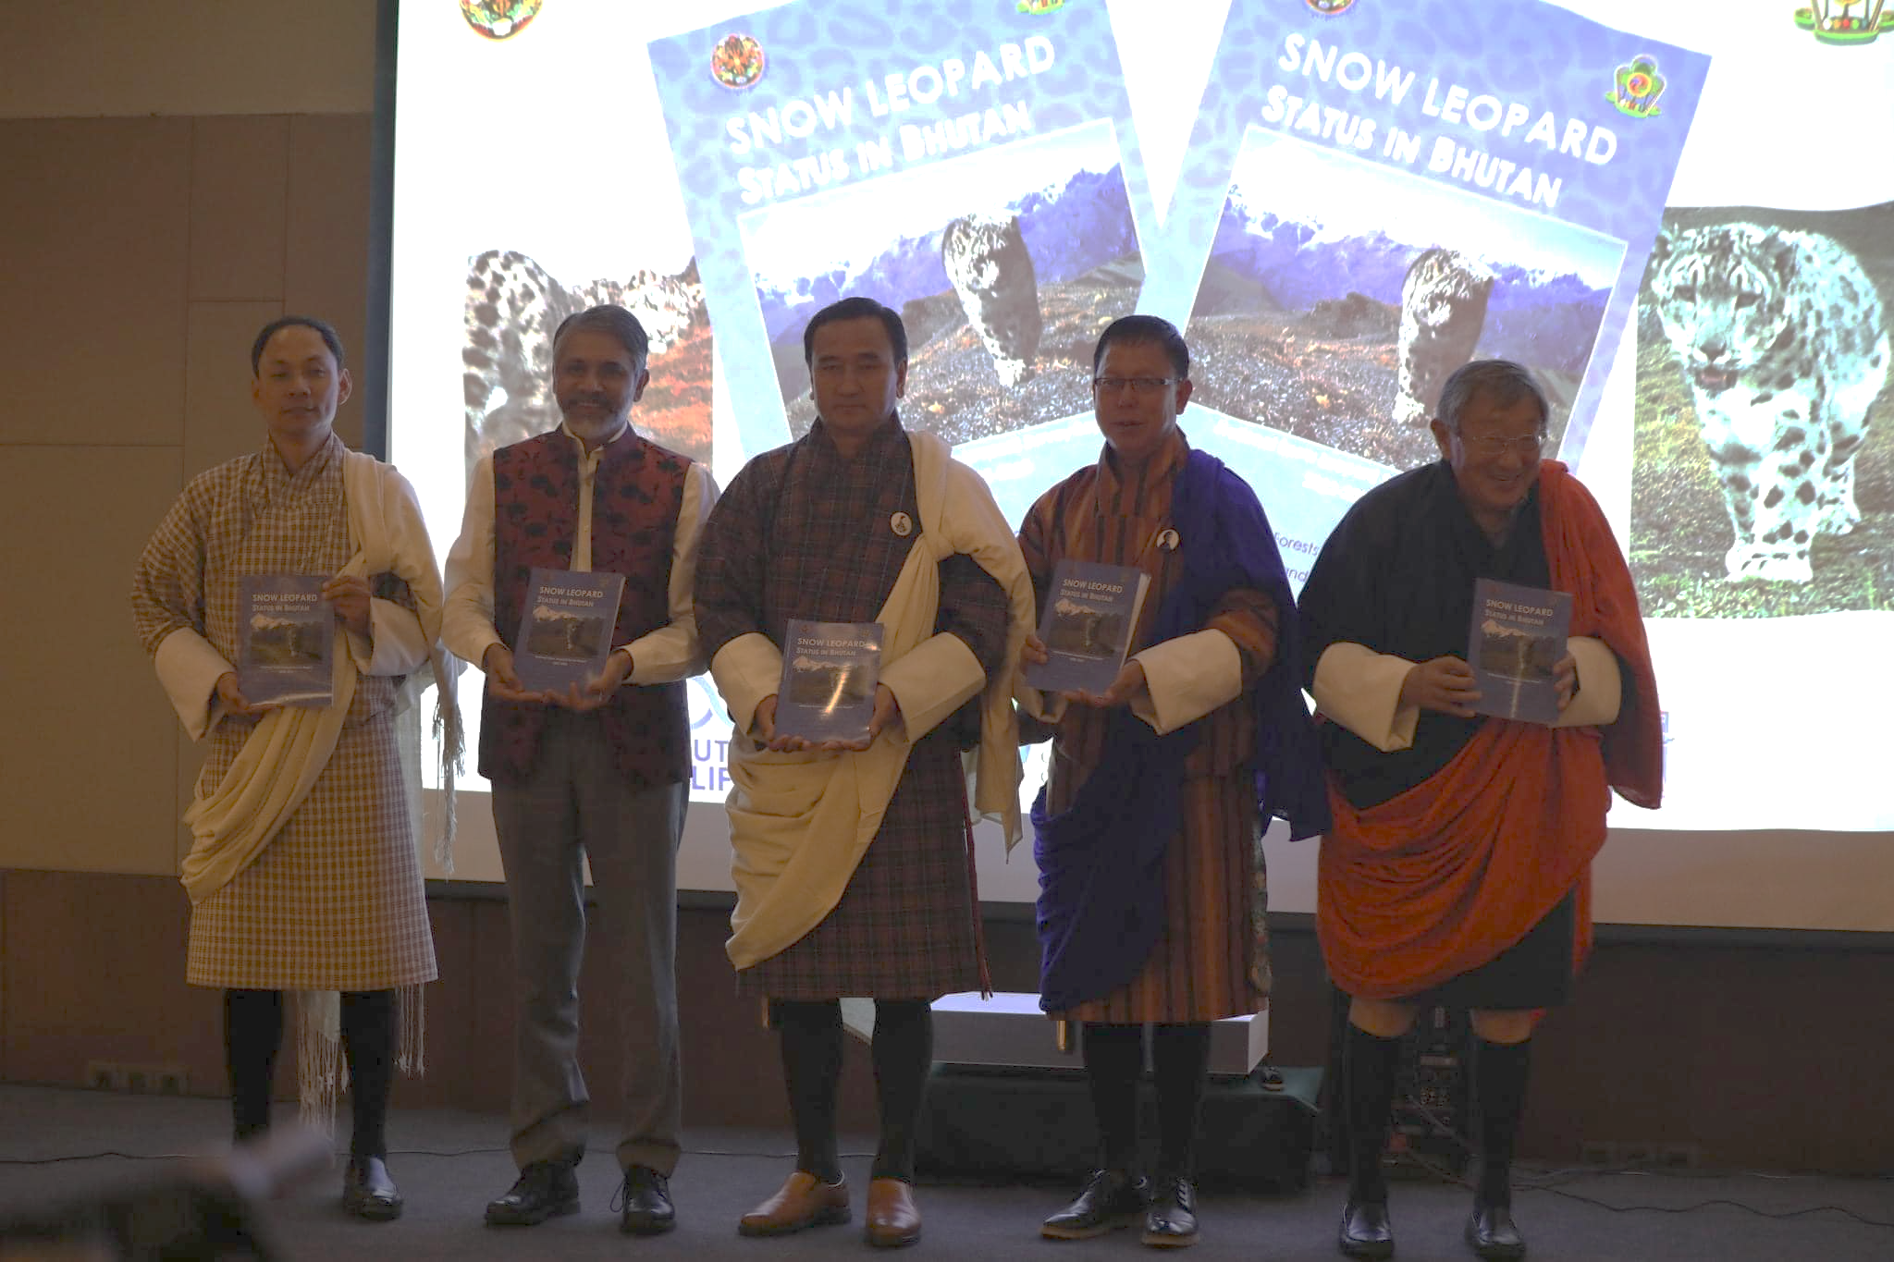
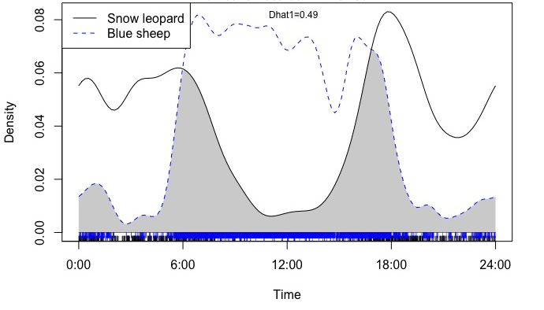
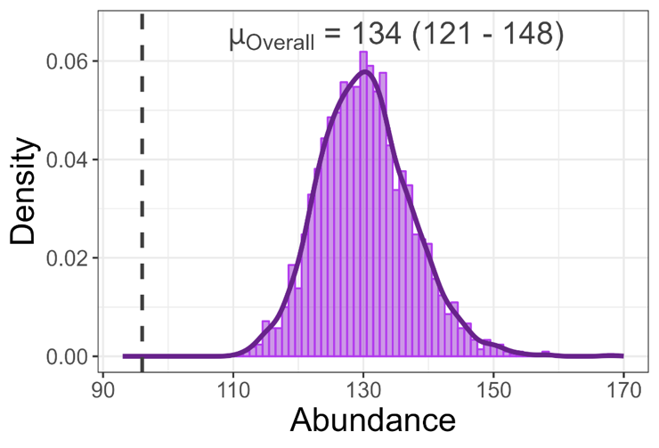
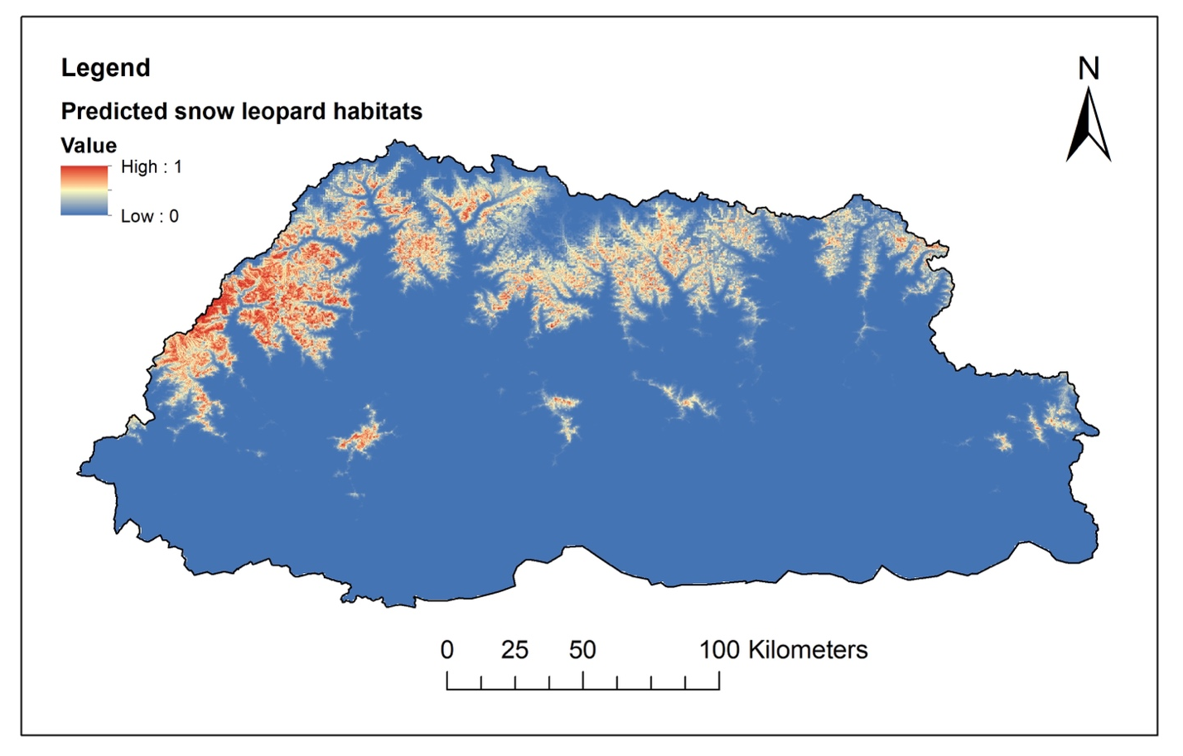
Snow Leopard population in Bhutan
Report: NSLS-II report launched on 16th September, 2023.
Estimated: 134 individuals (SD ± 706).
Density: 1.34 snow leopards per 100 km² (SD ± 0.071).
Occupancy: 43.25% (SE±4.09)
This is an increase of snow leopard population in Bhutan by 39.5% from the baseline population of 2016 where 96 (SD ± 8) individuals were estimated.
Activity patterns & capture history
Snow leopard Habitat suitability
Gaps and needs

Slide 8
Inputs for the Report:
Dr Ian Durbach,
Dr Koustubh Sharma, and
Dr Justine Shanti Alexander of the PAWS initiatives under the GSLEP for their invaluable contribution in designing the survey and reviewing the report.

Slide 9
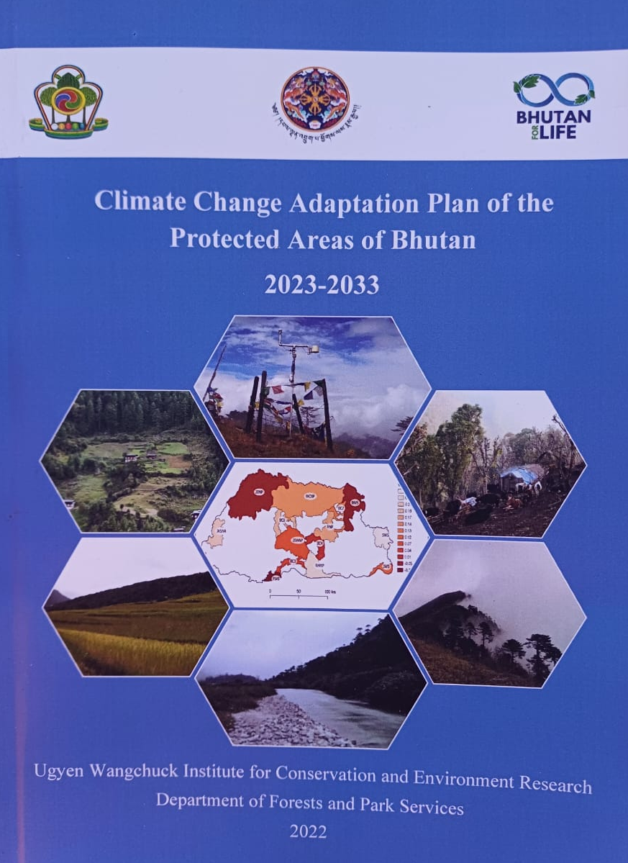
Climate Adaptations/Nature-based Solutions
Climate Vulnerability & Capacity Analysis (CVCA) Report 2022.
Bhutan adopted the Climate Change Policy of the Kingdom of Bhutan 2020.
Climate adaptation for biodiversity & local communities:
SMART Green Infrastructure
Socio-economic resilience
Future resilience
Ecosystem services
Gaps and needs: Require additional resources to reduce knowledge gap and implement National Adaptation Plan

Slide 10
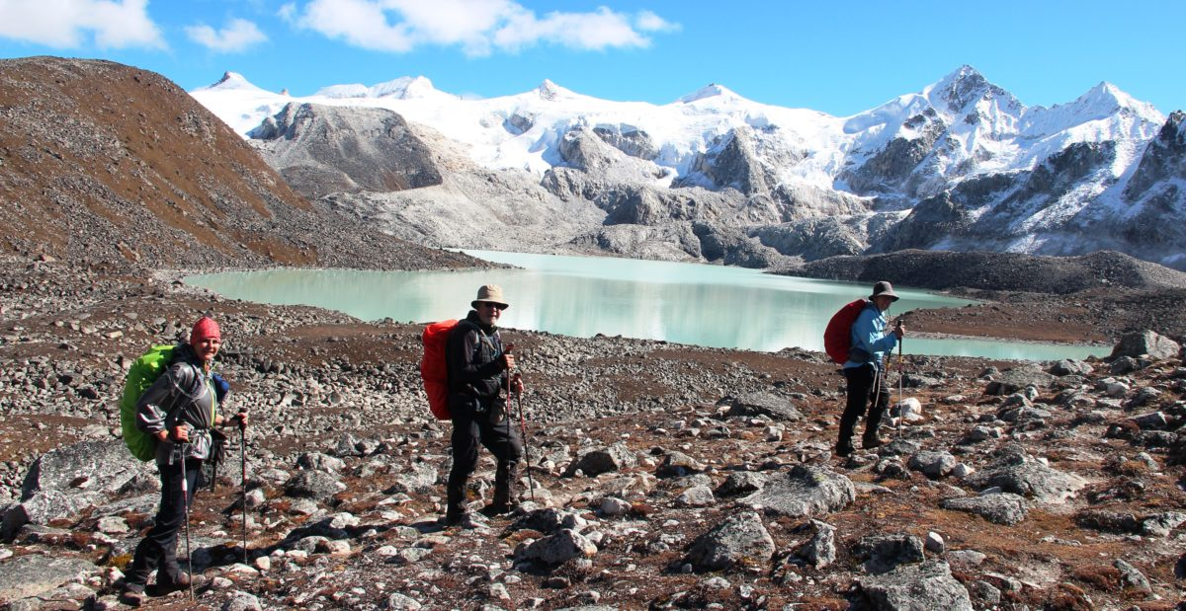
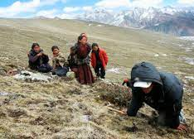
Green economy interventions
Promoting ecotourism (trek routes, camping sites, mountain festival, farm house, capacity building)- Snowman Trek/Race.
Sustainable resource management- High altitude medicinal and aromatic plants

Slide 11
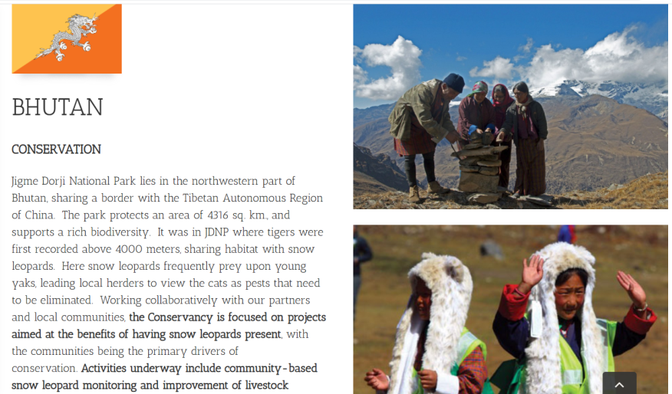
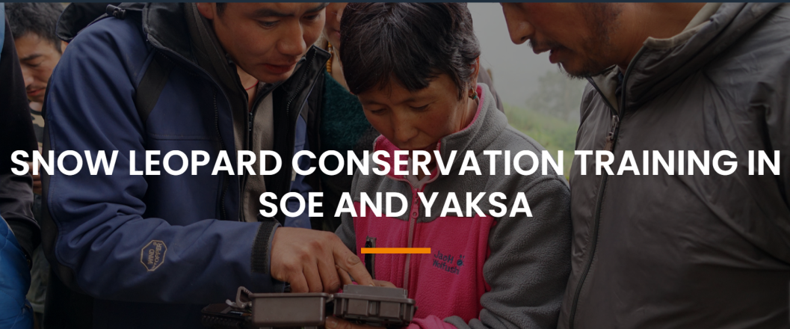
Community-based conservation initiatives
Snow Leopard Conservation group in JDNP
Highland festivals for community engagement
& ecosystem services.

Slide 12
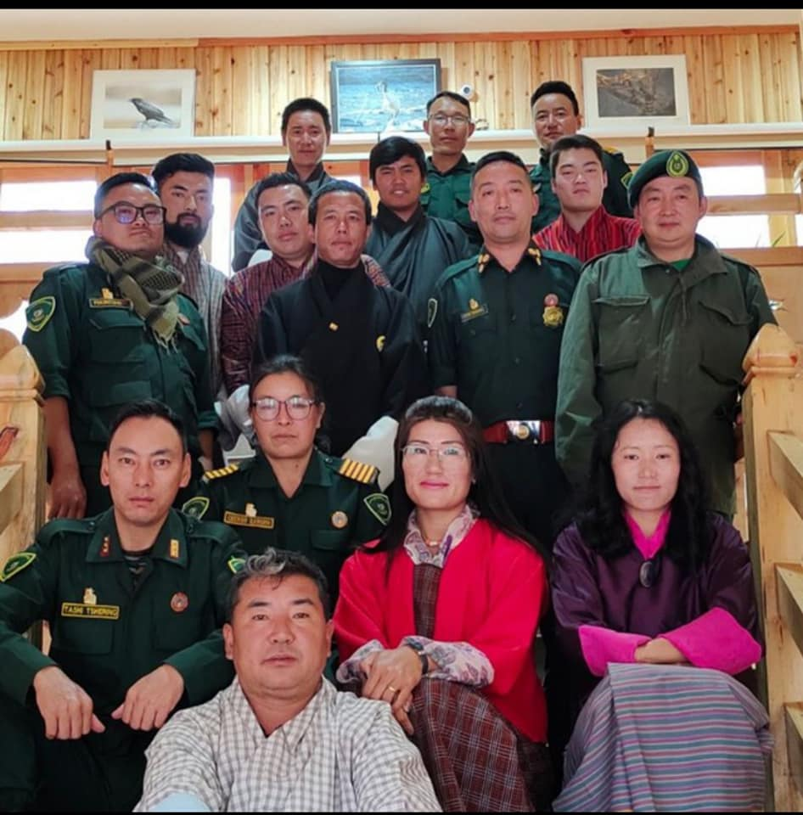
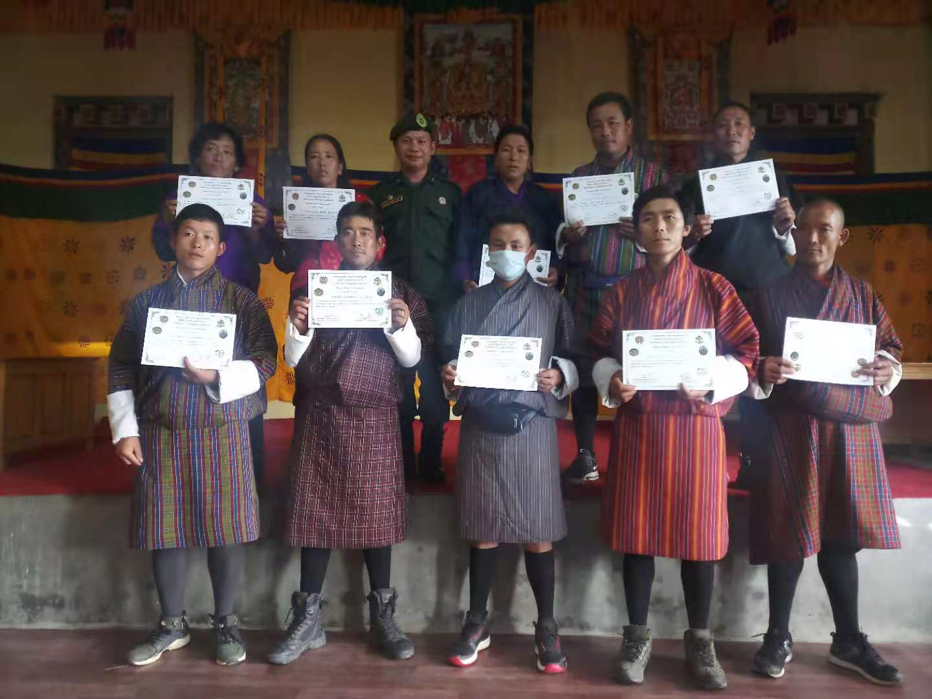
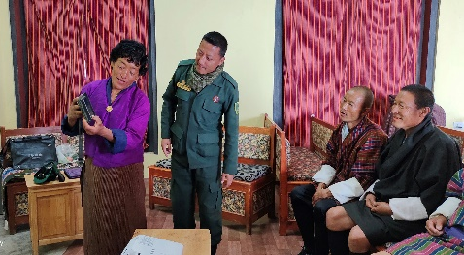
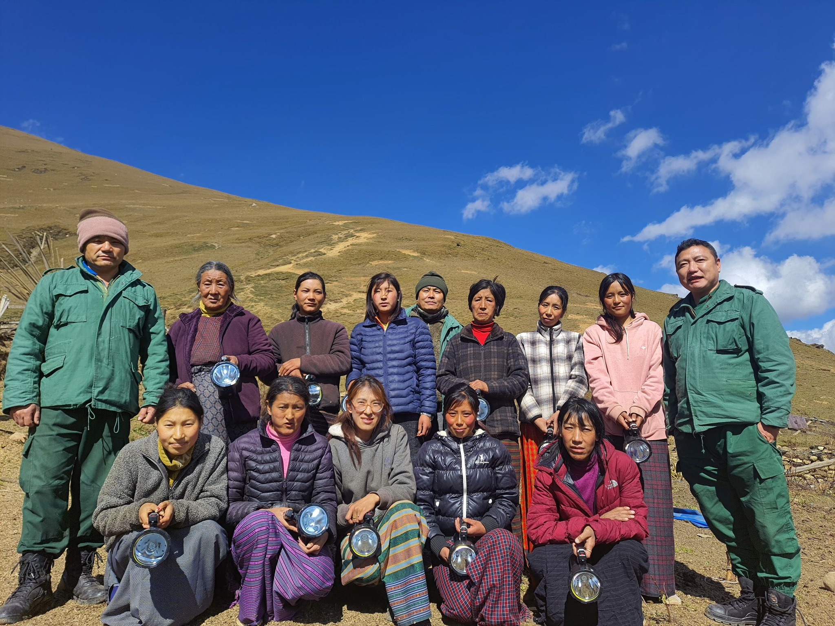
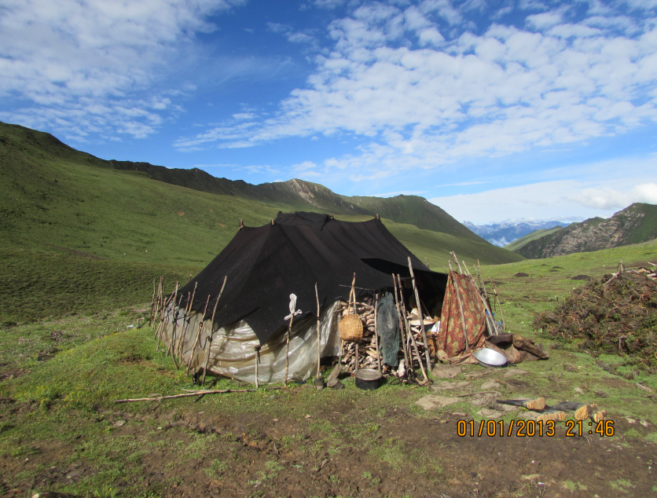
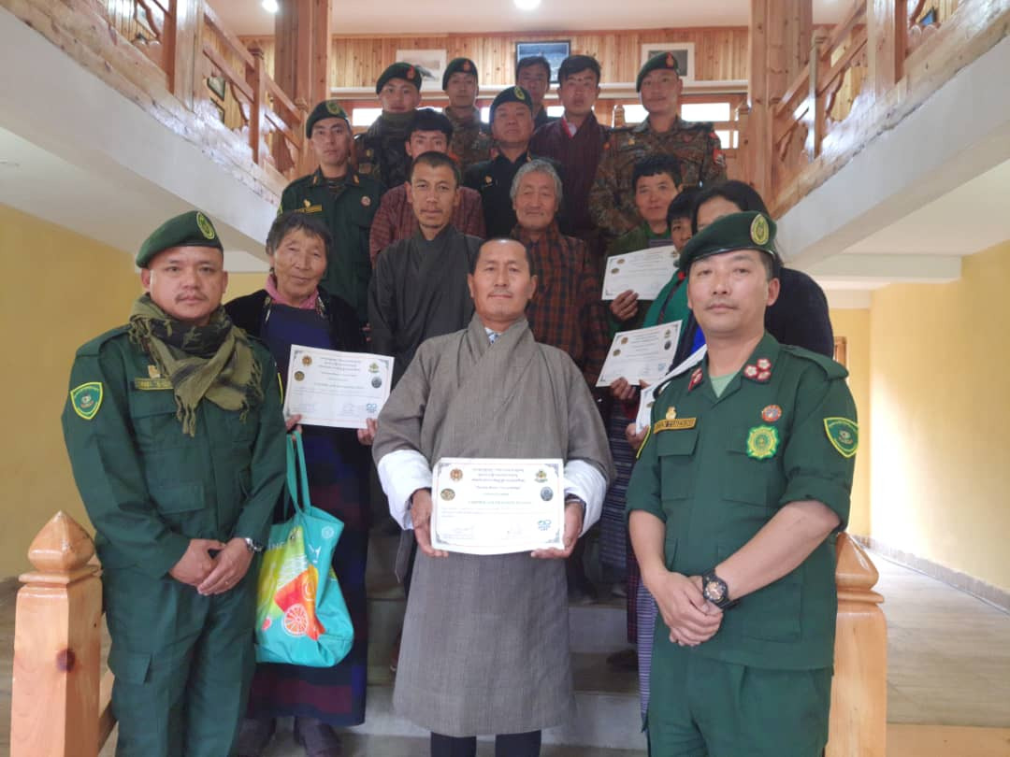
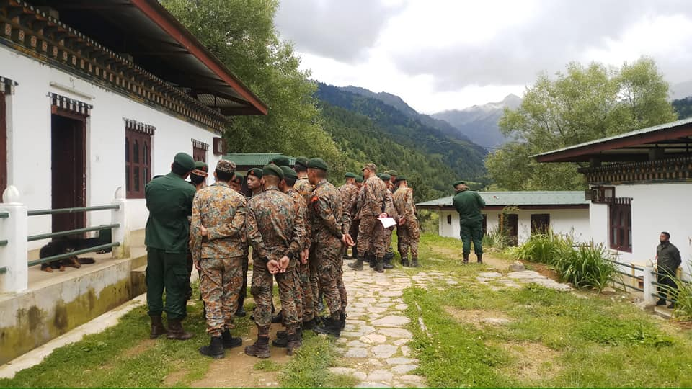
Community Rangers as Citizen Scientists Group in JKSNR
Conservation Partner initiative with Royal Bhutan Army in Haa
Friends of Nature – Local Nature Guide
Women Snow leopard Conservation Group in Paro
Quick Response Team in all Snow leopard range areas
Gap: Require adequate compensation and incentives for yak herders

Slide 13
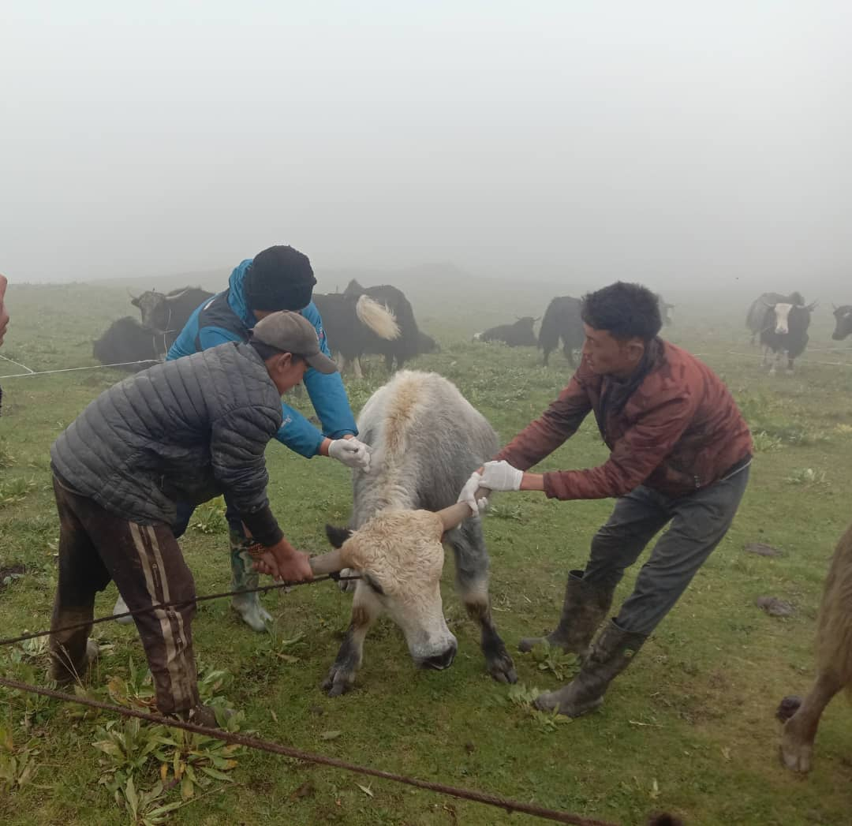
Management & monitoring of disease systems
Bhutan One Health Strategy: A multi-sectoral approach to protecting the health of humans & animals.
Wildlife Health Strategy – Surveillance of disease outbreak.
Quick Response Team - Monitoring and management of disease outbreak in livestock & wildlife.
Initiated “Nationwide Accelerated Dog Population Management and Rabies Control Programme”.
Nationwide vaccination for Lumpy skin diseases.
Gaps: Limited technical capacity and resources

Slide 14
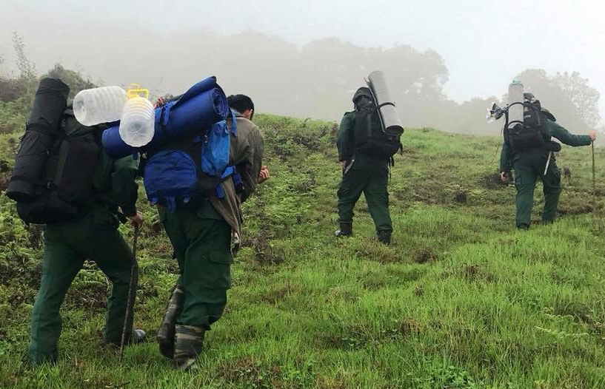
Disrupting illegal wildlife trade in the country
Record no cases on poaching and illegal trade of snow leopard.
Records indicate merely three instances of retaliatory killing of snow leopards, likely due to the absence of a compensation scheme.
Measures:
Strengthening protection & Law enforcement:
- SMART Patrolling rolled out at national level.
- FNCA 2023 (Chapter 5: 87, 91) – Listed under
Schedule I
- FNCRR 2023 (Offence & Penalty)

Slide 15
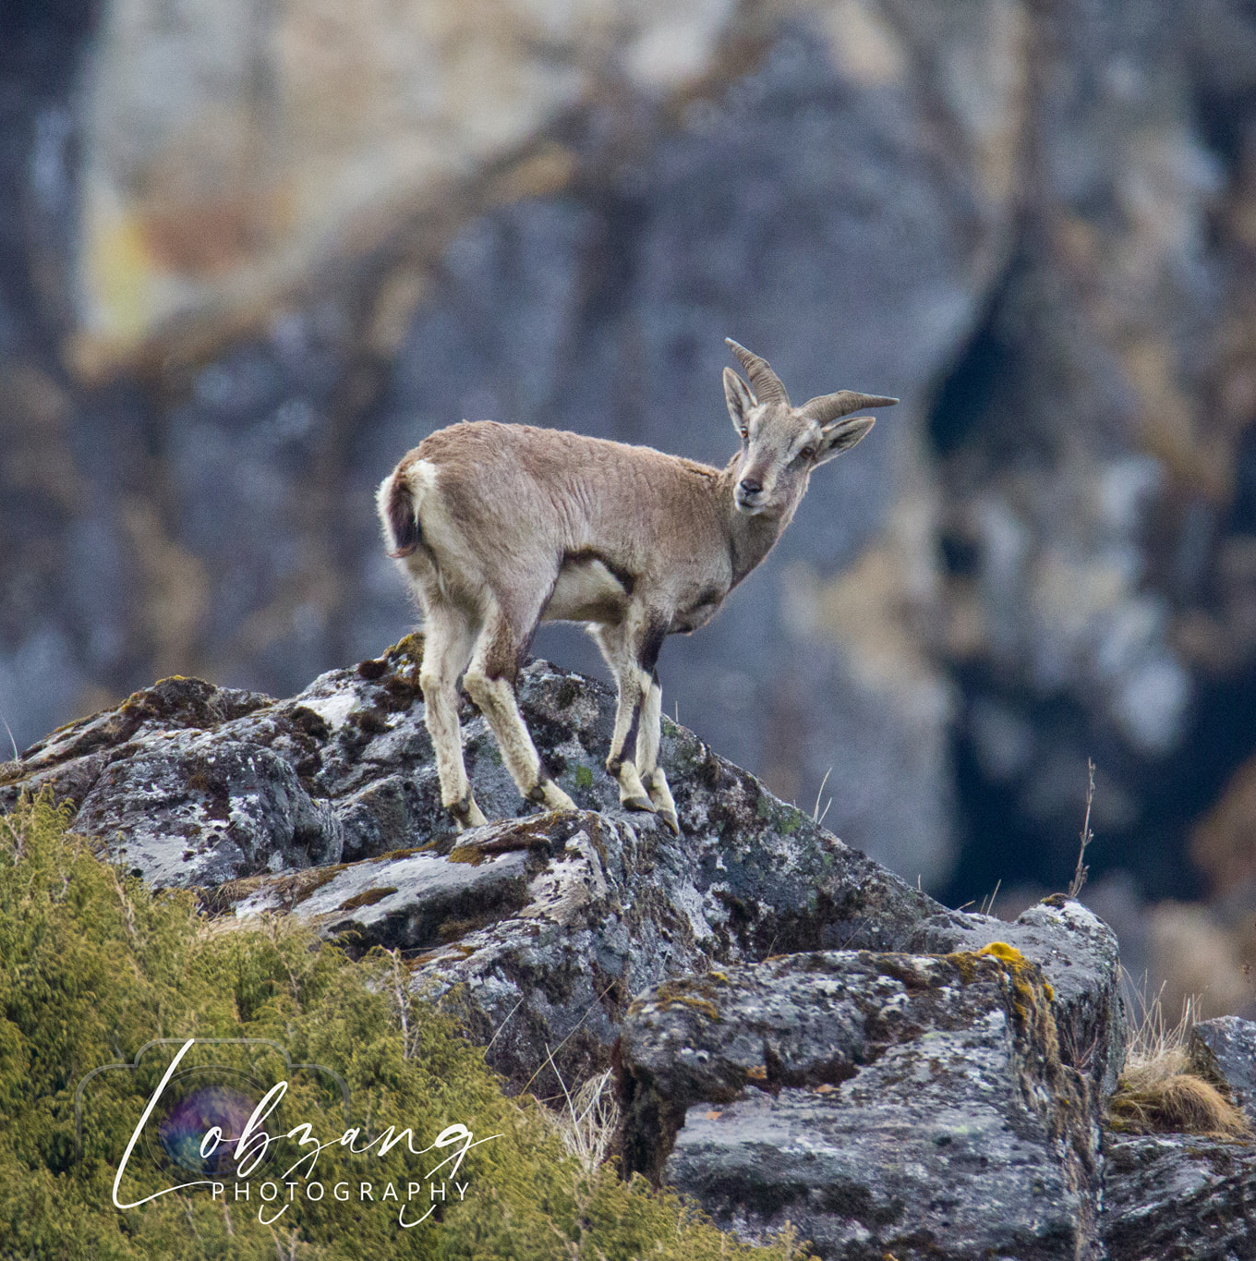
Managing Infrastructure initiatives in snow leopard landscape
No major infrastructure development/project implemented in Snow leopard landscape.
No motorable roads inside snow leopard landscape.
All major developmental activities in Bhutan are require environmental clearance, forestry clearance, EIA, ESSG and EMP.

Slide 16
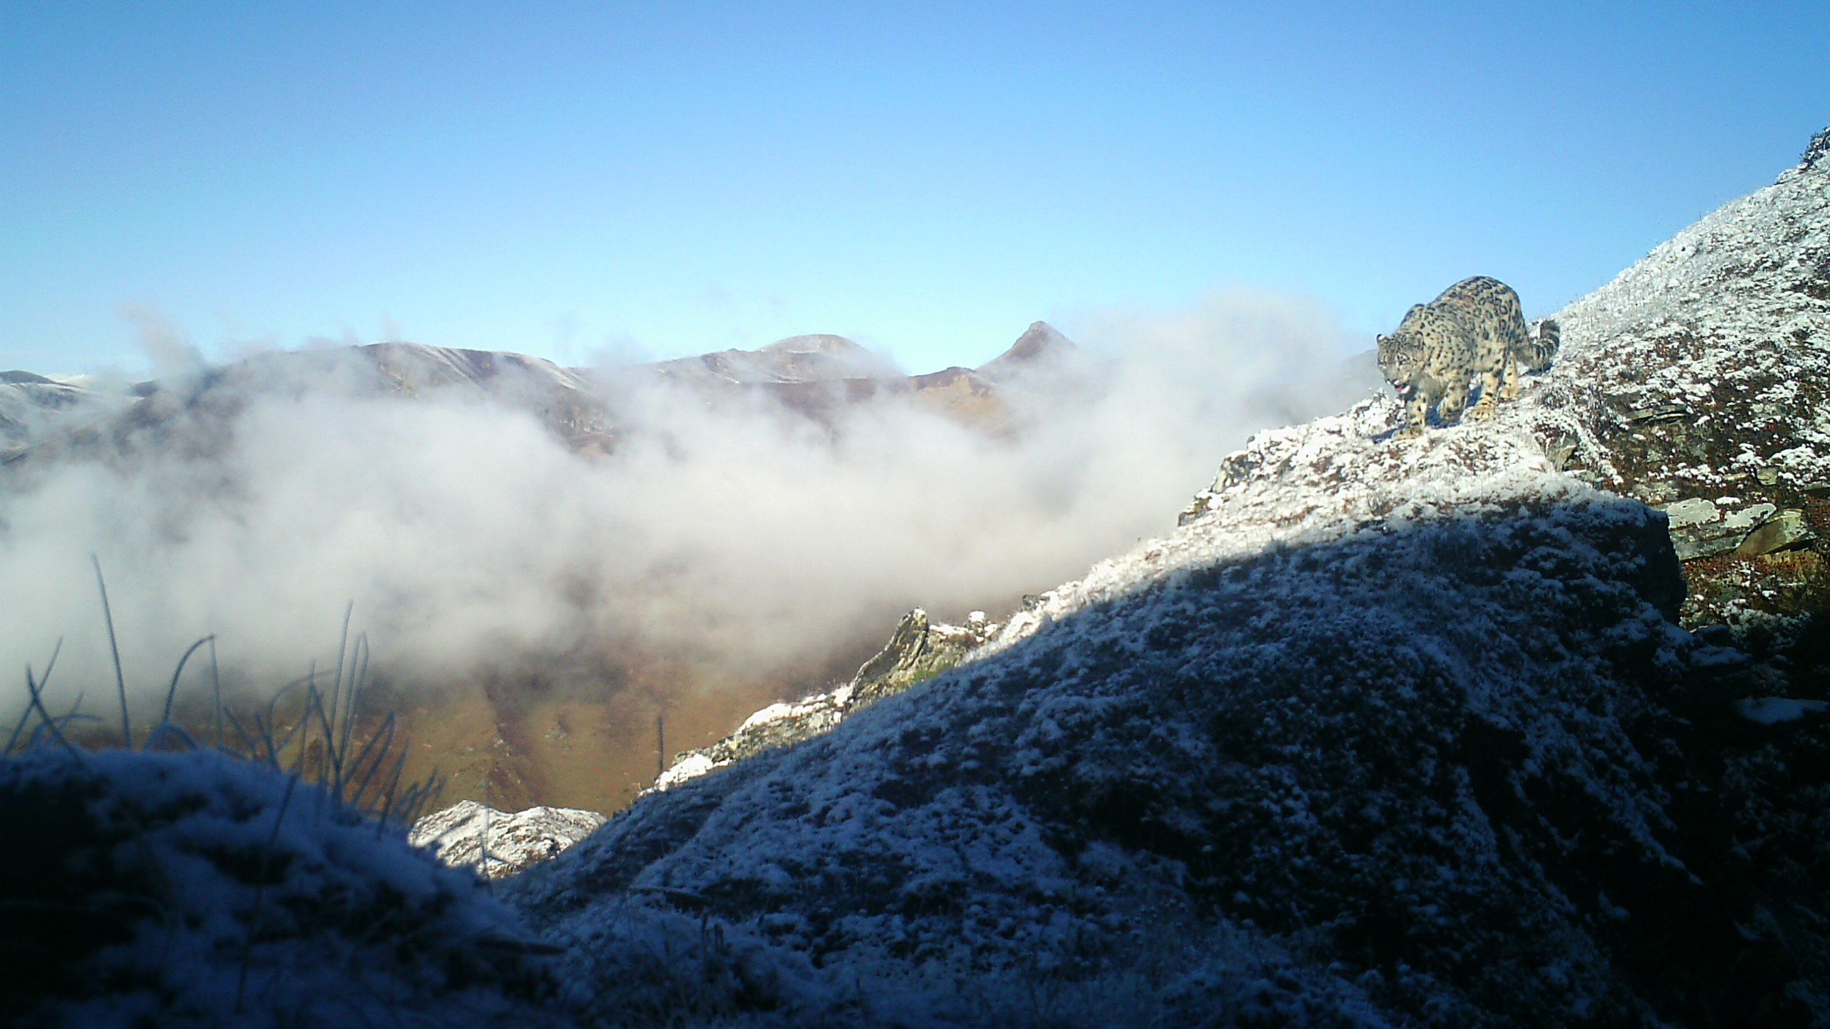
Trans-boundary initiatives
Snow leopard is a flagship species in the Kanchenjunga Landscape Conservation and Development Initiative Program of ICIMOD.
GSLEP: It aims to conserve snow leopards and their ecosystems which outlines strategies for conservation, research, and community engagement -12 range.
Regional cooperation are essential for the long-term conservation of snow leopards and their habitats-population dispersal.
Love to see trans-boundary conservation work happening within the snow leopard range countries- potential for collaboration.

Slide 17
Continued partnership in our collective efforts to safeguard the snow leopard and its fragile ecosystems.
Together, we are making a tangible difference in the protection and conservation of these iconic species and their habitats.
Aims to ensure long-term viability of snow leopards while fostering harmonious coexistence with local communities.

Slide 18
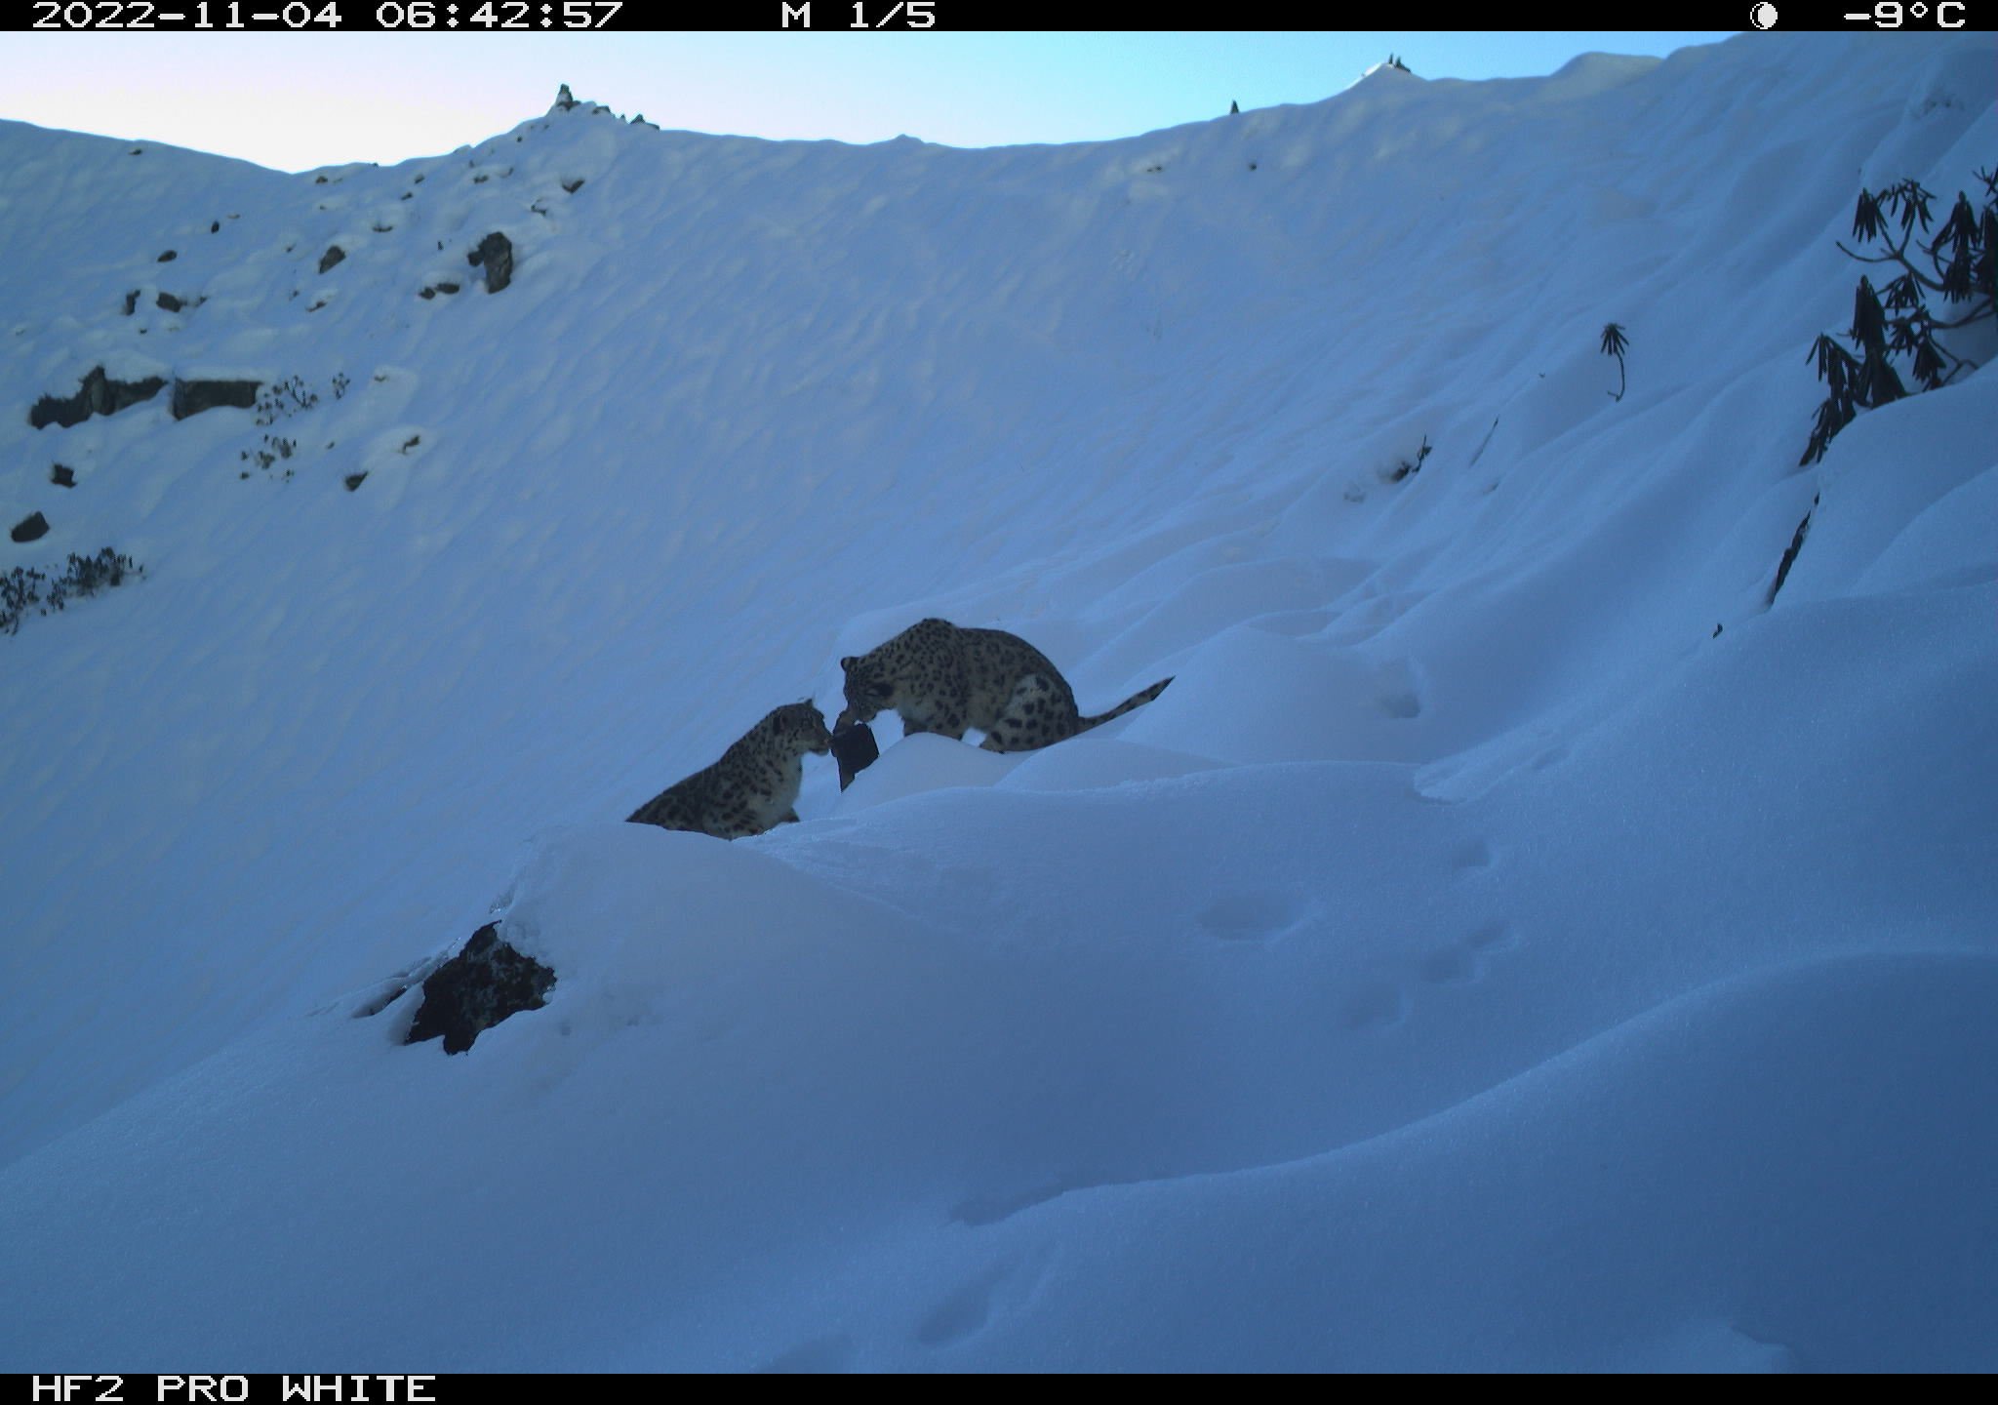
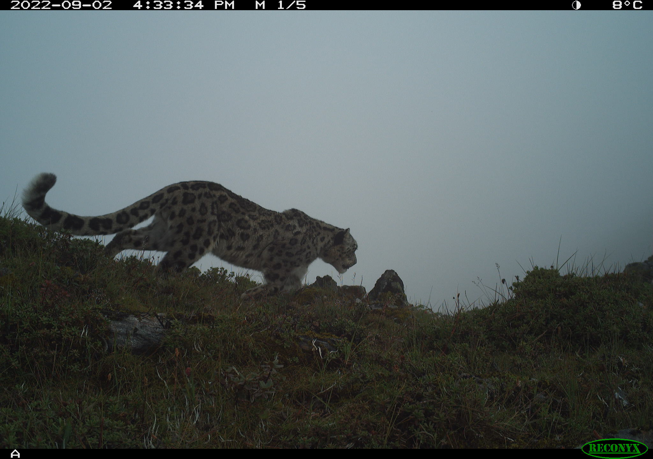
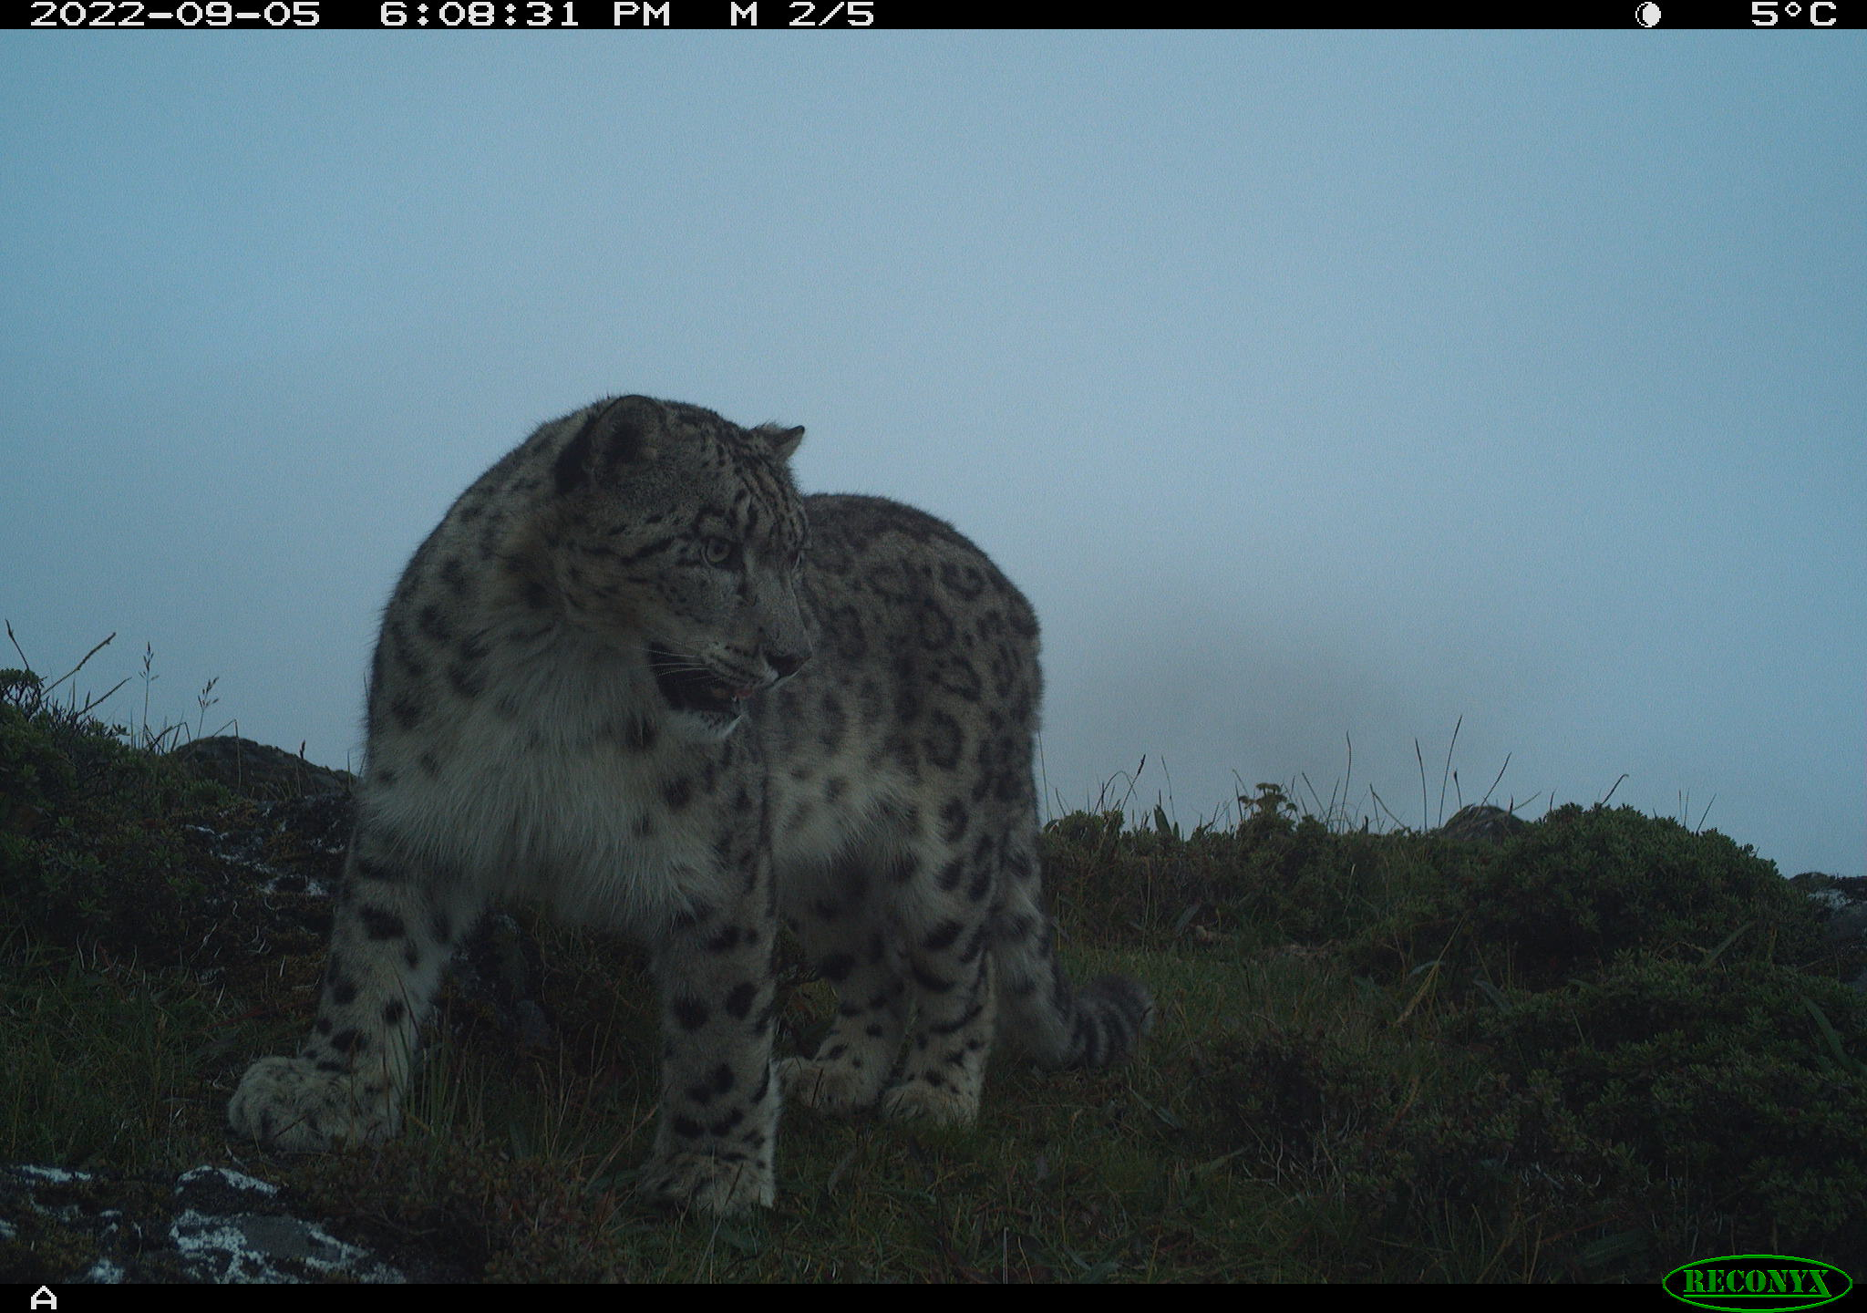
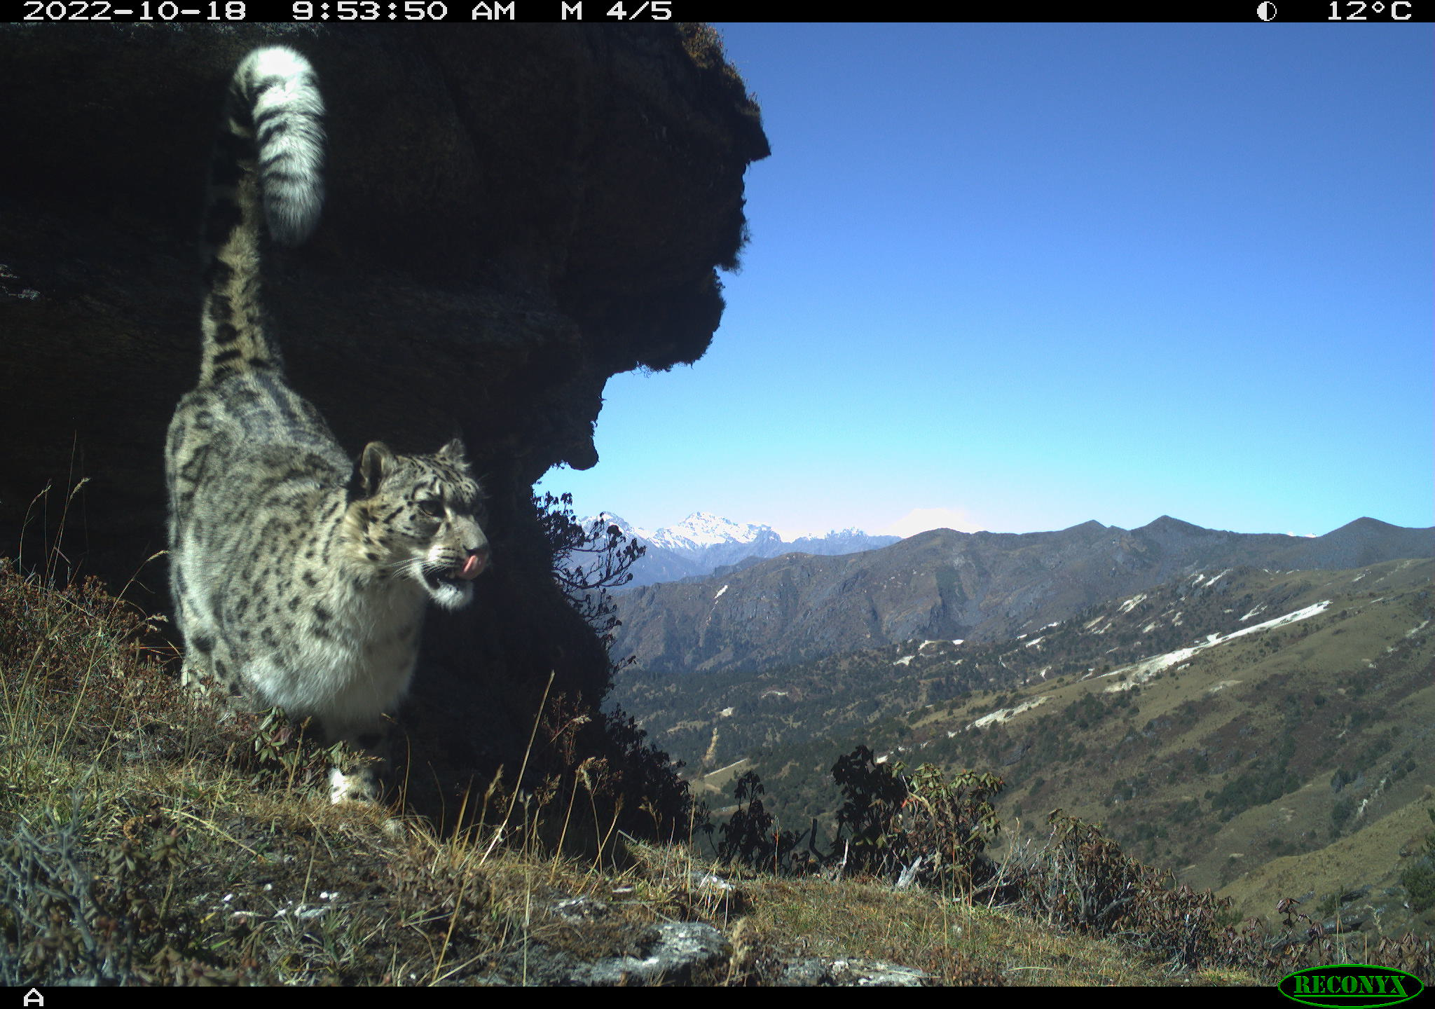
Few cameratrap images from NSLS-II

Slide 19
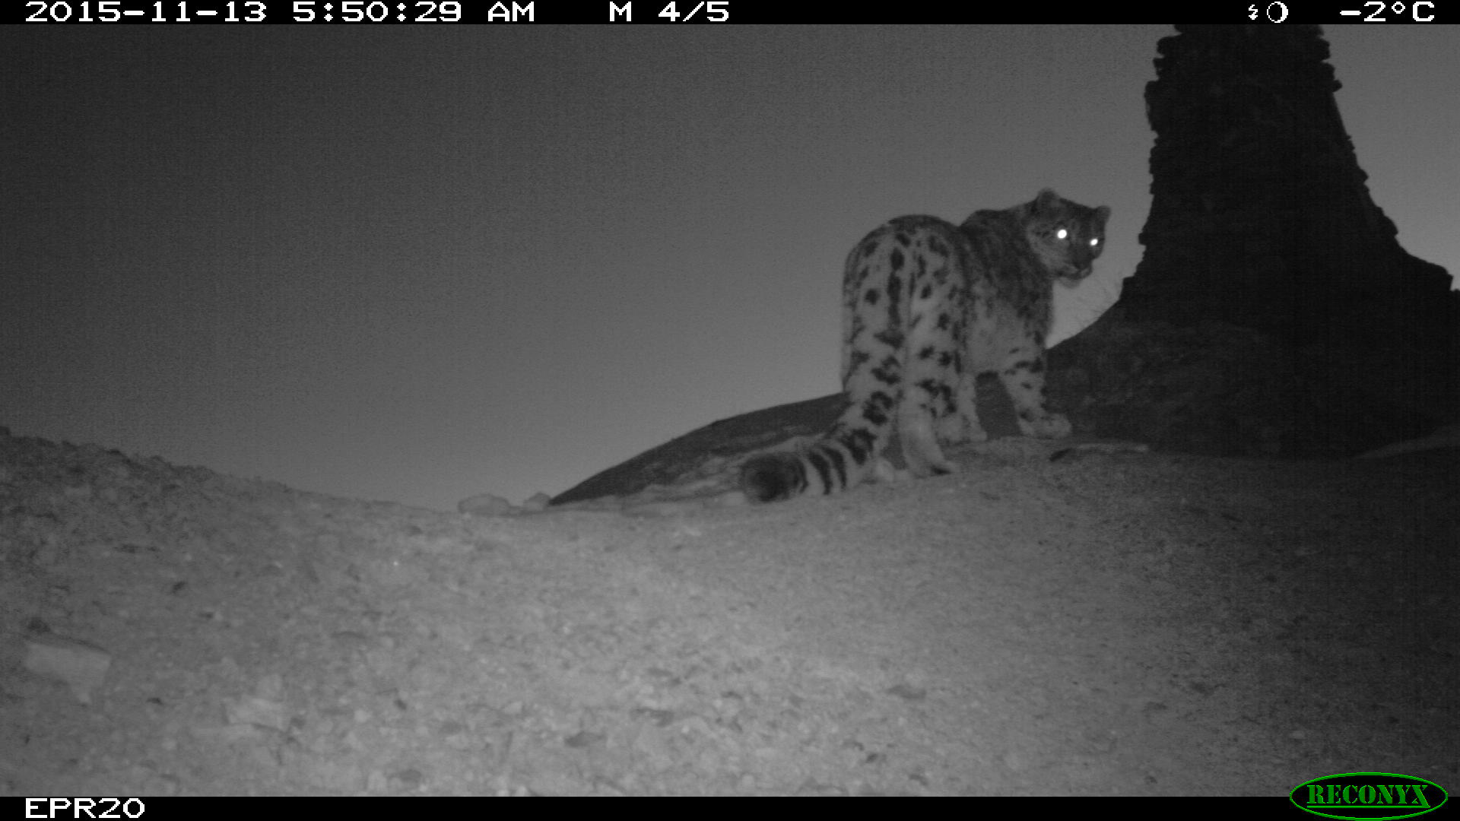
Kadrinchey!
We express our deep gratitude to the Government of Uzbekistan for their warmth and hospitality.
Ugyen Wangchuk
Ugyen
Department of Forests and Park Services
Ministry of Energy & Natural Resources
Royal Government of Bhutan
Email: ugyenwangchuk@moenr.gov.bt
utakchu@gmail.com
Thank You!

