Slide 1
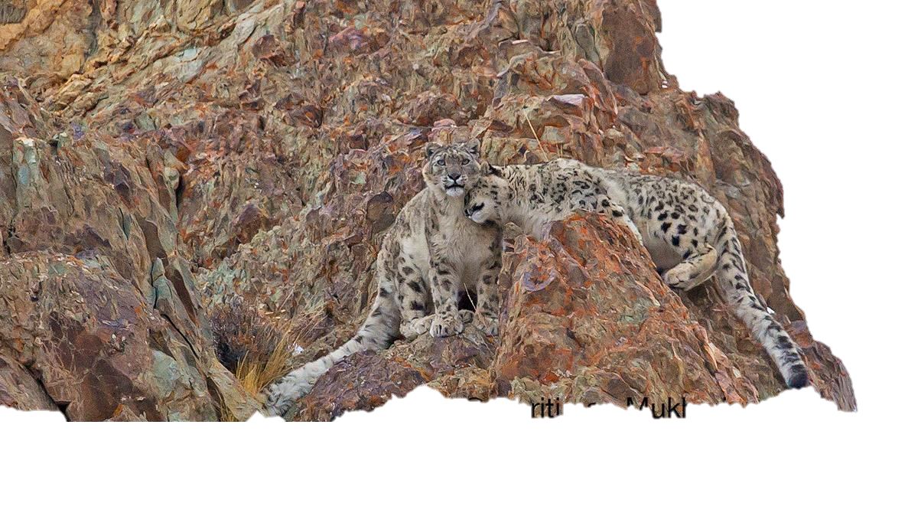
GSLEP Program Update India
Steering Committee Meeting
Rakesh Kumar Jagenia
Deputy Inspector General of Forests
Ministry of Environment, Forest and Climate Change, Government of India
Samarkand, Uzbekistan
11 February , 2024

Slide 2
Status of knowledge on snow leopard and prey species in India
State | State’s Area (km²) | Potential Area Under PSL (km²) | Percent Geographical Area Under PSL
Jammu & Kashmir * & Ladakh | 128,534 | 77,833 | 61
Himachal Pradesh | 54,975 | 27,846 | 51
Uttarakhand | 59,846 | 13,885 | 23
Sikkim | 8,318 | 3,031 | 36
Arunachal Pradesh | 81,174 | 6,162 | 8
Total | 3,32,846 | 1,28,757 | 39

Slide 3
Implementation status of the NSLEP (National Goals of GSLEP) – Project Snow Leopard
Project Goal
To safeguard India’s unique natural heritage of high altitude wildlife populations and their habitats by promoting conservation through participatory policies and actions
Implementation Status
Year of launch: 2009
Promotion of inclusion and participatory Approach
Inclusion of communities, conservationists, conservation scientists, CSOs
Support to wildlife managers, particularly for landscape level planning and management
Strong network for protection from poaching and illegal trade
Steering Committee for monitoring the implementation of PSL
Use of Technology for Monitoring and Surveillance

Slide 4
Implementation status of the NSLEP (National Goals of GSLEP) – Project Snow Leopard
Landscape-level approach to wildlife conservation – NWAP (2017-2031)
Rationalising and improving protected area and their management – Protected areas and Eco-sensitive Zones
Species Recovery Program supporting focused conservation for snow leopard and its prey
Promotion of stronger measures for wildlife protection and law enforcement through Wild Life Crime Control Bureau
Capacity building programs for better understanding and management of human-wildlife conflicts

Slide 5
Resource mobilization for NSLEP (National Goals of GSLEP)
Funds secured from:
internal –
Centrally Sponsored Scheme of Development of Wildlife Habitats - Recovery of Endangered Species programme, Development of Protected Area and Support Outside PA
CAMPA
external - SECURE HIMALAYAS - 72.36 million US $
Financial gaps and needs: Based on the Annual Plan of Operations submitted by the Field Units
Future plans – Continued Support from the CSS – DWH, CAMPA, dedicated SNOW LEOPARD CELL

Slide 6
Reanalysing Threats to Snow Leopards, their Ecosystems, and Local Livelihoods
Referring to the NSLEP, describe if any of the reported threats have changed over the years; Human Wildlife Conflict, feral dogs
Status of the emerging threats such as climate change, mining, infrastructure projects in the snow leopard landscapes
Proposed strategy to tackle emerging threats Management Effectiveness Evaluation of National Parks and Sanctuaries in the country, including the Protected Areas covering the Snow leopard landscape.

Slide 7
Implementation of PAWS protocols- Snow Leopard Population Assessment in India (SPAI)
State forest departments involved
Scientific institutions/ organizations involved

Slide 8
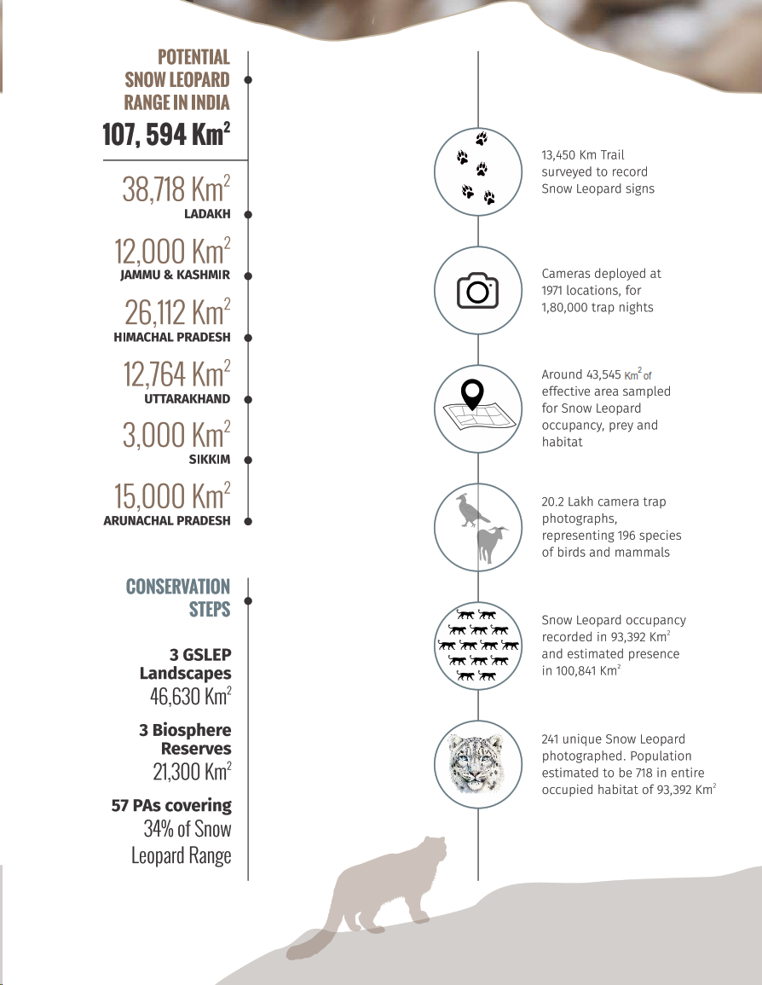
Status of Snow Leopard in India Report

Slide 9
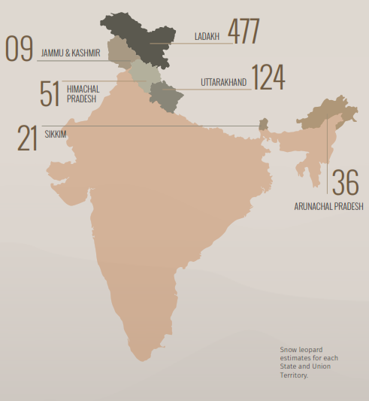
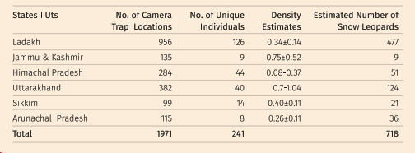
Population Status of Snow Leopards
WII National Coordinator
States/UTs, Ladakh and Uttarakhand
NCF
Jammu & Kashmir and Himachal Pradesh
WWF
Sikkim and Arunachal Pradesh
718 Snow Leopards
SPAI exercise to be repeated every 4 years

Slide 10
Community-based conservation initiatives
Ongoing or upcoming community-based conservation programs in the snow leopard habitats –
Guidelines on Ecotourism,
Home Stays
Cconstruction of corral pens, solar fencing, Animal Intrusion Detection and Repellent System (ANIDERS), bio-digester plant in Army Camps for management of solid waste and control of feral dog population, etc have been done, scaled up and replicated across the landscapes which have brought down the instances of HWC.
65 Biodiversity Management Committees or BMC (21 in Ladakh landscape; 29 in Uttarakhand landscape; 35 in Himachal Pradesh landscape) have been constituted to promote the conservation, sustainable use and documentation of local biodiversity.
Conservation based livelihood activities, are being supported throughout the landscapes for e.g., nettle based enterprise in Sikkim, Uttarakhand, seabuckthorn in Himachal Pradesh
Spatial coverage of the existing initiatives in relation to the snow leopard range in the country
Resources secured
Gaps and needs (technical and financial)

Slide 11
Climate Adaptations
Mission life: Lifestyle for Environment entails:
Strengthening campaign of solid waste management and freedom from single use plastic
Water conservation wetlands, inside and in areas surrounding protected areas
Experience based learning for conservation and protection of wildlife
Carbon sequestration while planning developmental projects in and around protected areas

Slide 12
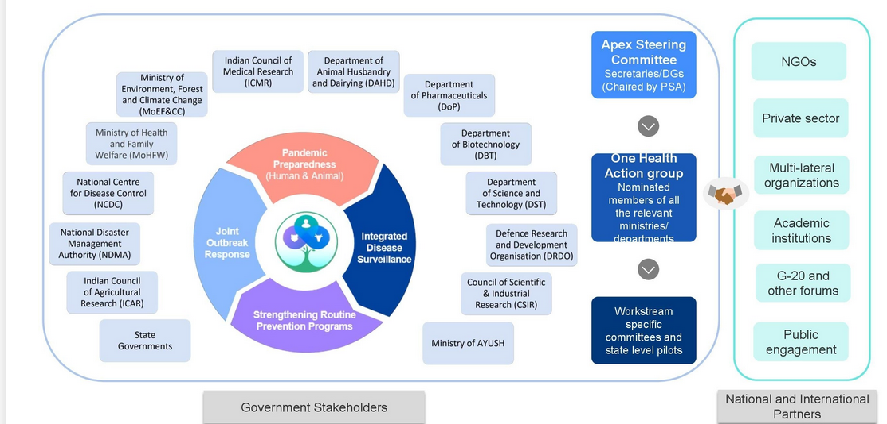
Management & monitoring of disease systems
On-going programs initiated to manage, monitor or research disease and/or disease spread in livestock and wildlife of the high mountain habitat
immunisation against communicable diseases of the live-stock kept in or within five kilometres of a sanctuary.
No person shall take, or cause to be taken or grazed, any live-stock in a sanctuary without getting it immunised.
Funding support under DWH
New programs being proposed to manage, monitor or research disease and/or disease spread in livestock and wildlife of the high mountain habitat – National Wildlife Referral Centre
Gaps and needs – Capacity Building
Disease gap prioritization exercise
Mapping of existing surveillance programs
Mapping of laboratory capabilities
Mapping institutional capabilities

Slide 13
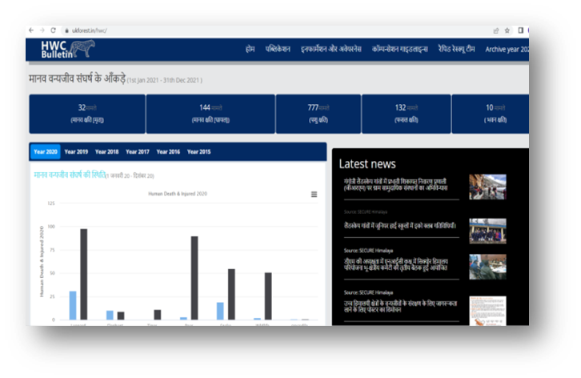
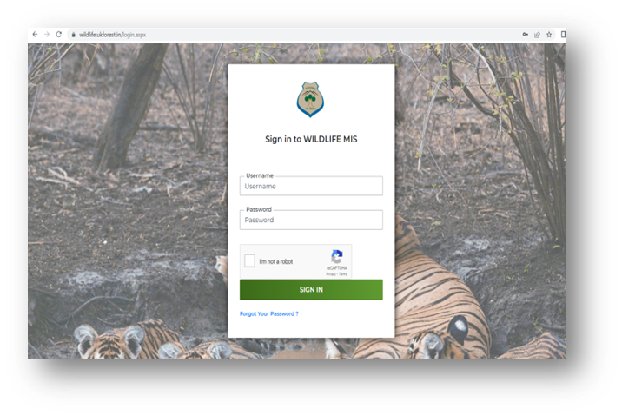
Disrupting illegal wildlife trade in the country
Efforts made to disrupt poaching and illegal wildlife trade in snow leopard habitat
Capacity building of enforcement officers
Community volunteers have been engaged for monitoring and patrolling of wildlife habitats
identification of hotspots of illegal trade and wildlife crime pathways to support enforcement agencies.
National Helpline Number
Number of snow leopard poaching/confiscation cases during the past one year - None
Number of convictions (if any) – None
Gaps and needs
State/UT
 | No of program | No of officers trained
Himachal Pradesh | 1 | 111
Jammu & Kashmir | 1 | 93
Ladakh | 0 | 0
Sikkim | 0 | 0
Arunachal Pradesh | 1 | 34
Uttarakhand | 3 | 221
 | 6 | 459

Slide 14
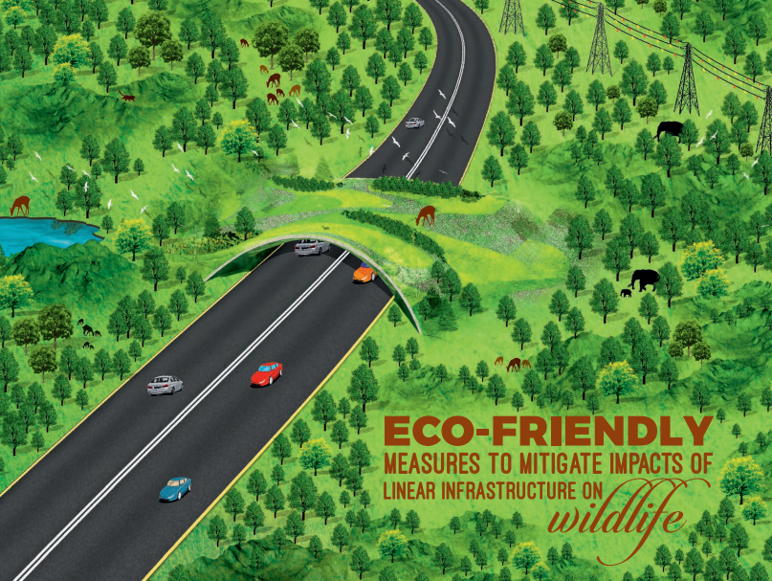
Managing Infrastructure/Developmental initiatives in snow leopard landscape
On-going policies, initiatives or projects being implemented to minimize and mitigate impacts of:
Infrastructure – Road infrastructure – Linear Infrastructure guidelines, National Board for Wild Life
Tourism in the snow leopard habitat
Upcoming initiatives or projects - Revision of guidelines being undertaken
Gaps and needs

Slide 15
Trans-boundary initiatives
Developments in improving trans-boundary cooperation
Launch of International Big Cats Alliance – 16 countries, several multilateral organisations
MoU on Biodiversity Conservation finalized with Government of Nepal
Meeting of the IUCN – APAP – Dehradun – April, 2023
Capacity building of enforcement authorities of SAWEN through WCCB and WWF
Gaps and needs: establishment of joint working groups and regular meetings

Slide 16
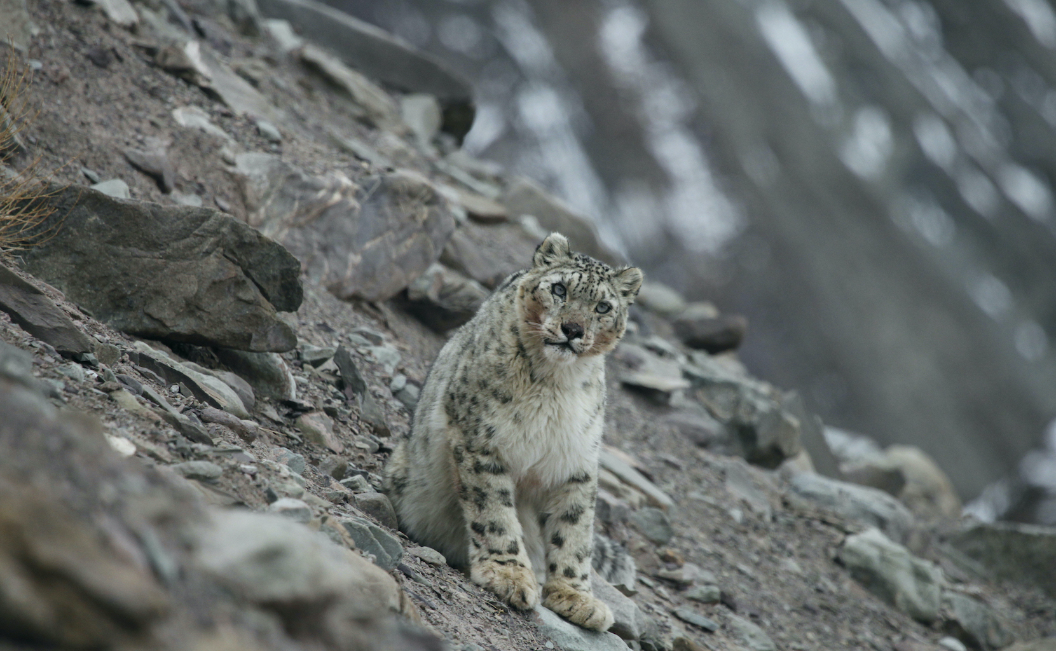
Thank You

