Slide 2
CONSERVATION AND SUSTAINABLE MANAGEMENT OF FORESTS FOR ENVIRONMENTAL AND SOCIO-ECONOMIC BENEFITS
Aim of the project: improvement of the system of conservation and management of forest resources and mountain ecosystems important for the conservation of biodiversity, land resources and the welfare of the local population
The project also aims to promote gender equality and the empowerment of women, as far as it is relevant and possible within the project framework.
Global Environment Facility
Executive partner:
Forestry and Wildlife Committee of the Ministry of Agriculture of the Republic of Kazakhstan
Implementation period:
VI
2018
X
2024

Slide 3
Thematic areas of the project
Development of a network of forest protected areas and improvement of management of protected areas
Improvement of the management of high conservation value forests at the landscape level
Conservation of the snow leopard population and international cooperation

Slide 4
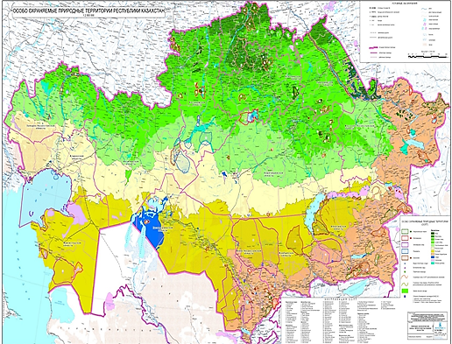
Geographical focus of the project
Project territories:
Protected areas | Number of snow leopards
Sairam Ugam National Park | 4-5
Aksu Zhabagly Nature Rererve | 8-10
Merke Forestry (planned National Park) | 5-8
Ile Alatau National Park | 15-20
Almaty Reserve | 20-25
Kolsai Kolderi National Park | 13-15
Outside PAs in Northern Tien Shan | 12-14
Jongar Alatau National Park | 20-25
Outside Pas in Zhetisu Alatau | 30-35
Altyn Emel National Park | 10-17
Katon Karagai National Park | 3-6
East Kazakhstan region: forests of the Altay Mountains, Saur and Tarbagatay
Almaty region: mountain forests of the Zhetysu Alatau, mountain forests of the Northern and Central Tien Shan, tugai forests of the Ile and Charyn rivers and saxaul forests of the Balkhash region
South Kazakhstan region: mountain forests of the Western Tien Shan, tugai forests of the Syrdarya river
Institutional focus of the project:
14 existing protected areas
10 state forestry institutions
12 rural districts, 4 villages and 6 districts

Slide 5
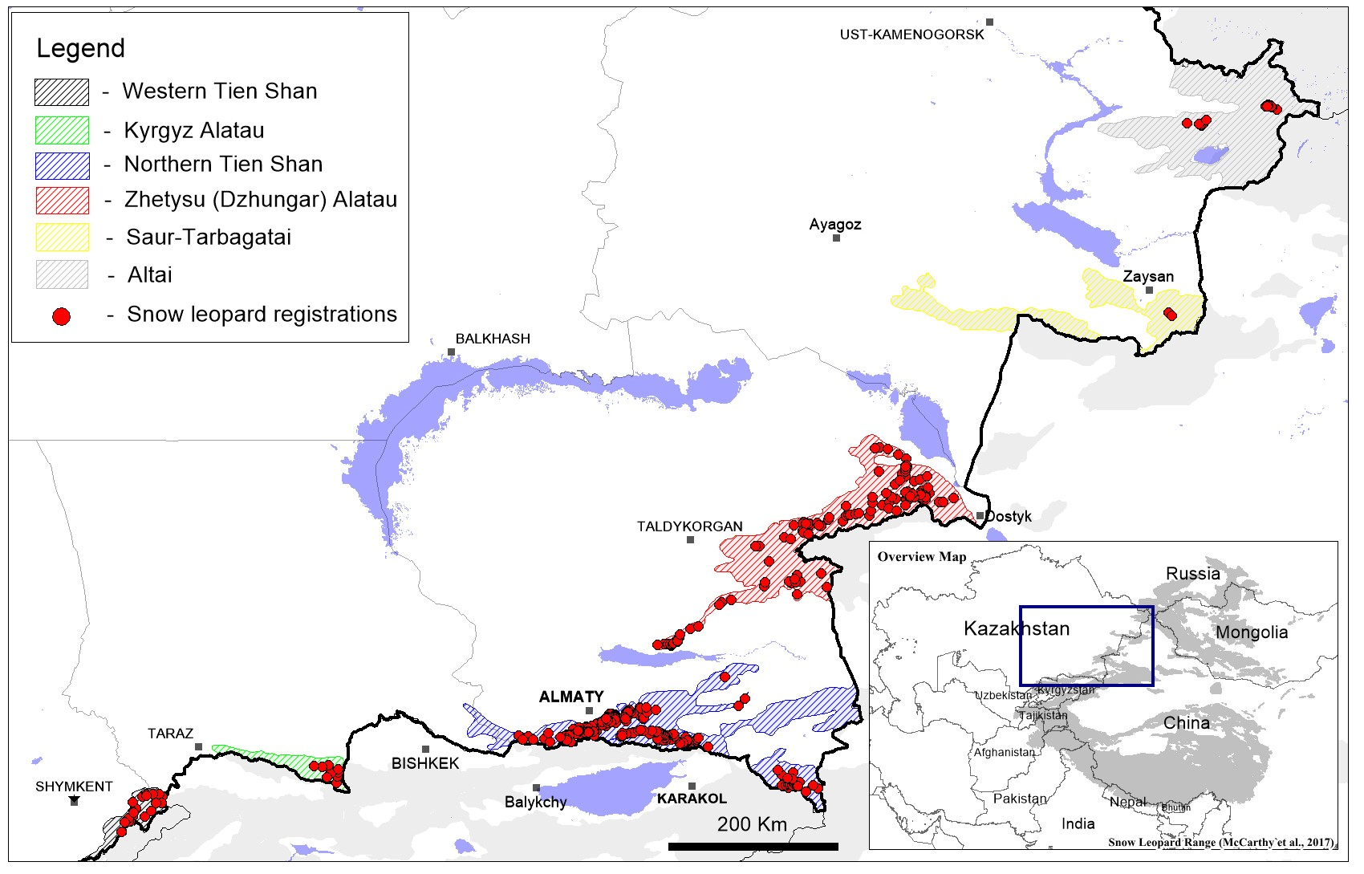

Slide 21
KAZAKHSTANI SNOW LEOPARD POPULATION: APPROACHES AND SOLUTIONS
Population dynamics of the
snow leopard in Kazakhstan
Actual distribution of snow leopard in Kazakhstan

Slide 22
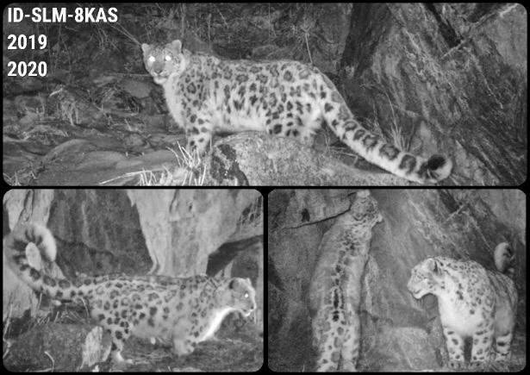
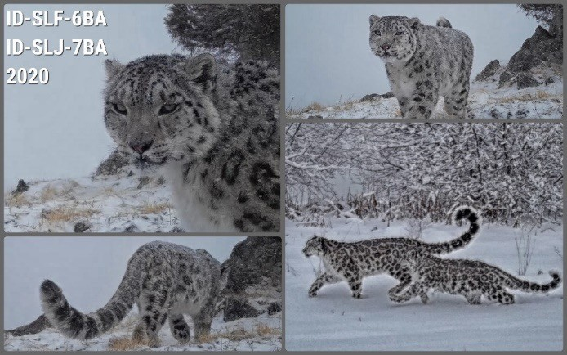
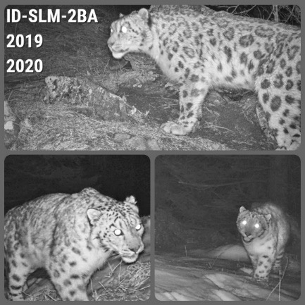

Slide 23
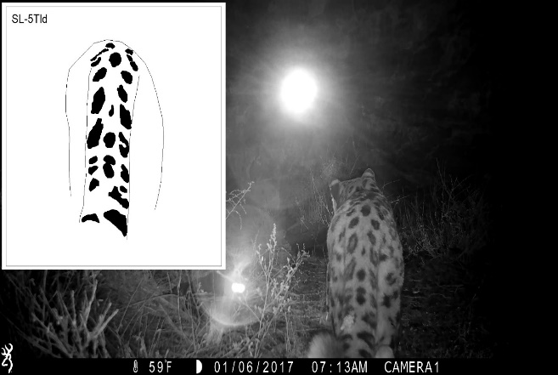
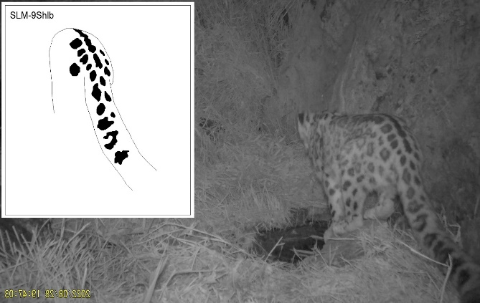
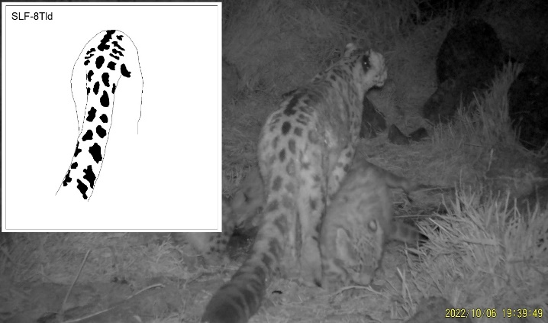
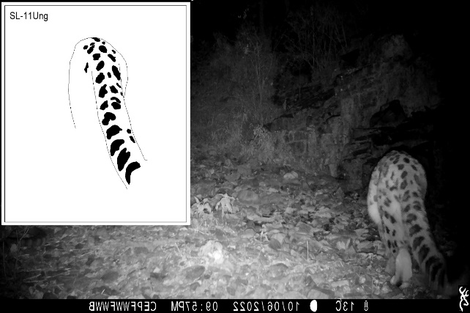
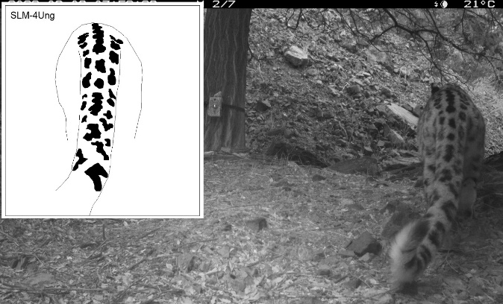
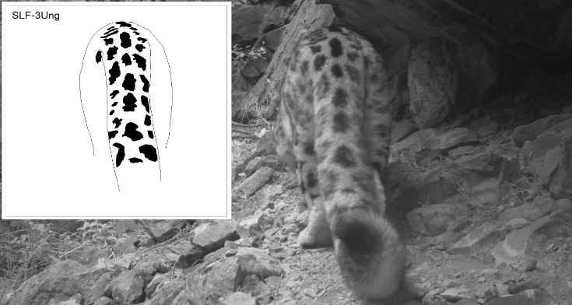
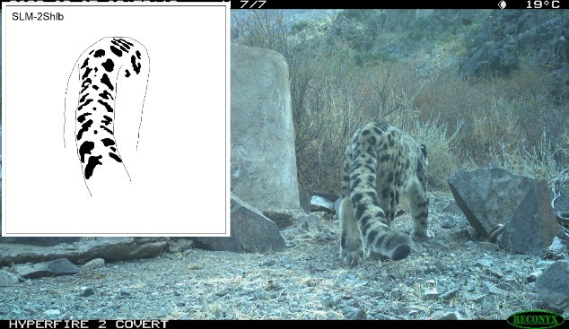
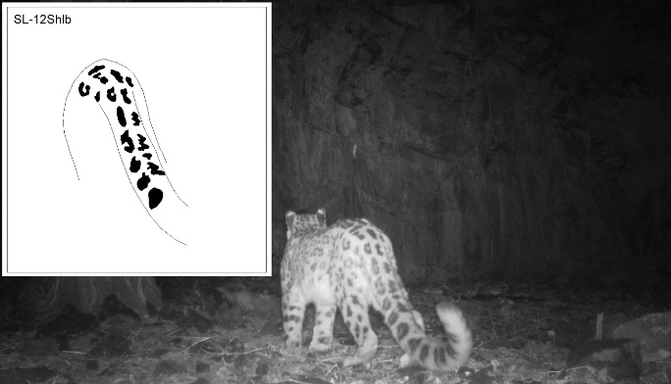
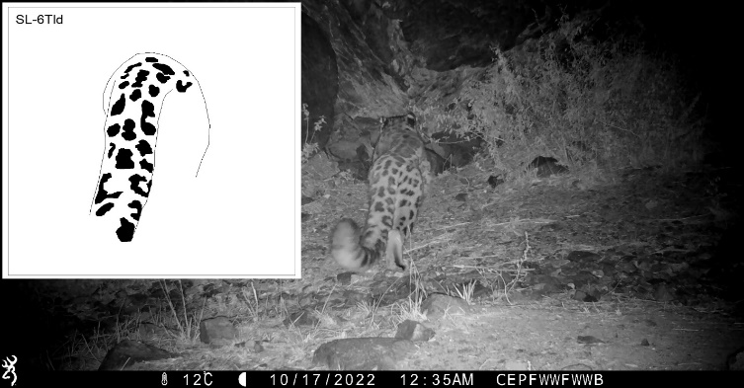

Slide 24
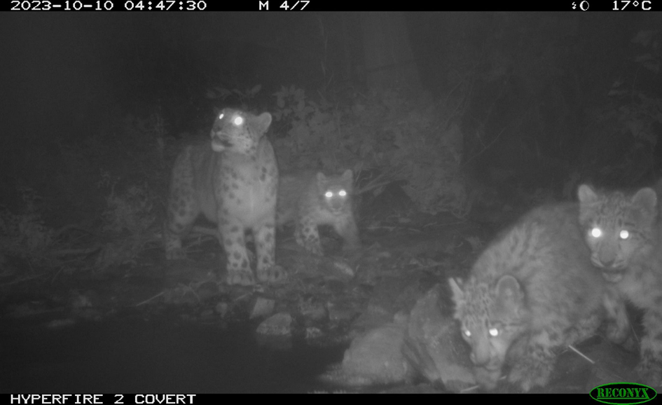

Slide 25
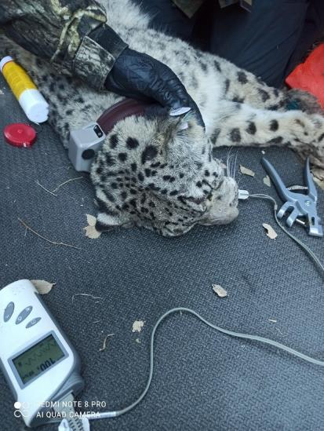
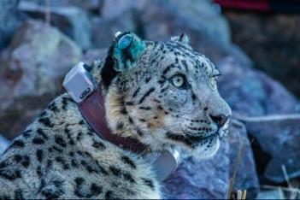
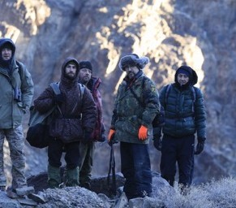
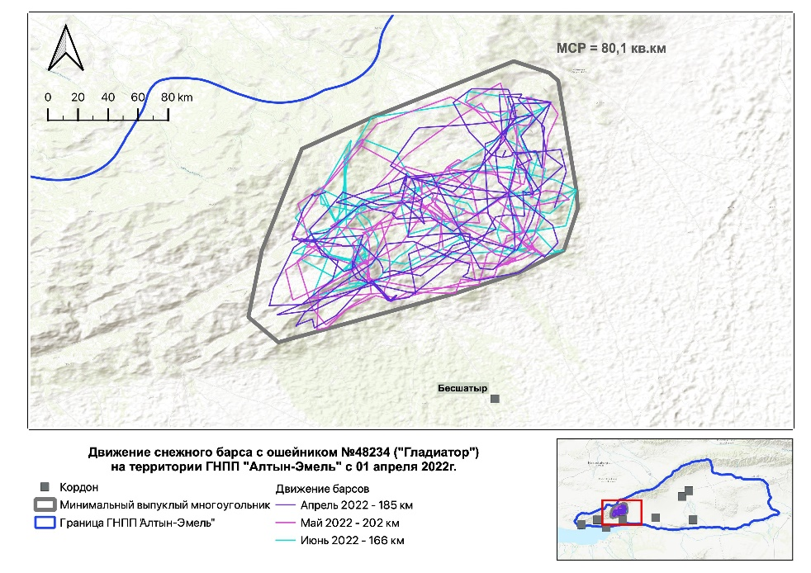

Slide 26
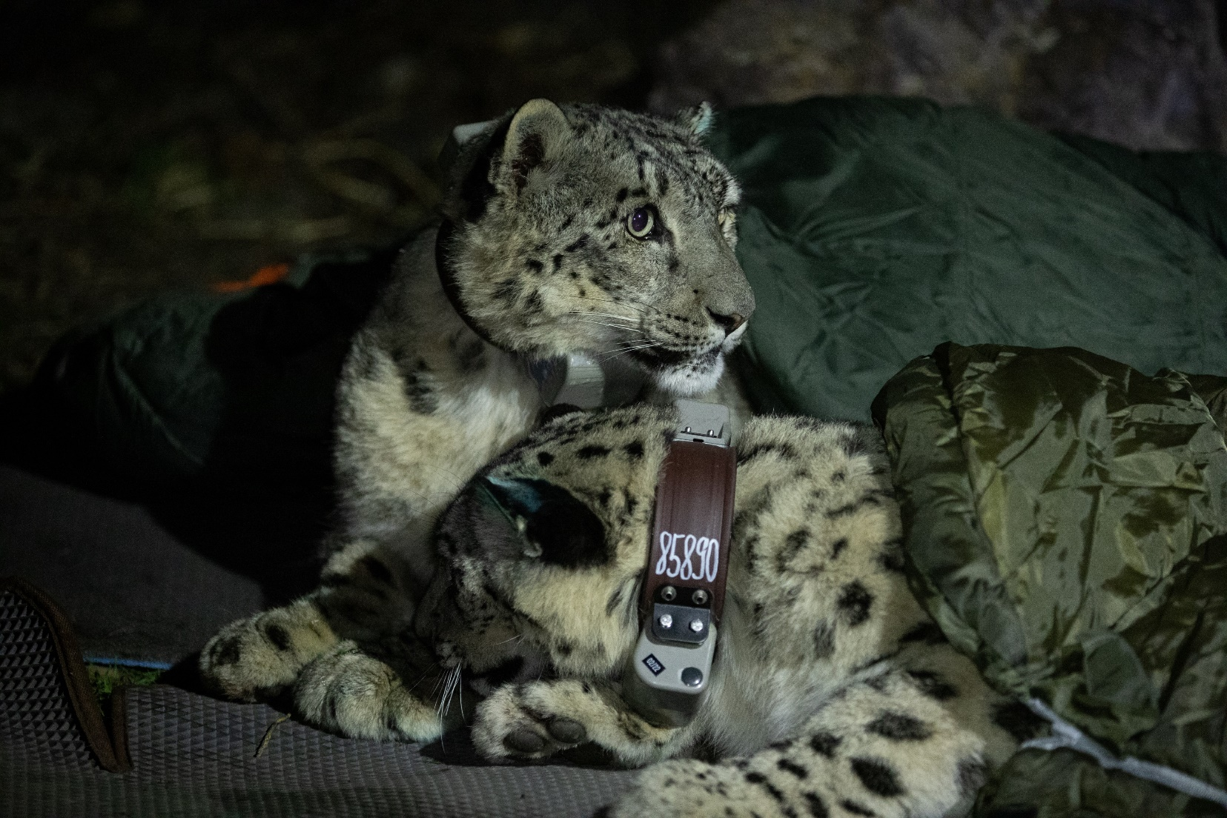
Satellite telemetry
Since 2021, 10 snow leopards have been tracked with satellite-collars,
with 6 of them in 2023.

Slide 27
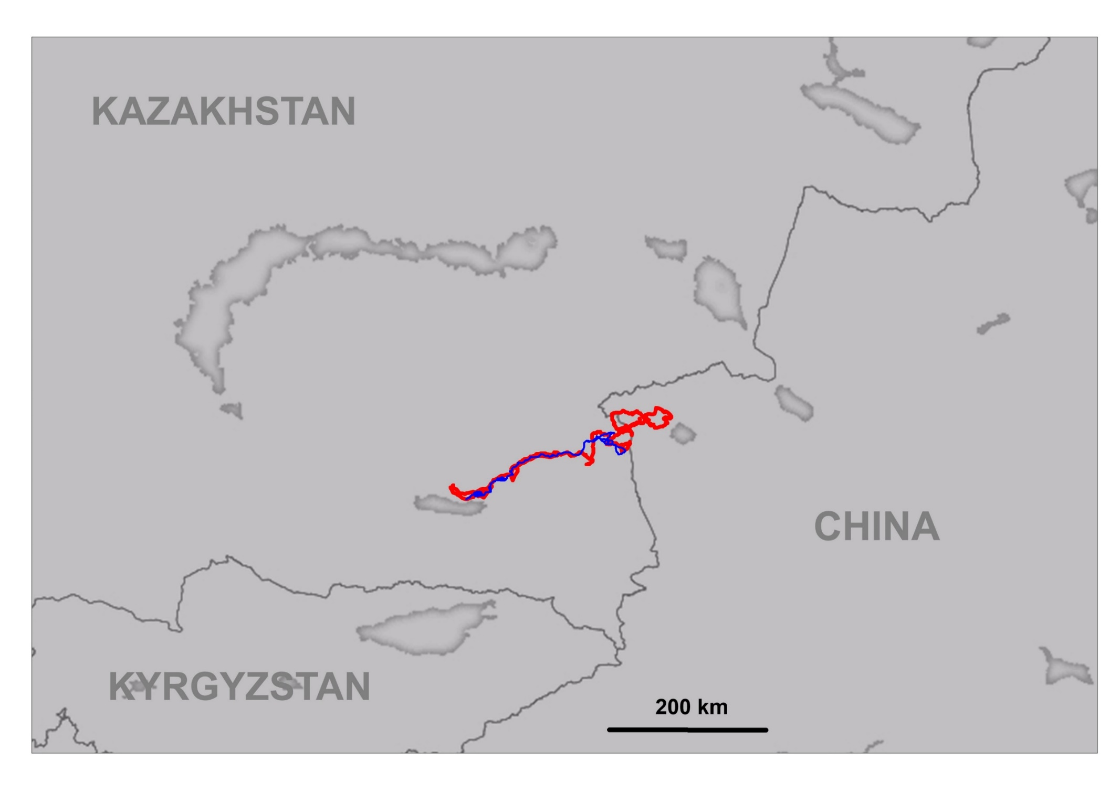
Satellite telemetry

Slide 28
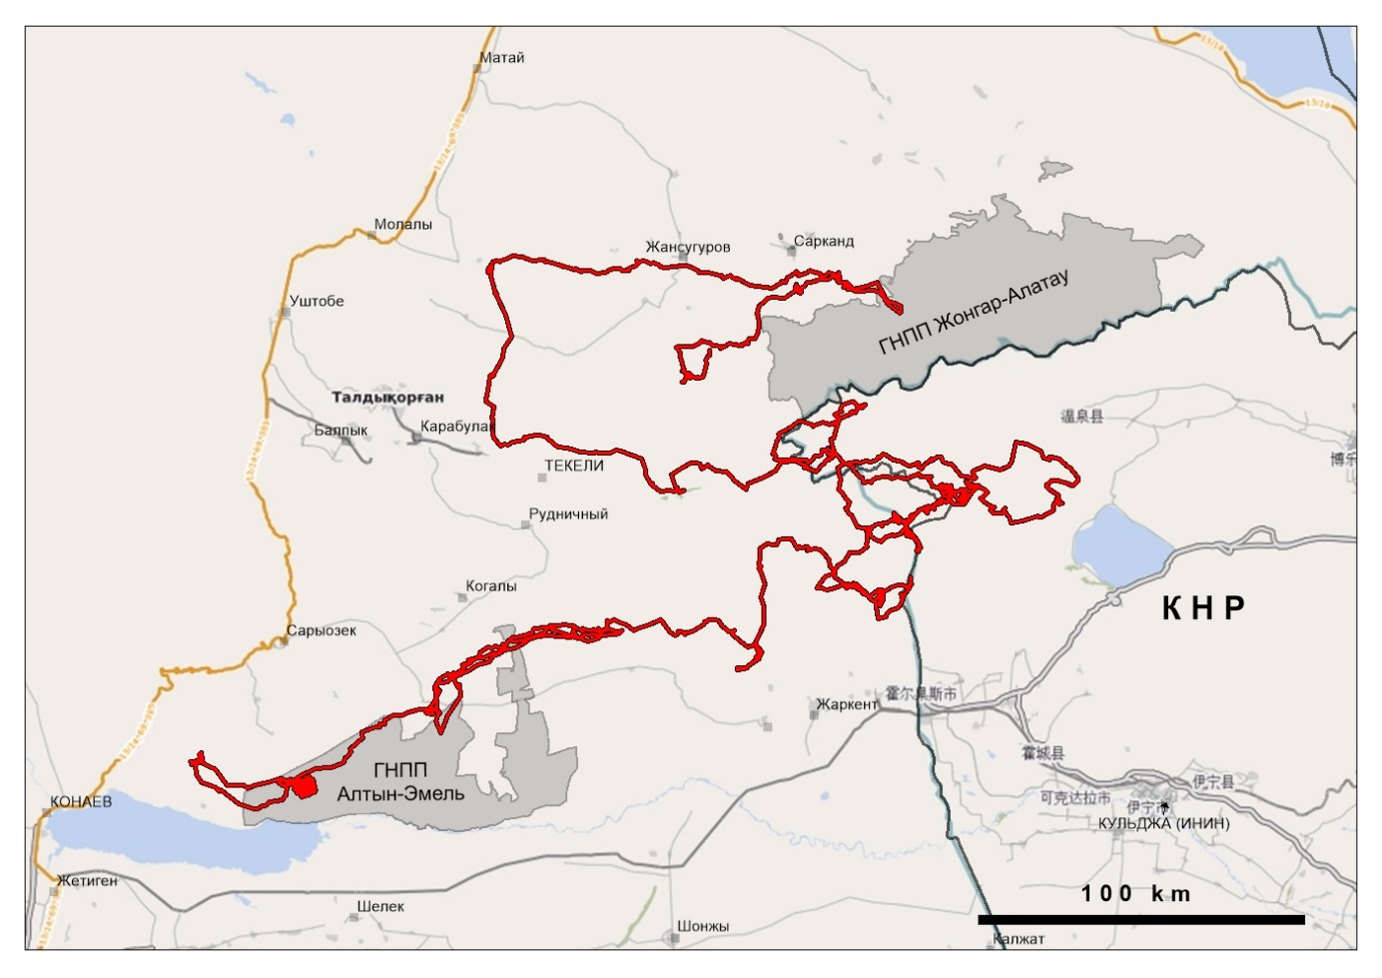
Satellite telemetry
Kazakhstan
Zhongar-Alatau NP
China
NP
Altyn-Emel

Slide 29
Translocation of conflict snow leopards
In 2023, for the first time in Kazakhstan, the rehabilitation and translocation of the conflict snow leopard was successfully carried out, with the individual later successfully adapting to new habitat environment.

Slide 30
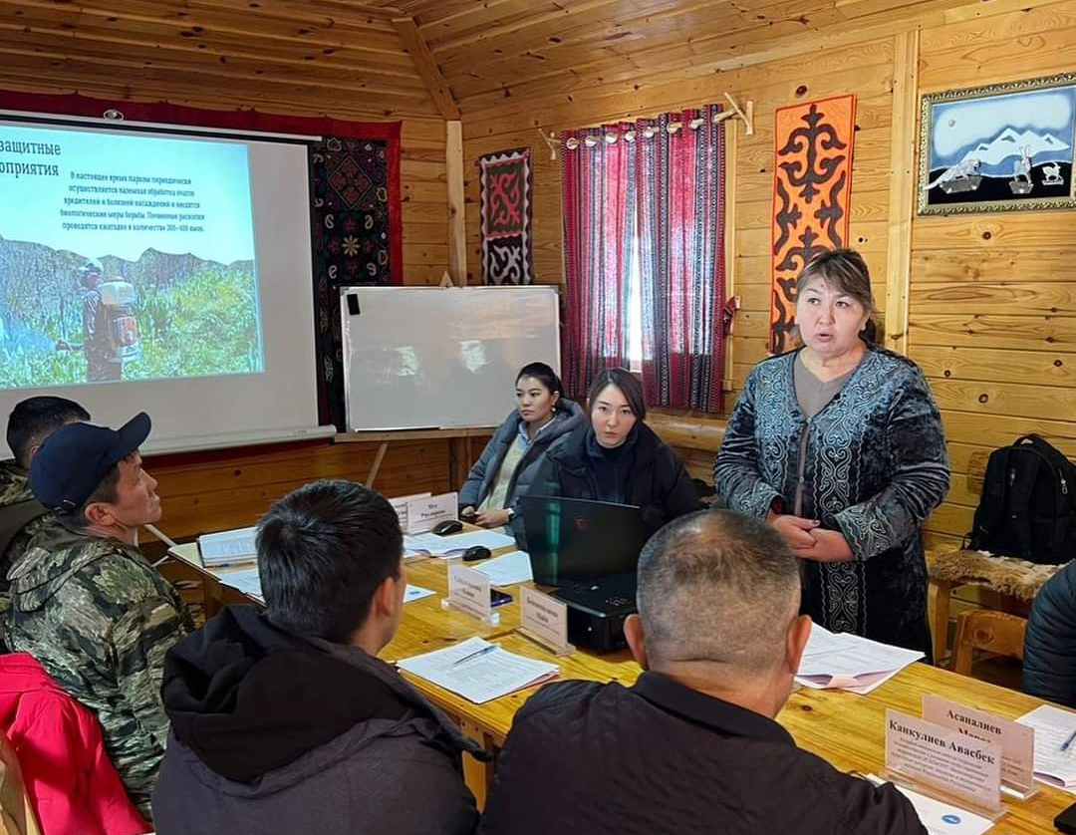
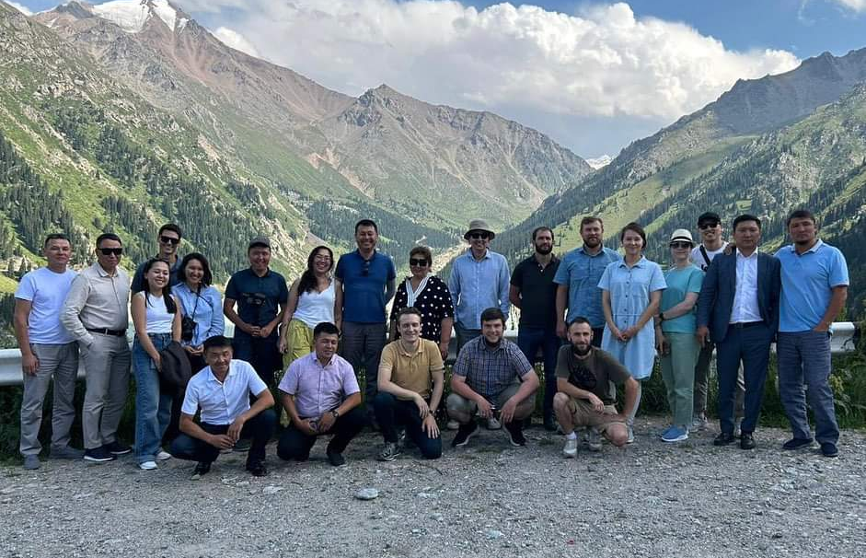
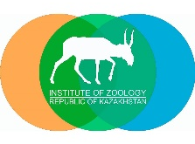
Transboundary conservation
Project name: Enhancing Transboundary Conservation Efforts Between Ile-Alatau (Kazakhstan) and Chon Kemin (Kyrgyzstan) – 2023-2024

Slide 31
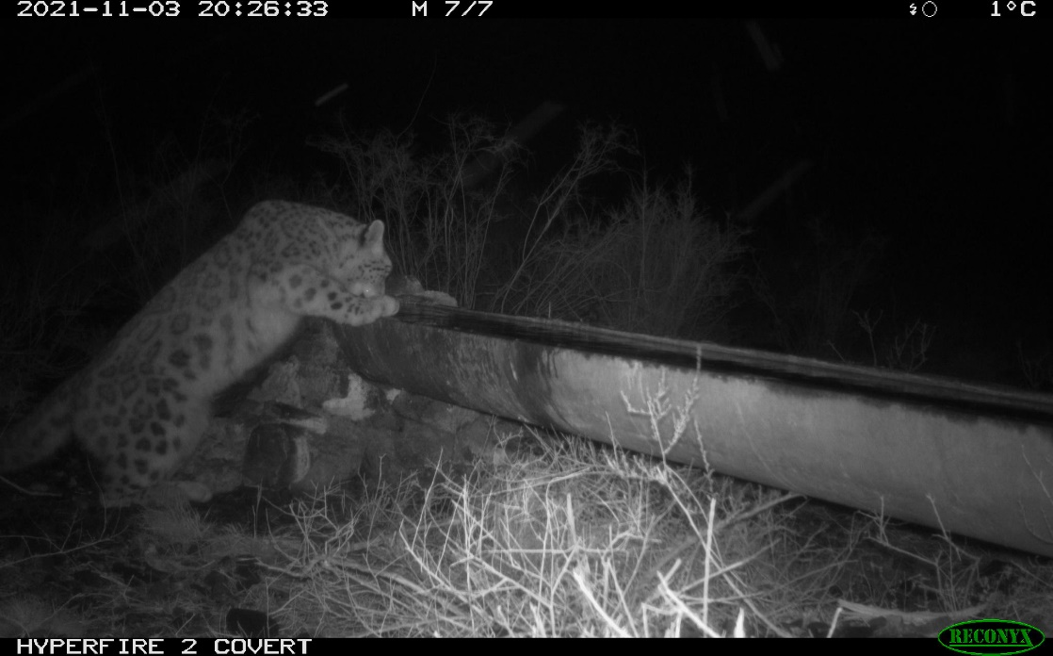
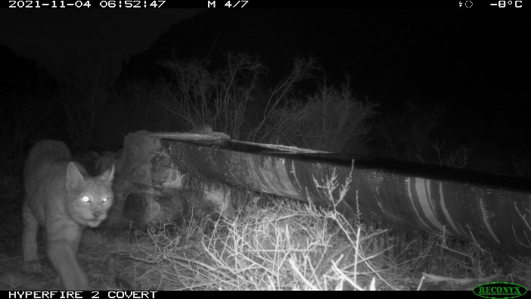
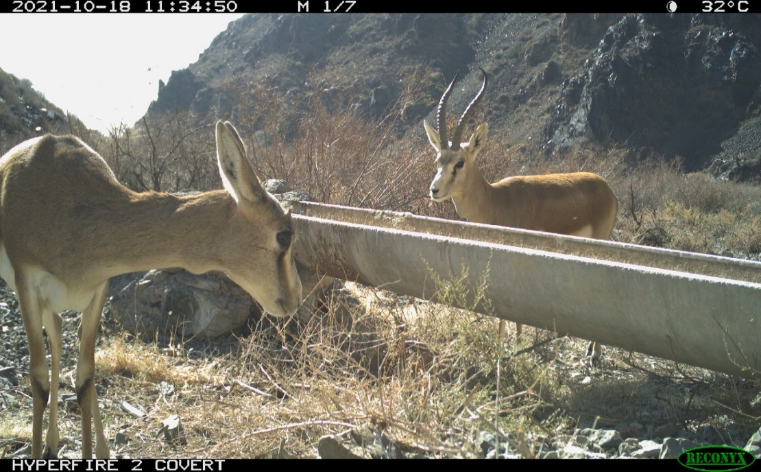
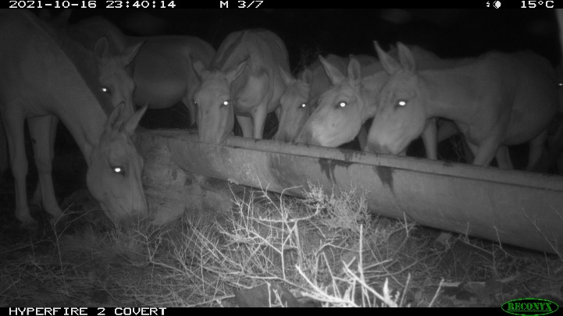
Mitigating climate change for wildlife

Slide 32
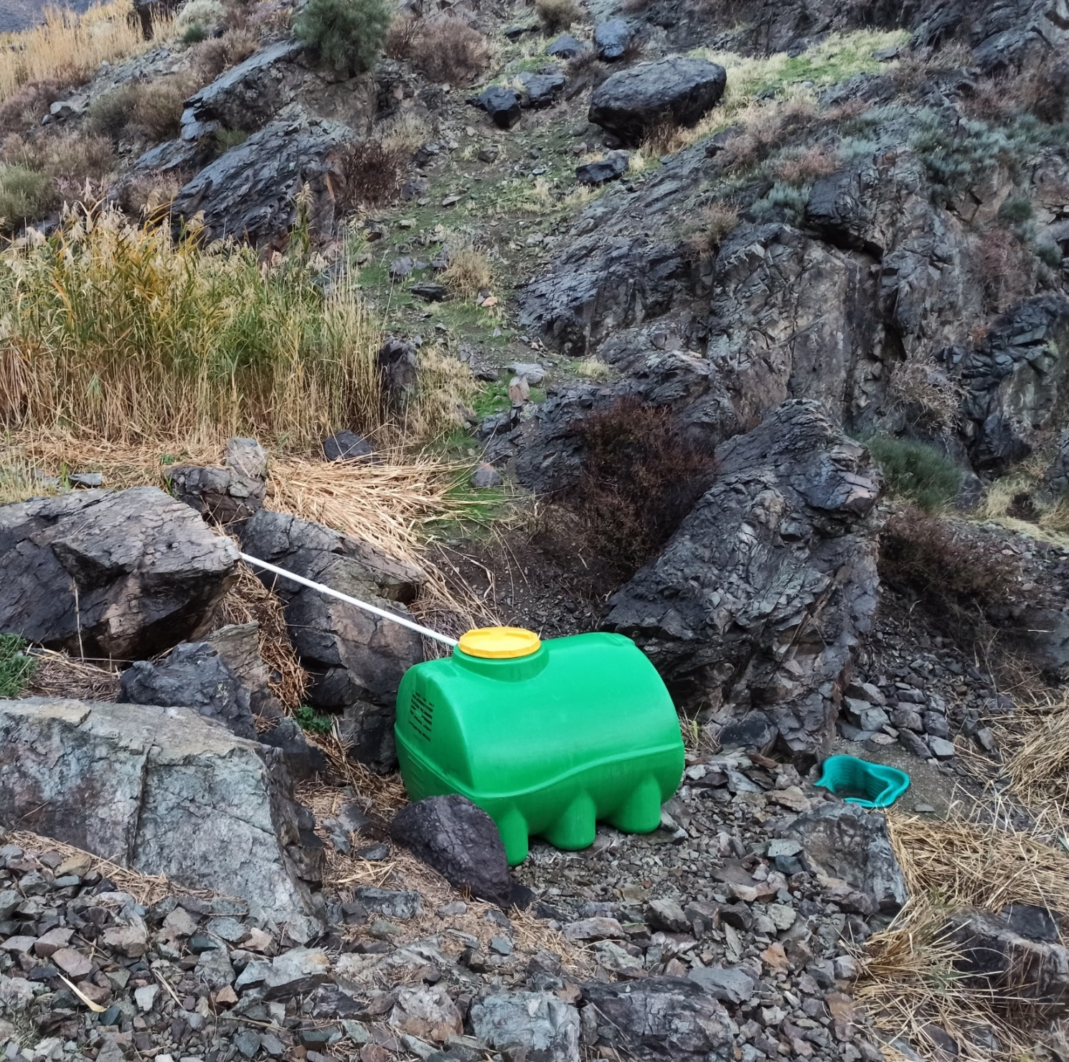
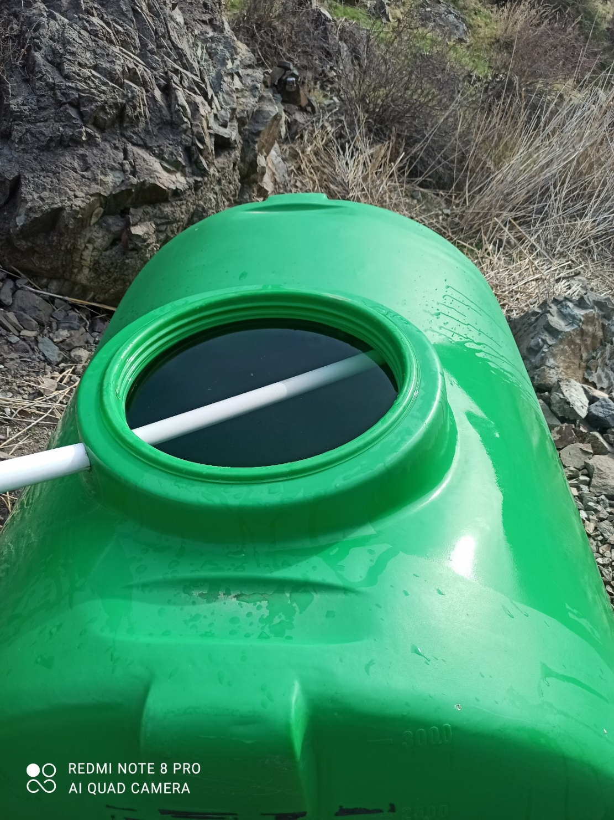
Mitigating climate change for wildlife

Slide 33
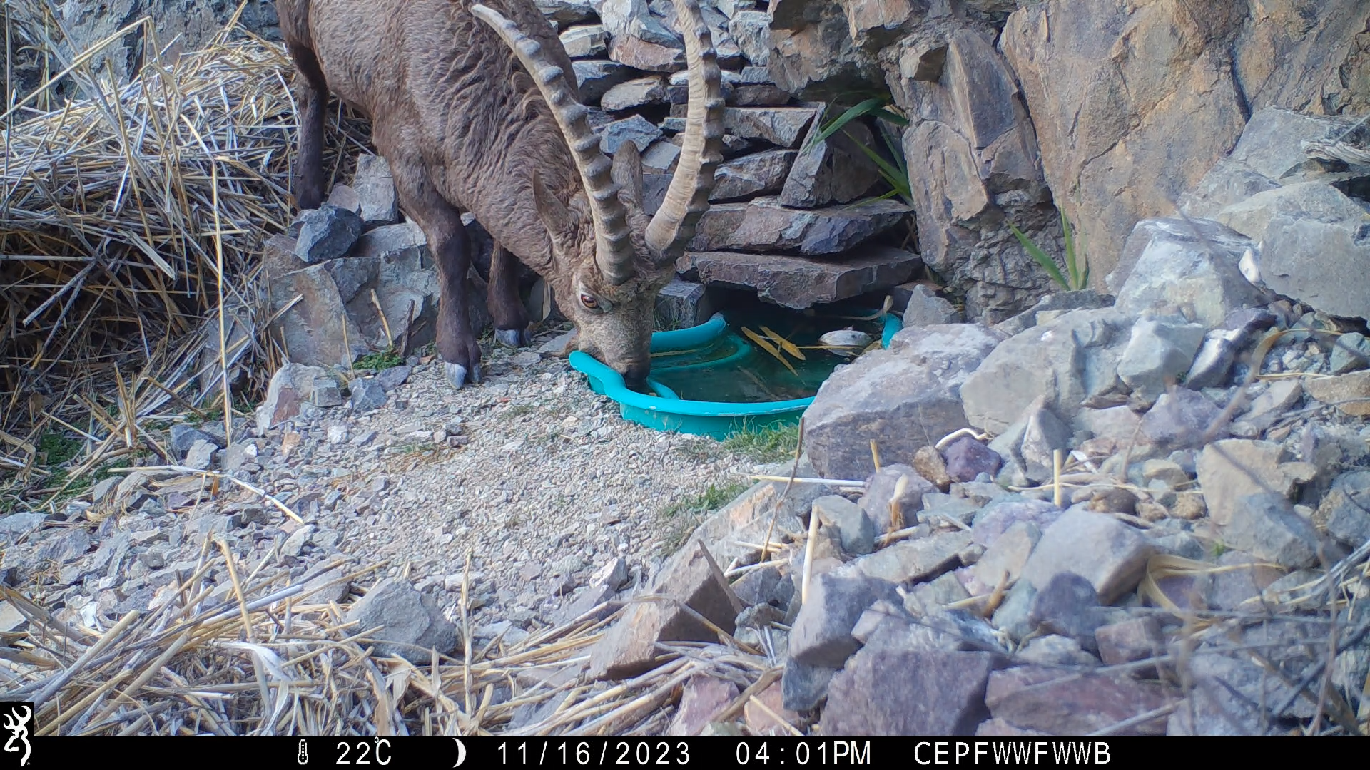
Mitigating climate change for wildlife

Slide 34
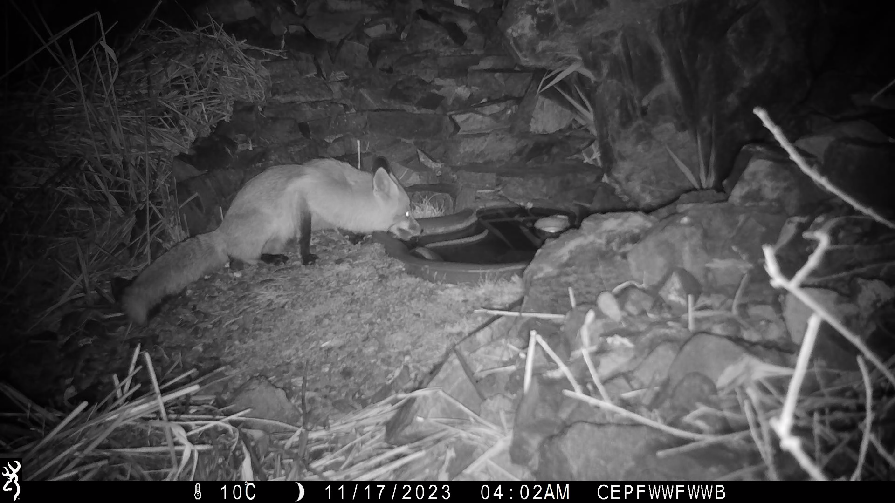
Mitigating climate change for wildlife

Slide 35
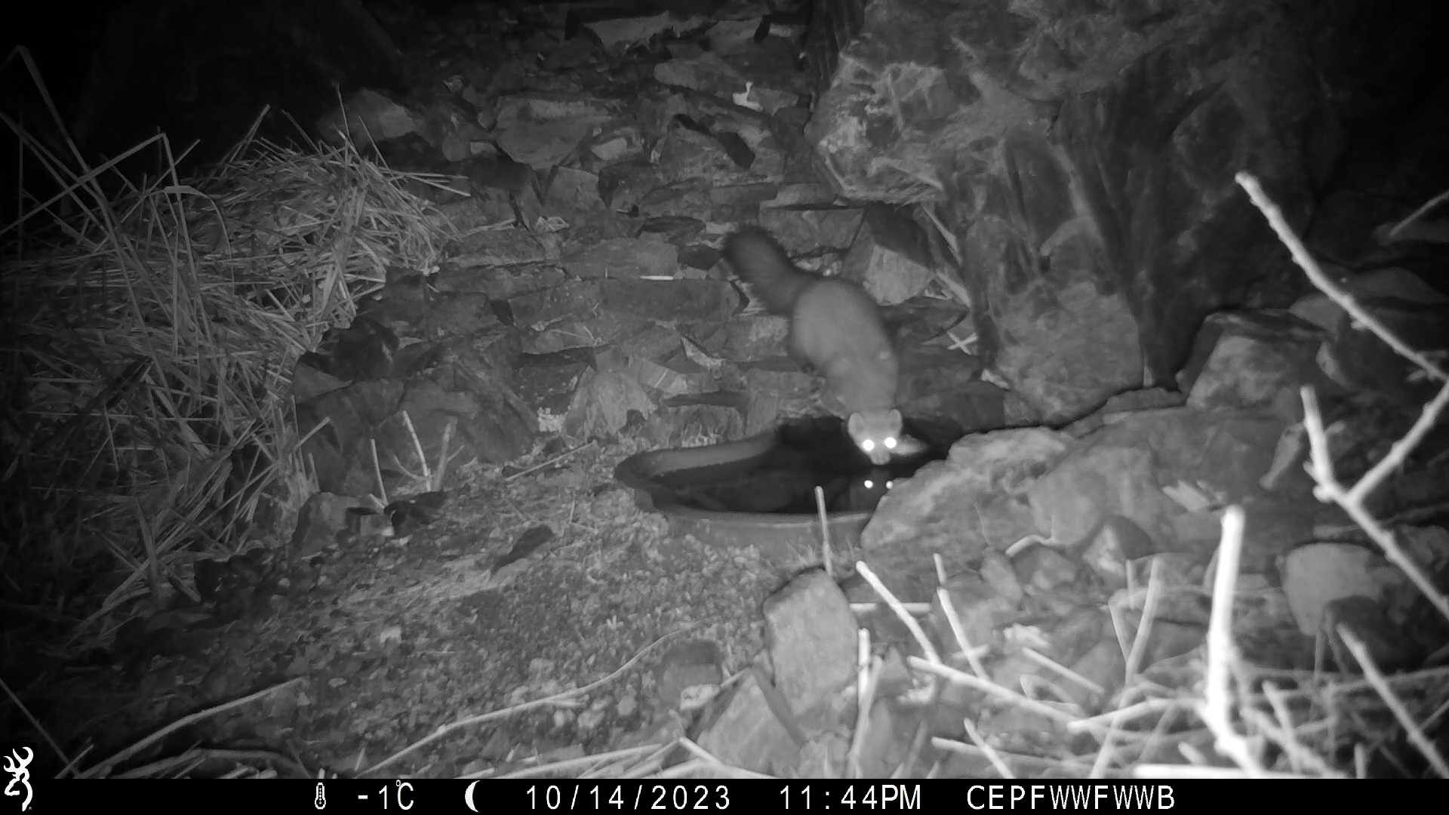
Mitigating climate change for wildlife

Slide 36
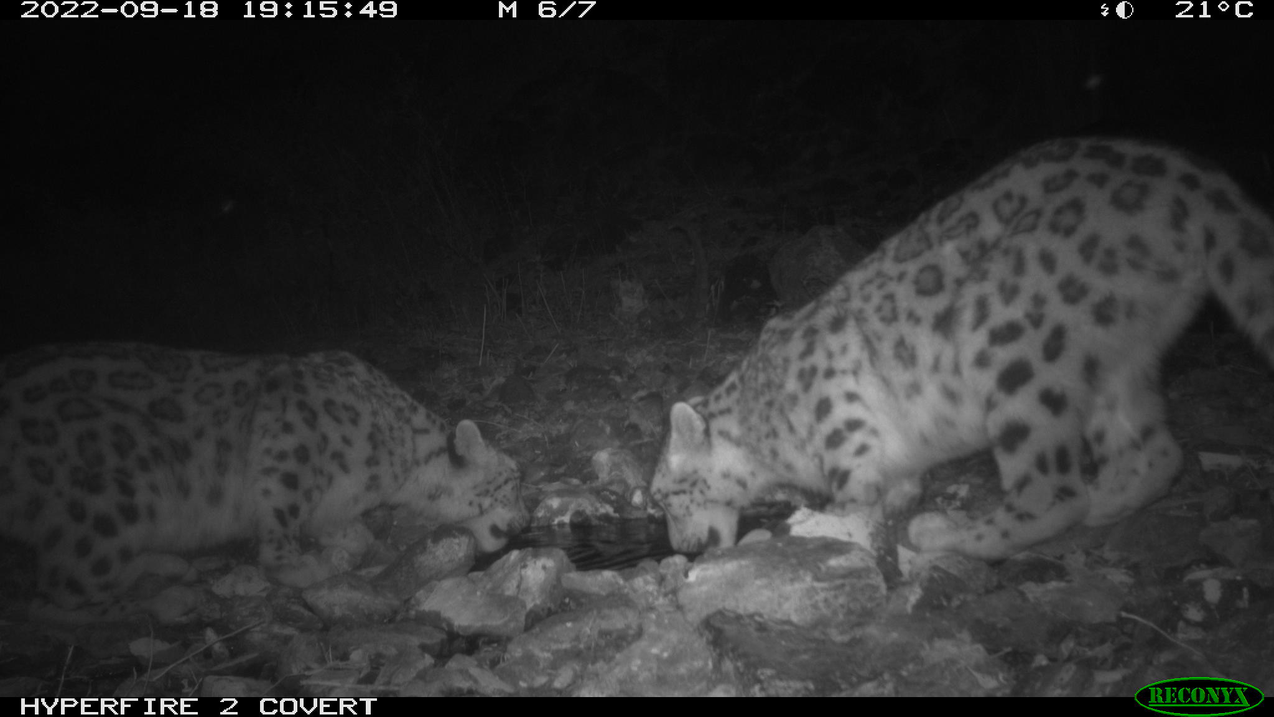
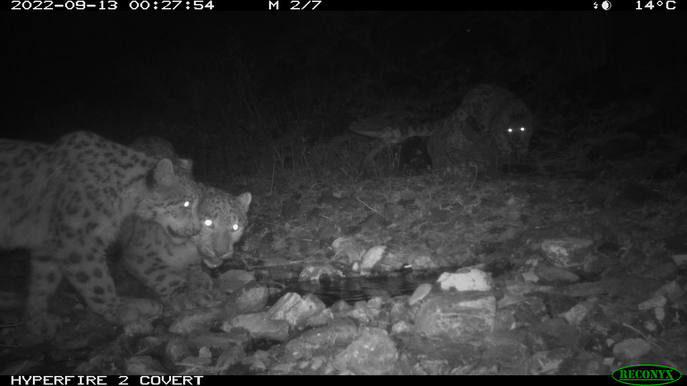
Mitigating climate change for wildlife

Slide 37
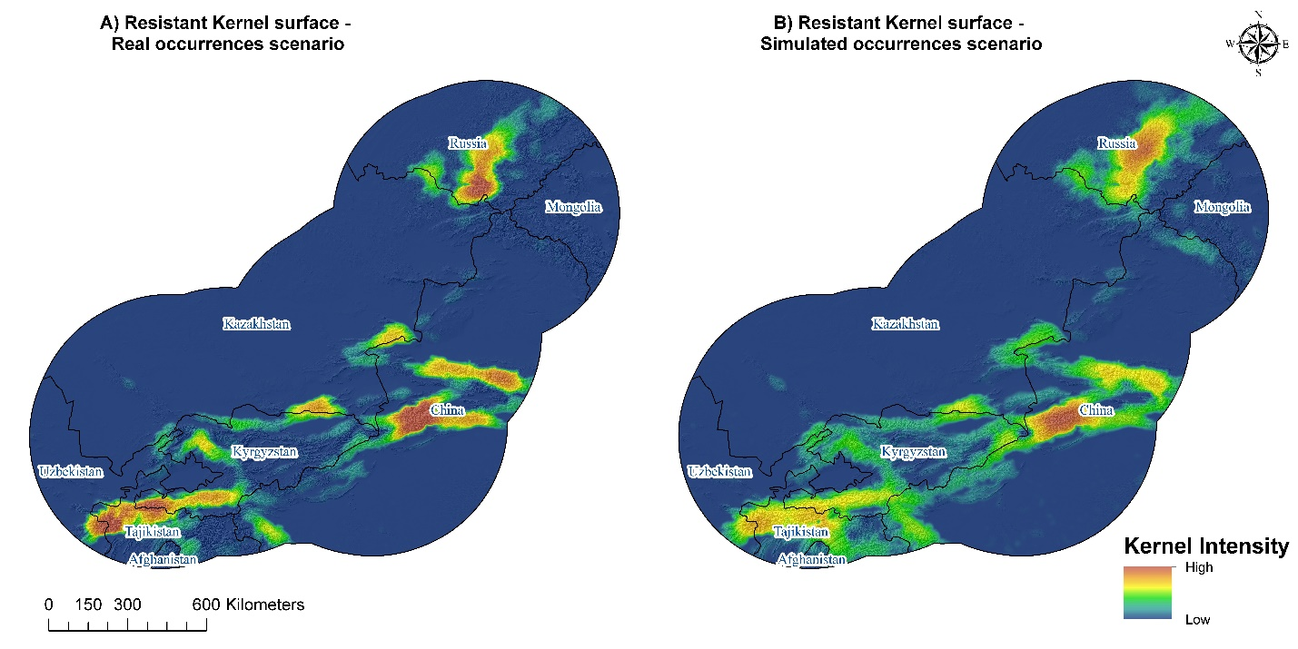
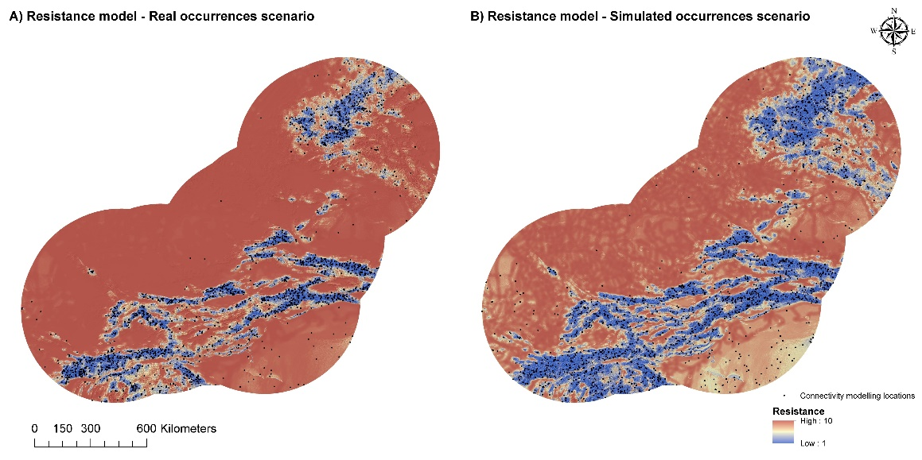
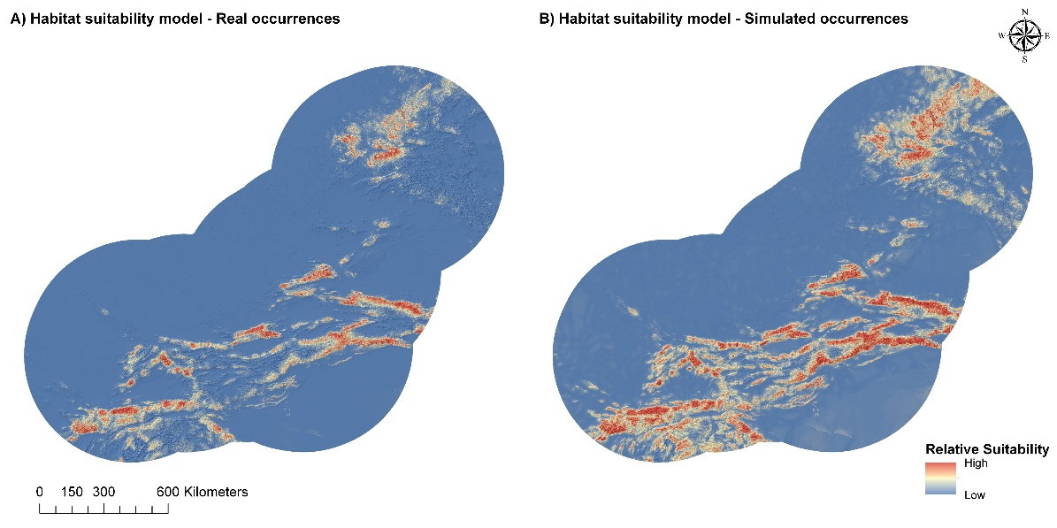
Conservation of snow leopard landscapes
Distribution modelling

Slide 38
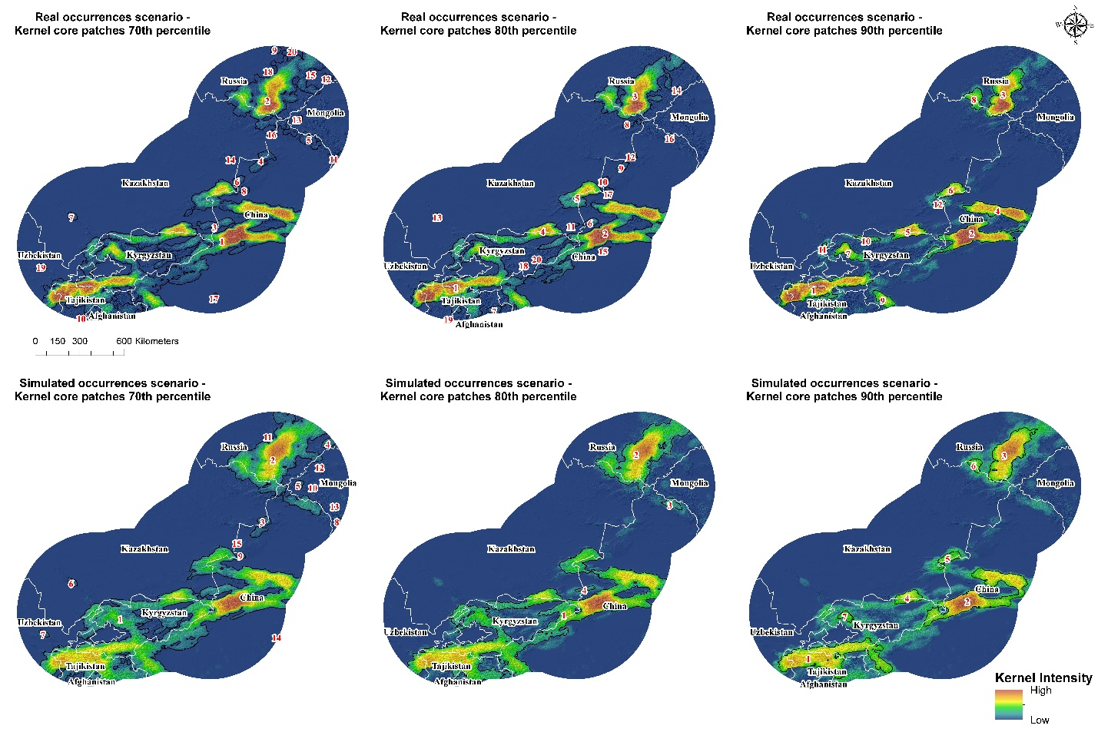
Conservation of snow leopard landscapes

Slide 39
THANK YOU
for your
attention

